Slide 1
America is Under Siege
From a Nazi Ecology

Slide 2
Harry Overstreet, Chair of Department of
Philosophy and Psychology at City College of New York Wrote in 1952:
Through clinical experience, we have come to recognize one invariable characteristic of that sick condition of the mind we call neurosis: namely, Rigidity…the rigidity is found in several areas.

Slide 3
In 1948, the National Association for Mental Health Declared:
Principles of mental health cannot be successfully furthered in any society unless there is progressive acceptance of the concept of world citizenship. World citizenship can be widely extended among all peoples through applications of the principles of mental health…At a major turning point in world history there is an obligation of social scientists and psychiatrists to attempt this new formulation.

Slide 4
In 1948, the National Association for Mental Health Declared:
In each of these we can predict that the individual will respond with trigger-quickness and in exactly the same way. Sometimes, it appears, such persons have constellation of prejudice areas. A man, for example, may be angrily against race equality, public housing, the TVA, financial and technical aid to backward countries, organized labor, and the preaching of social rather than salvational religion.

Slide 5
In 1948, the National Association for Mental Health Declared:
Try as we may, we can scarcely open up a subject that does not tap their permeative, automatic “againstness.” Such people may appear “normal” in the sense that they are able to hold a job and otherwise maintain their status as members of society, but they are, we now recognize, well along the road toward mental illness.

Slide 6
Holocaust Survivor
Viktor Frankl:
The gas chambers of Auschwitz were the ultimate consequence
of the theory that man is nothing but the product of heredity and environment—or as the Nazis like to say, ‘of blood and soil.’ I’m absolutely convinced that the gas chambers of Auschwitz, Treblinka, and Maidanek were ultimately prepared not in some ministry or other of Berlin, but rather at the desks and in the lecture halls of nihilistic scientists and philosophers.”

Slide 7
Dr. Mark Musser:
“There is a luxuriant oak tree standing just outside the gated entrance into Auschwitz Camp I where the sign reads “work makes you free.” In fact, there are many stately oaks inside the camp and just outside the entrance. There were also oak trees in the immediate proximity of a few of the gas chambers and crematoriums as well.

Slide 8
Dr. Mark Musser:
More ominous, the gas chamber doors at both Auschwitz and Treblinka were made of solid oak. At Auschwitz, the Nazis made double oak doors that sealed the sacrificial fate of all the victims when they were shut. The intimate proximity of such oak symbolism to concentration and death camps like Auschwitz and Treblinka is not likely to be merely coincidental. There was a certain method to the
Nazi madness…

Slide 9
Dr. Mark Musser:
No matter how industrial the gas chambers may have been so often characterized, the ancient symbolism of human sacrifice being practiced under the oak trees bleeds through the veneer of Nazi modernism.

Slide 10
Dr. Mark Musser:
“The weaknesses of the modern western world were presumed to have its crumbling foundations within the longstanding influences of the Judeo-Christian tradition with the Jews in particular being at the very core of the problem. The “green” sacrifice of the Jews would therefore be required to help the European world return back to Nature and her eugenic racial laws of evolutionary development that the Judeo-Christian
worldview interrupted.

Slide 11
Dr. Mark Musser:
In his youth while attending architectural school in Vienna in 1908, Adolf Hitler wrote up a play about religious sacrifices centering on the differences between Christianity and German paganism…Hitler was clearly very aware of the practices of religious sacrifice under the oak trees in ancient paganism.

Slide 12


Slide 13
David Brower, the First Executive Director of the
Radical Environmentalist Organization
The Sierra Club Declared:
Childbearing [should be] a punishable crime against society, unless the parents hold a government license…All potential parents [should be] required to use contraceptive chemicals, the government issuing antidotes to citizens chosen for childbearing

Slide 14
The Paul Ehrlich, His Wife and
John Holdren Wrote:
It has been concluded that compulsory population-control laws, even including laws requiring compulsory abortion, could be sustained under the existing constitution if the population crisis becomes sufficiently severe to endanger society…if some individuals contribute to general social deterioration by overproducing children, and if the need is compelling, they can be required by law to exercise reproductive responsibility.

Slide 15
Maurice Strong:
Isn’t the only hope for the planet that the industrialized civilizations collapse? Isn’t it our responsibility to bring that about?

Slide 16
Maurice Strong:
It is simply not feasible for sovereignty to be exercised unilaterally by individual nation-states, however powerful. It is a principle which will yield only slowly and reluctantly to the imperatives of global environmental cooperation.

Slide 17
Helen Caldicott
Union of Concerned Scientist:
Free enterprise really means rich people get richer. They have the freedom to exploit and psychologically rape their fellow human beings in the process. Capitalism is destroying the earth.

Slide 18
The Historical Roots of Our Ecologic Crisis
By Lynn White Jr.
Christianity, in absolute contrast to ancient paganism and Asia's religions (except, perhaps Zoroastrianism), not only established a dualism of man and nature but also insisted that it is God's will that man exploit nature for his proper ends.By destroying pagan animism, Christianity made it possible to exploit nature in a mood of indifference to the feelings of natural objects.

Slide 19
The Historical Roots of Our Ecologic Crisis
By Lynn White Jr.
But, as we now recognize, somewhat over a century ago science and technology hitherto quite separate activities-joined to give mankind powers which, to judge by many of the ecologic effects, are out of control. If so, Christianity bears a huge burden of guilt.

Slide 20
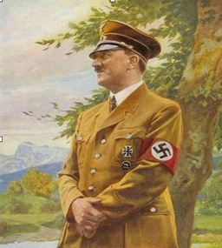
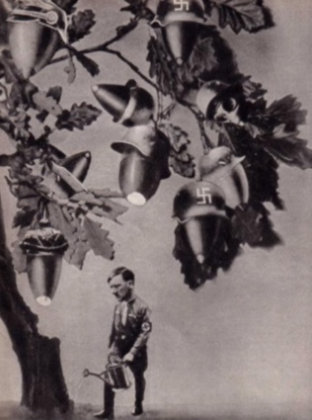
Sacrificial Nazi Oaks
In 1908, a play written by Guido Von List was most likely the inspiration of Hitler’s own play that he feverishly wrote & passionately described one night to his roommate depicting German shamans protecting the Bavarian Alps from Christian missionaries with sacrificial oak tree imagery lurking in the background.
The Aryans of Europe worshipped the oak as it was the symbol of fertility, sacrifice & power – values which the
Nazis glorified politically through Hitler’s secularized version of volkisch socialism as they promoted aryan fertility & power through sacrifice.

Slide 21
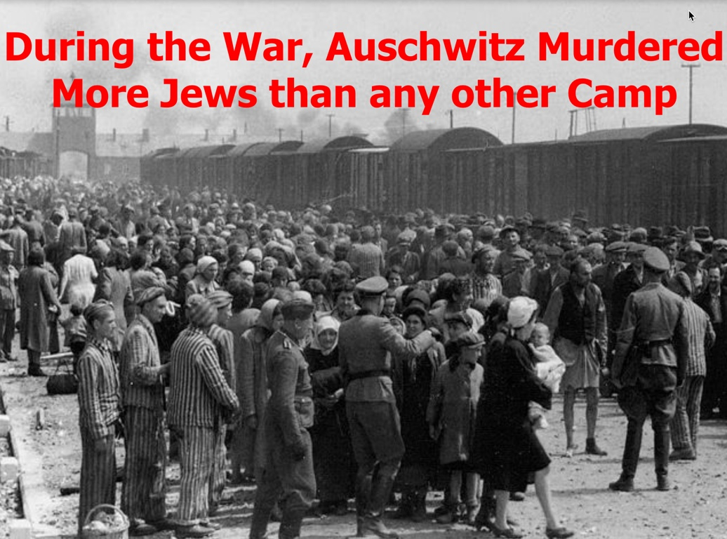

Slide 22
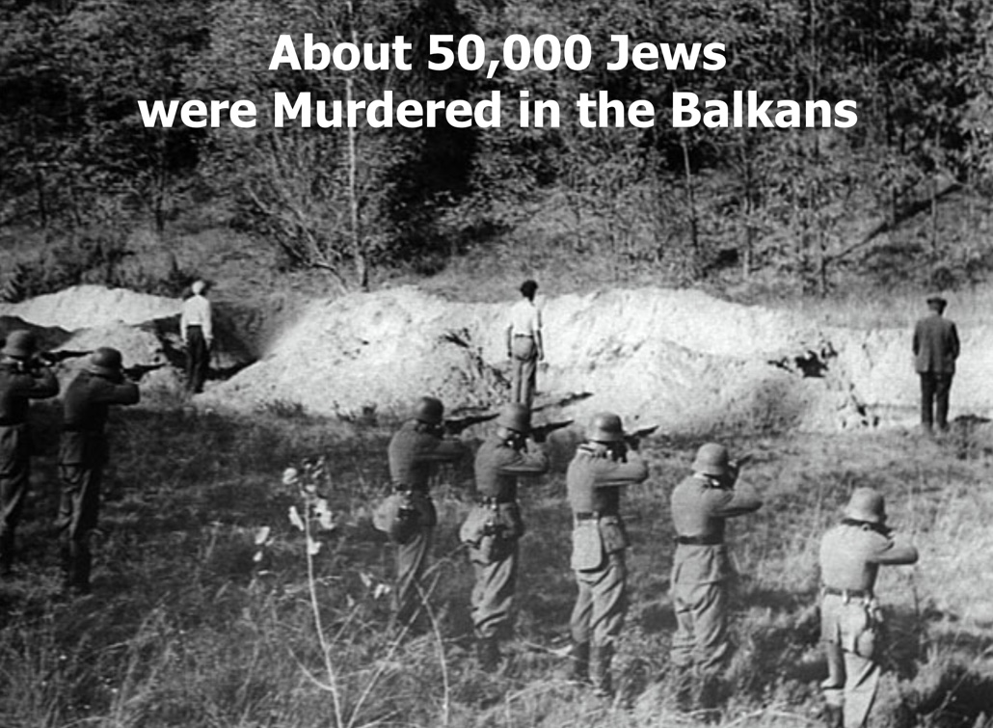

Slide 23
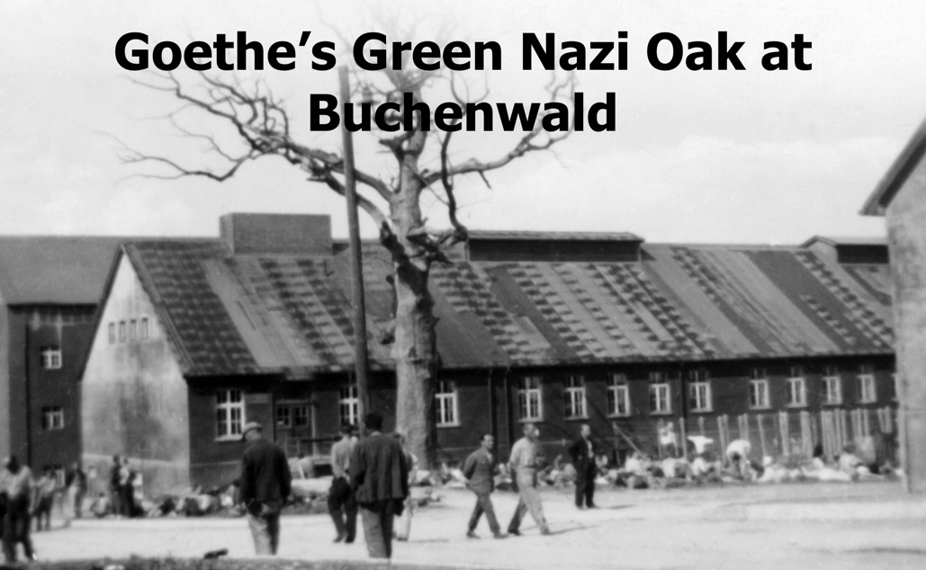

Slide 25
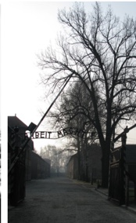

Slide 26
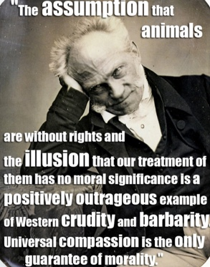
Arthur Schopenhauer was an
Anti-Semitic Animal Rights Guru 1788-1860

Slide 27
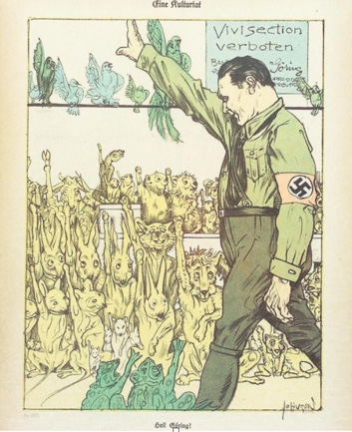

Slide 28
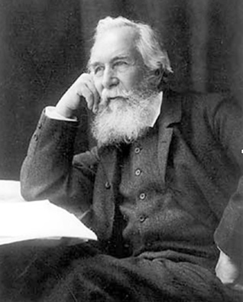
Ernst Haeckel
1834-1919
The Father of German Ecology
& Social Darwinism
Haeckel coined the term ‘ecology’ in 1866.
Haeckel was the first German scientist to describe the Jews as a biological problem.
He mutated Darwinian natural selection into racial eugenics.
He laid the groundwork for the ‘Blood & Soil’
Nazi doctrine where eugenics & environmentalism were mixed together.

Slide 29
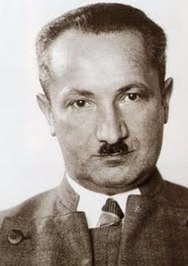
Martin Heidegger
He interpreted Nietzsche for national socialist environmentalism
He was involved in Nazi book burning ceremonies & the removal of Jewish professors.
After the war he became an environmentalist whose views often coincided with deep ecology. source: Dr. Mark Musser

Slide 30
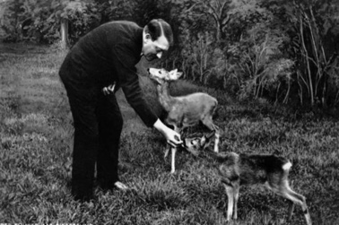
Green Nazi Animal Rights
In 1933, the Nazi passed the Tierschutzrecht where Hitler declared, “Cruelty to animals should no longer exist.”
In 1934, Hitler was awarded the Eichelberger
Humane Award by a Seattle based U.S. Animal
Rights Foundation.
Strict animal transport regulations were introduced for train travel to protect animals.
The Nazi animal rights law forbid Jewish ritual slaughter practices.

Slide 31
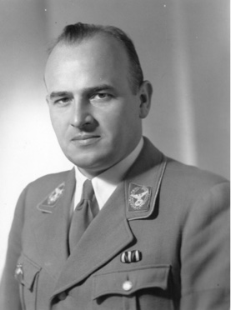
How Green was Governor General Hans Frank of
Poland where the Holocaust was Perpetrated?
In 1930, Dr. Hans Frank, Hitler’s attorney, presented an emotional tirade before an animal rights group in Munich denouncing Jewish ritual
Kosher slaughter.
After he finished his animal rights sermon, a resolution was adopted which stated, “The time will come for the salvation of animals from the perverse persecution of retarded subhumans.”

Slide 32

The Nazi Propaganda Documentary “The Eternal Jew” Reveals a Nature-Based Anti-Semitism
At one point in the film, the Jews are characterized as an Invasive species of rats who corrupt the economy/culture/society because they do not understand hardy/healthy work in the countryside – but only buy/sell on filthy city Streets in ghettos with themselves on top of the financial food chain.
The climax of the film stunningly reveals a strong green rationalization based on animal rights for the estruction of the Jews.
Hitler’s Infamous Reichstag Speech where He promises to send the Jews to Hell on Earth is then presented as the Veritable Conclusion of the Propaganda Film.

Slide 33
An inordinate amount of time is given over to the alleged cruelty of Jewish kosher slaughter after which the Fuhrer shows up for the first time in the film - who is then extolled for the passing of his animal rights saw.

Slide 34
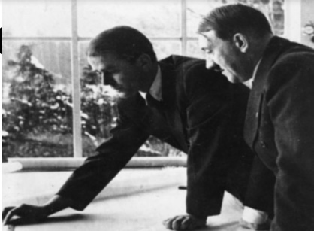
Green Nazi
Sustainable Development
Nazi Germany was not only the greenest regime on the planet in the 1930’s – but also emphasized green sustainable development plans in order to blend modern life into a more harmonious relationship with nature.
Even the economic four year war plan was to be governed by sustainable development.
The Nazis believed Aryan technology indigenous to Germany was good, but soulless technology of international capitalism was evil.
The Nazis emphasized saving/regulating energy together with recycling long before it became popular in the west.
During the war, the eastern occupied territories were to be governed by the
SS’s green sustainable development plans.
Hitler believed the future belonged to the wind, hydrogen & to the tides.

Slide 35
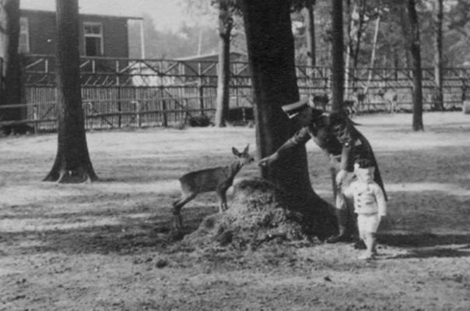
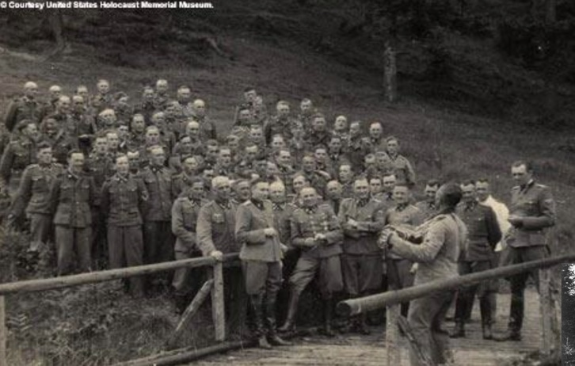
Nazi Environmental Plans on the Eastern Front
As the war shelved green plans in Germany itself, they were taken up again with a vengeance in the eastern occupied territories under Himmler’s SS.
Gottfried Feder’s garden cities & towns were to be built.
Master planned communities with environmental spacial planning would ameliorate the poor planning of the past & become a model for Germany’s future.
National parks & game reserves were planned.
Widespread environmental sustainable development plans were drawn up.
Hitler wanted to Cover Ukraine with Windmills.
The landscape would also be cleansed of excess population.

Slide 36
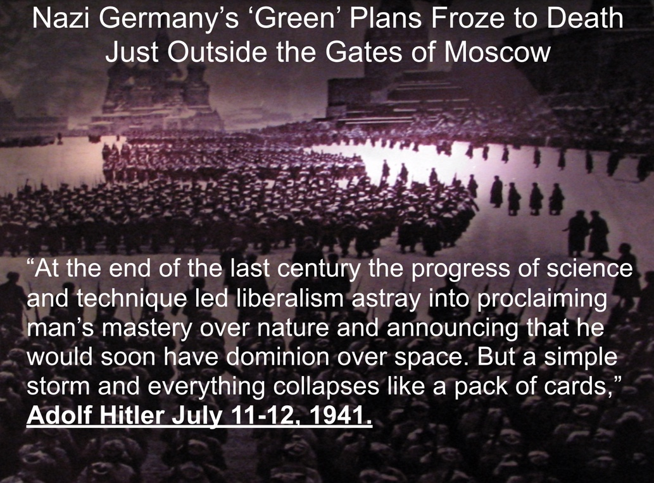

Slide 37
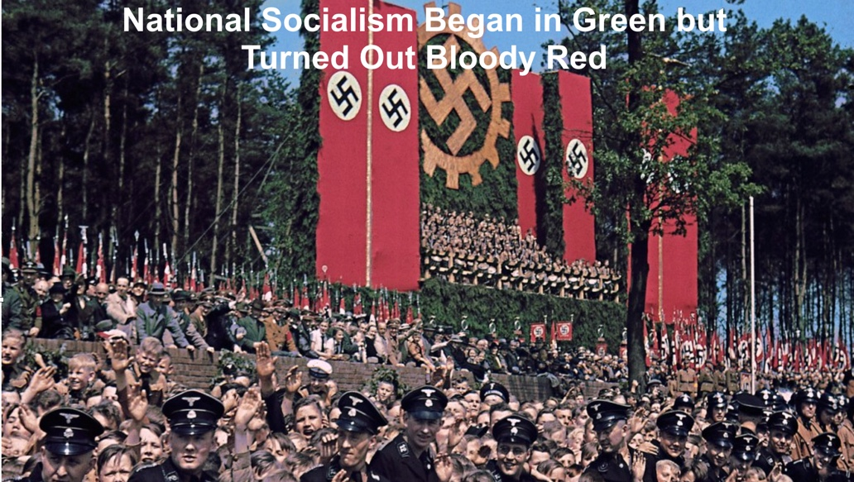

Slide 38
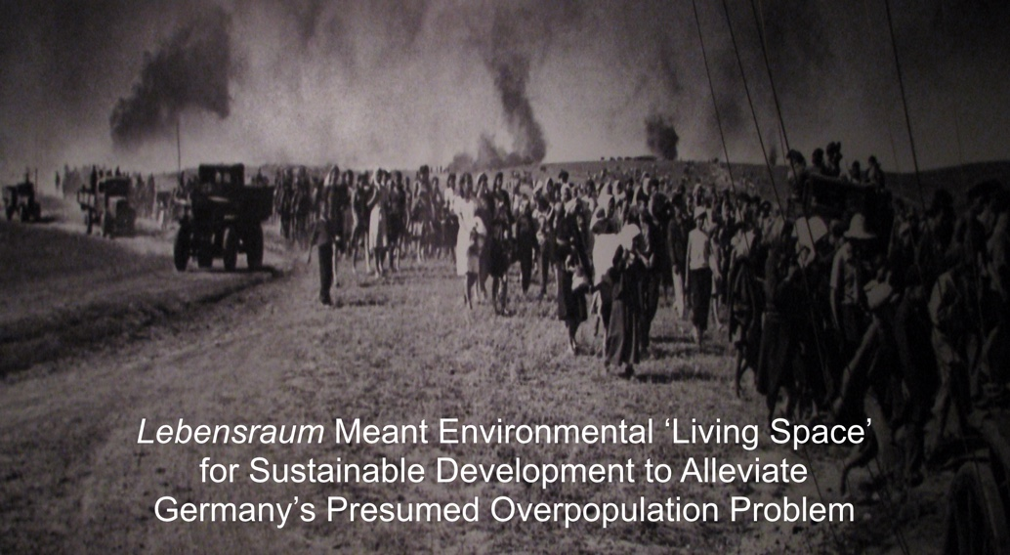

Slide 39
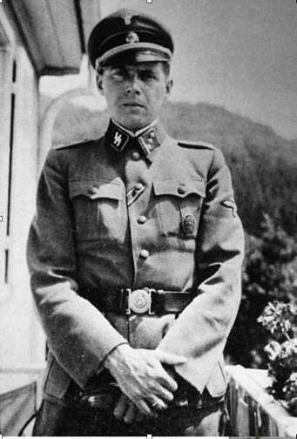
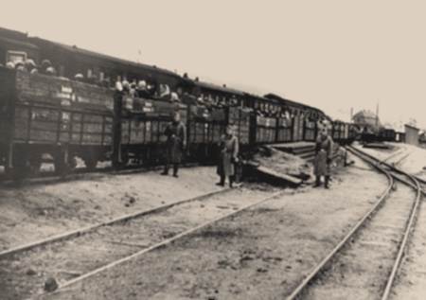
Nazi Eugenics Was Converted into a Form of
Environmental Social Justice/Revenge
Police battalions knew that stuffing Jews into cattle cars like sardines was a violation of
Nazi animal transport laws.
Pets were taken away from Jews before being put on the trains because they knew it would violate
Nazi animal transport laws.
Many Jews & political prisoners were treated like
experimental animals.
Dr. Mengele was a greener & he called the barracks that housed his favorite guinea pigs – twins – “the zoo.”
At Treblinka, while Jews were being gassed & burnt on a huge scale, the SS was apparently involved in trying to bring back foxes.

Slide 40
The Merging of Eugenics
& Environmentalism is Still with us Today
The Atlantic came out with an article in March of 2012 entitled, “How Engineering the Human
Body Could Combat Climate Change.”
They want to genetically engineer the human body to become vegetarian.
They want to give the human being cat-like eyes so we can see better in the dark.

Slide 41
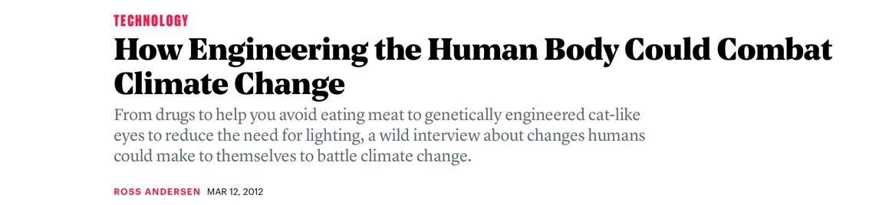
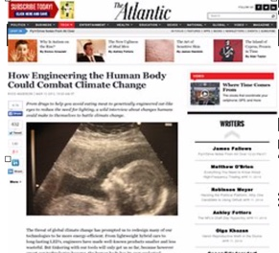
The Merging of Eugenics
& Environmentalism is Still with us Today
They want to have fixed greenhouse gas
limits for each family.
They want to engineer people in such a way so they become smaller & thus not eat as much.
They want to induce people to have more altruism & empathy toward nature.
Some technocratic elites & transhumanists are looking for ways to resolve the environmental crisis in order to save the planet.

Slide 42


Slide 43
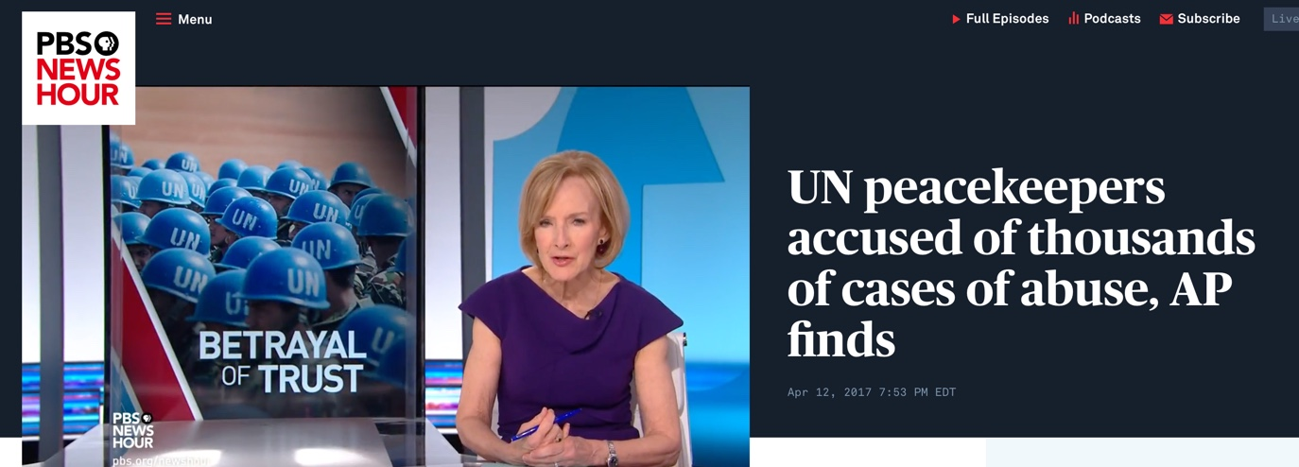

Slide 44


Slide 45
Sustainable Development
Includes:
Abortion on demand
Population control
Gun control
Social justice
Global governance
The New World Order

Slide 46
Sustainable Development
Includes:
Socialized medicine
Social welfare programs
Elimination of property rights
Elimination of national sovereignty
Elimination of parental authority
Elimination of free-market capitalism
Education to serve the masses

Slide 47
Sustainable Development
Includes:
Public housing
Redistribution of wealth
Legal positivism and judicial activism
Hate-crime laws that criminalize Christianity

Slide 48
Former Secretary of State John Foster Dulles in His Autobiography War or Peace Declared:
I have never seen any proposal made for collective security with ‘teeth’ in it, or for ‘world government’ or for ‘world federation,’ which could not be carried out either by the United Nations or under the
United Nations Charter.

Slide 49
The United Nations Allied
Commission on Global Governance Declared:
The environment, perhaps more than any other issue, has helped to crystallize the notion that humanity has a common future. The concept of sustainable development is now widely used and accepted as a framework within which all countries, rich and poor, should operate. The aspect that particularly concerns us is the global governance implications.

Slide 50
David Rockefeller in His
2002 Autobiography Memoirs:
"Some even believe we [the Rockefellers] are part of a secret cabal working against the best interests of the United States, characterizing my family and me as internationalists and of conspiring with others around the world to build a more integrated global political and economic structure — one world, if you will,” Rockefeller explains on page 405. “If that’s the charge, I stand guilty, and I am proud of it.”

Slide 51
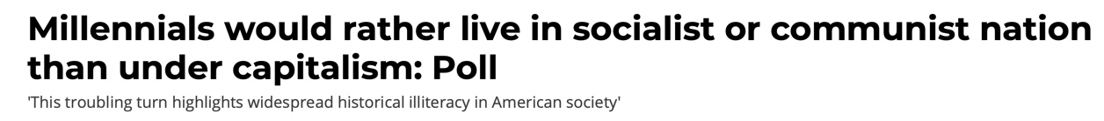

Slide 52
Arthur Schopenhauer
Anti-Semitic Animal Rights Extremist:
We owe the animals not mercy but justice, and the debt often remains unpaid in Europe, the continent that is permeated with [Jews]…It is obviously high time in Europe that Jewish views on nature should be expelled from Europe.

Slide 53
Arthur Schopenhauer
Anti-Semitic Animal Rights Extremist:
The fault lies with the Jewish view that regards the animal as something manufactured for man’s use.

Slide 54
Green Nazi
Hans Stadler Complained:
The Jewish merchants specializing in the timber trade—had bought and processed the last of the strong oaks and the last of the beautiful walnut trees in the region & were now seeking to exterminate the pear trees.

Slide 55
Arthur Schopenhauer
Anti-Semitic Animal Rights Extremist:
These are the effects of Genesis 1 and generally of the whole Jewish way of looking at nature.

Slide 56


