Slide 1
Black Reds:
The History of How International Communists & Their Trained Black Agents Targeted, Penetrated, Controlled & Oppressed Black Americans For Their Agenda & Political Propaganda

Slide 2
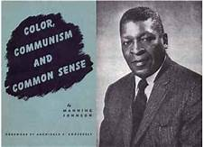

Slide 3
Who Was Manning Johnson?

Slide 4
Brainwashing Was Key To How the Communists Targeted, Penetrated, Controlled & Oppressed Black Americans For Their Agenda and Political Propaganda

Slide 5
Co-Opting & Controlling The Black Reds

Slide 6
Moscow’s Goal of Racial & Guerrilla Warfare in The United States of America

Slide 7
Black Reds and Marxianity

Slide 8
Black Reds Seek Black Entrepreneurial Defeat to Maintain Political Narrative

Slide 9
Black Reds Use The Media to Push Their Propaganda

Slide 10
Black Reds and Their Propaganda of Victimization

Slide 11
The Black Reds & Their Communist Handlers Are Working to Divided & Conquer America

Slide 13
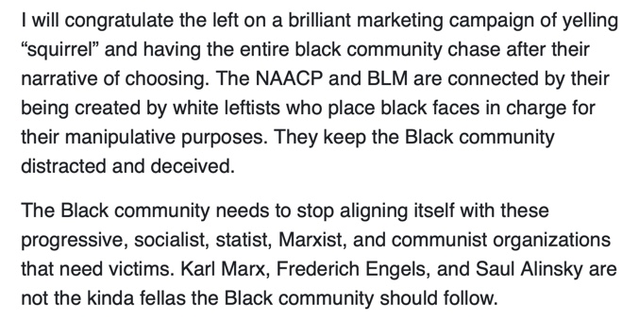

Slide 14
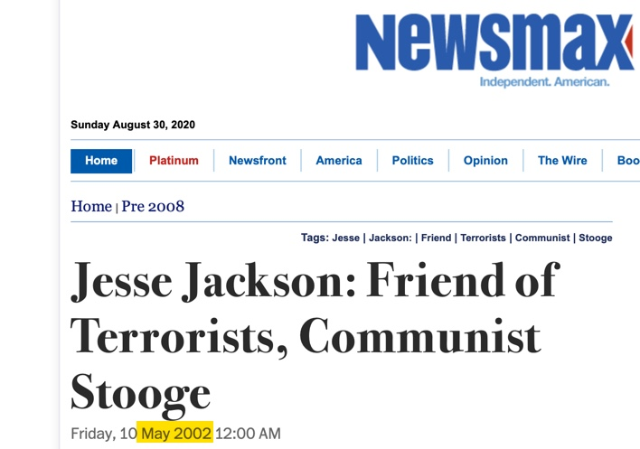

Slide 15
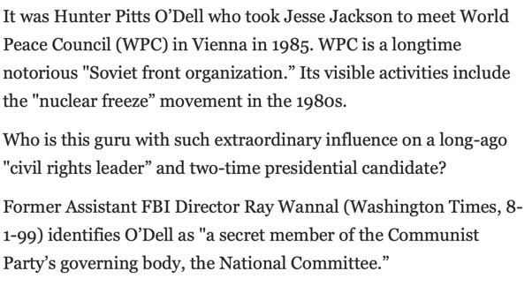

Slide 17
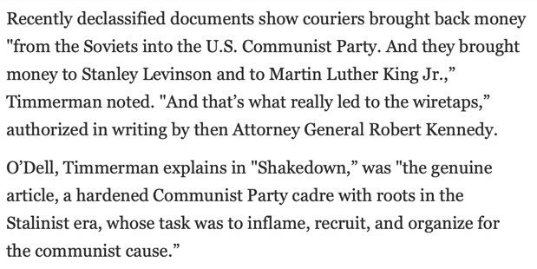

Slide 21
Who Was Manning Johnson?

Slide 22
Manning Johnson
December 17, 1908 – July 2, 1959
Former Communist Party USA High Ranking Official In 1966, W. Cleon Skousen called Johnson "the most important Negro Communist in the United States.

Slide 23
Manning Johnson
Became a vocal critic of Communism in speeches, a book & Congressional testimony.

Slide 24
Antifa planned anti-government insurgency for months, law enforcement official says
By Bill Gertz
June 3, 2020
CPUSA leader Manning Johnson testified to Congress in 1953 that the goal of the front group was never the abolishment of fascism, but rather “the subversion and subsequent overthrow of the United States.”

Slide 27
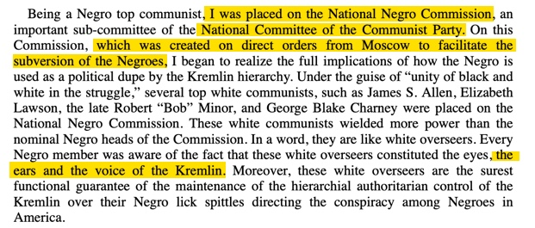

Slide 29
Brainwashing Was Key To How the Communists Targeted, Penetrated, Controlled & Oppressed Black Americans For Their Agenda and Political Propaganda

Slide 31
Co-Opting & Controlling The Black Reds

Slide 33
Moscow’s Goal of Racial & Guerrilla Warfare in The United States of America

Slide 38
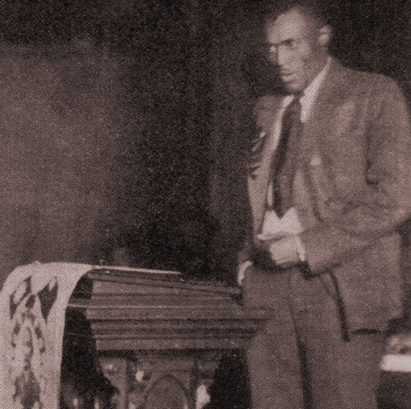
Lovett Huey Fort-Whiteman speaking at the American Negro Labor Congress in 1925. TIME Magazine in 1925 Called Him “The Reddest of the Blacks”

Slide 40
Source: https://www.cpusa.org/party_info/remembering-james-w-ford/

Slide 41
Source: https://www.cpusa.org/party_info/remembering-james-w-ford/

Slide 42
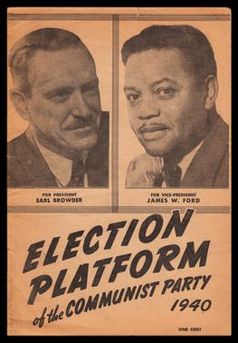
James W. Ford ran for vice president on the Communist Party ticket in 1932, ’36 and ’40,

Slide 46
Part Two

Slide 47
Black Reds:
The History of How International Communists & Their Trained Black Agents Targeted, Penetrated, Controlled & Oppressed Black Americans For Their Agenda & Political Propaganda

Slide 48
Brainwashing Was Key To How the Communists Targeted, Penetrated, Controlled & Oppressed Black Americans For Their Agenda and Political Propaganda

Slide 49
Co-Opting & Controlling The Black Reds

Slide 50
Moscow’s Goal of Racial & Guerrilla Warfare in The United States of America

Slide 51
Black Reds and Marxianity

Slide 52
Black Reds Seek Black Entrepreneurial Defeat to Maintain Political Narrative

Slide 53
Black Reds Use The Media to Push Their Propaganda

Slide 54
Black Reds and Their Propaganda of Victimization

Slide 55
The Black Reds & Their Communist Handlers Are Working to Divided & Conquer America

Slide 56
Black Reds and Marxianity

Slide 57
Part Two

Slide 58
Moscow’s Goal of Racial & Guerrilla Warfare in The United States of America

Slide 59
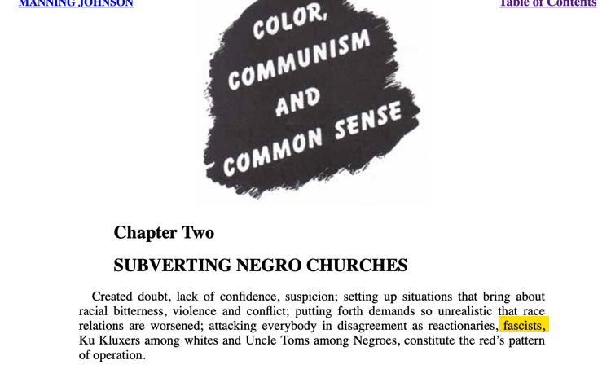

Slide 70
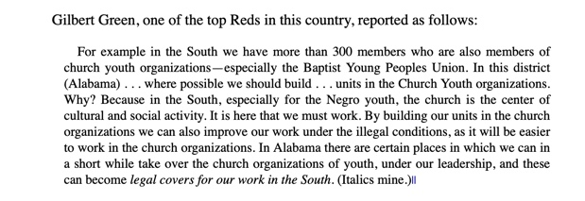

Slide 71
Black Reds Seek Black Entrepreneurial Defeat to Maintain Political Narrative

Slide 72
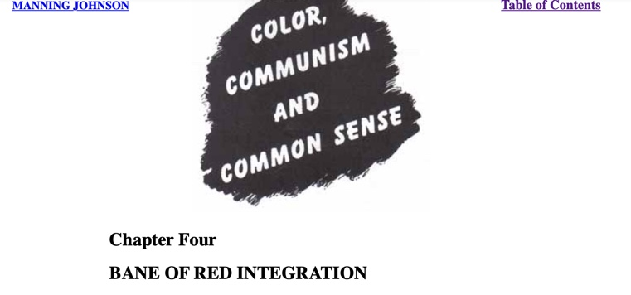

Slide 74
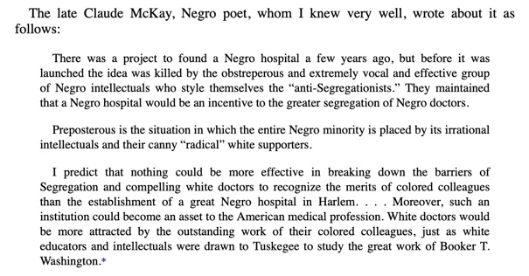

Slide 78
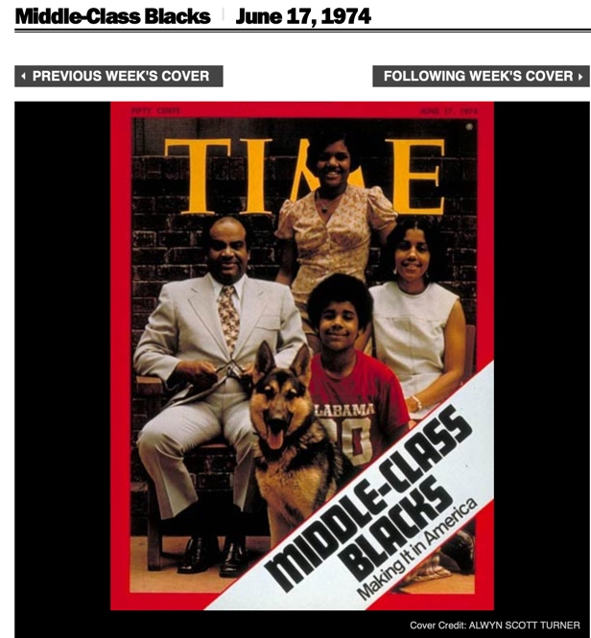

Slide 79
Black Reds Use The Media to Push Their Propaganda

Slide 81
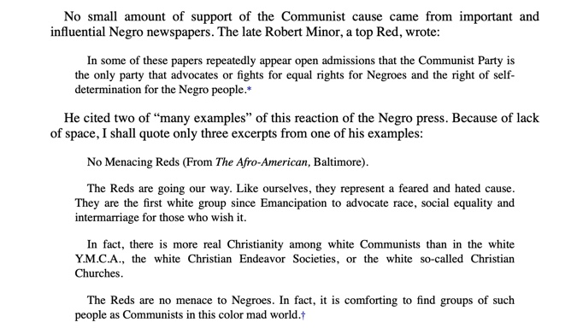

Slide 82
Black Reds and Their Propaganda of Victimization

Slide 87
The Black Reds & Their Communist Handlers Are Working to Divided & Conquer America

Slide 89
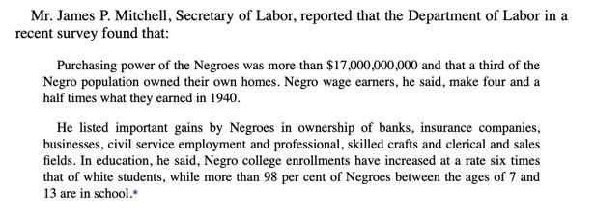

Slide 93
From Chapter Seven

Slide 94
Washington Post November 19, 2018

Slide 95
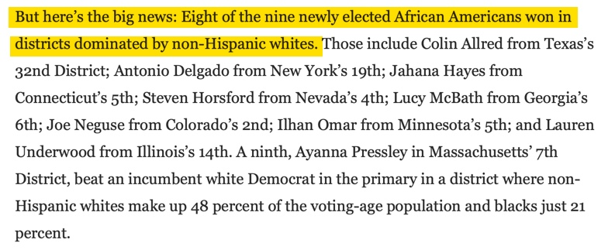
Washington Post November 19, 2018

Slide 96
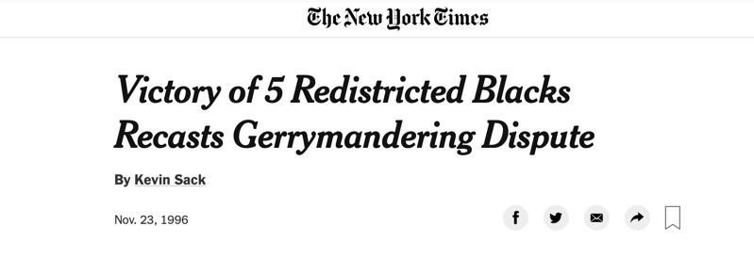

Slide 98
Washington Post, November 15, 1996

Slide 99
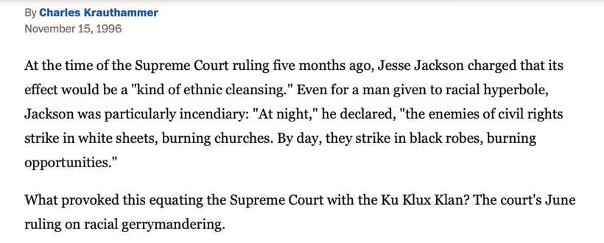
Washington Post, November 15, 1996

Slide 100
Washington Post, November 15, 1996

Slide 101
Washington Post, November 15, 1996

