Slide 1
Brainwashed America:
The Systematic Process & Historically Documented
Facts of How the Vast Majority of Americans Have
Been Brainwashed to Embrace
& Assist in the Cultural Marxist Revolution that is
Almost Complete Within the United States of America

Slide 2
Merriam-Webster Dictionary
Definition of Brainwashing
-A forcible indoctrination to induce someone to give up
basic political, social, or religious beliefs and attitudes
and to accept contrasting regimented ideas;
-persuasion by propaganda or salesmanship

Slide 3
Psychological Dictionary:
A method that manipulates and modifies a person’s emotions, attitudes, and beliefs. It utilizes intensely-persuasive, even coercive tactics in order to enforce these changes.

Slide 4

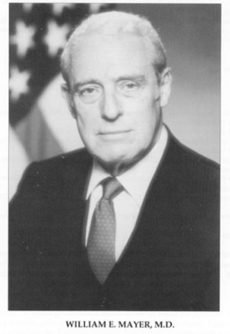
Major William E. Mayer (U.S. Army)
Brainwashing: The Ultimate Weapon, October 4, 1956

Slide 5
The term ‘brainwashing’ has been largely connected to the 1949 communist revolution in China.

Slide 6

Brainwashing by Edward Hunter
Published in 1956

Slide 7
Edward Hunter:
Served for 2 years as a “propaganda specialist” for the Office of Strategic Services during World War II

Slide 8
The new word ‘hraimuashing’ entered our minds and dictionaries in a phenomenally short time. This sinister political expression had never been seen in print anywhere until a few years ago…The word came out of the sufferings of the Chinese people. Put under a terrifying combination of subtle and crude metal and physical pressures and tortures, they detected

Slide 9
a pattern and called it brainwashing. The Reds wanted people to believe that it could be amply
described by some familiar expression
such as education, public relations, persuasion
or by some misleading term like mind reform and
re-education. None of these could define it because it was much, much more than any one of them alone.

Slide 10
The Chinese knew they hadn’t just been educated or persuaded; something much more dire than that had been perpetrated on them, similar in many peculiar ways to a medical treatment. What they had undergone was more like witchcraft, with its incantations, trances, poisons, and potions with a strange flair of science
about it all, like a devil dancer in a tuxedo,
carrying his magic brew in a test tube.

Slide 11
The communist hierarchy preferred people to believe that there was no such thing as brainwashing.
So long as they could keep it concealed,
without a name, opposition to it
could be kept scattered and ineffective.

Slide 12
The German-born Sinologue, Max Perleberg, who is fluent in both modern and classical Chinese, told me that the term might well have been derived from the
Buddhist expression “heart-washing,” which goes to the time of Mencius, [Men-Shee-as] a middle-aged man — perhaps weary of worldly care — living in a
bare pavilion in some placid corner of his garden, leaving his offspring to attend to his business.

Slide 13
The Bible mentions the heart 826 times.
“Heart” refers to the core of a person’s being.
In the Bible, the words “heart” and “mind”
are often interchangeable.

Slide 14
Proverbs 4:23 declares that out of the heart
“springs the issues of life.”
From the heart proceeds our good and bad thoughts, emotions, and behavior.

Slide 15
Genesis 3:1-5:
Now the serpent was more crafty than any
beast of the field which the Lord God had made.
And he said to the woman, “Indeed, has God said,
‘You shall not eat from any tree in the garden?”

Slide 16
The woman said to the serpent, “From the fruit of the
tree which is in the middle of the garden,
God has said, ‘You shall not eat from it or touch it,
or you will die.’” The serpent said to the woman,
“You surely will not die. For God knows that in the day you eat from it your eyes will be opened,
and you will be like God, knowing good from evil.”

Slide 17
Statement of Ed Hunter on March 13, 1958
U.S. Congressional Committee on Un-American Activities
“No man has ever been brainwashed whose mind has not first been put into a fog…The patient first has to be deprived of his bearings, to be shaken loose from whatever belief and convictions he formally held until he loses faith in them entirely.”

Slide 18
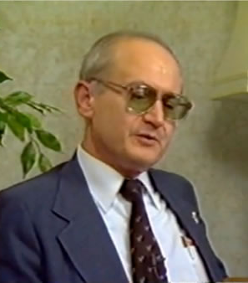
Yuri Bezmenov

Slide 19
G. Edward Griffin Interview with Yuri in 1984:
“The KGB was even curious about this gentleman..Maharishi Mahesh Yogi, a great spiritual leader, or maybe a great charlatan and crook,
depending on from which side you are looking at him.

Slide 20
[The] Beatles were trained at his ashram in Haridwar
in India [in] how to meditate; Mia Farrow and other useful idiots from Hollywood visited his school
and they returned back to [the] United States
absolutely zonked out of their minds with marijuana, hashish, and crazy ideas of meditation.

Slide 21
To meditate, in other words, to isolate oneself from the current social and political issues of your own country,
to get into your own bubble, to forget about [the] troubles of the world—obviously [the] KGB was very fascinated with such a beautiful school, such a brainwashing center for stupid Americans. I was dispatched by the KGB to check [into] what kind of VIP Americans attend this school.

Slide 22
You see, a person who is too much involved
in introspective meditation, you see, if you
carefully look [at] what Maharishi Mahesh Yogi
is teaching to Americans, [it] is that most of the problems, most of the burning issues of today, can be solved
simply by meditating. Don’t rock the boat, don’t get involved. Just sit down, look at your navel, and meditate. And the things, due to some strange logic,
due to cosmic vibration, will settle down by themselves.

Slide 23
This is exactly what the KGB and Marxist-Leninist propaganda want from Americans. To distract their opinion, attention, and mental energy from [the] real issues of [the] United States, into [non-issues], into a non-world,
non-existent harmony. Obviously it’s more beneficial
for the Soviet aggressors to have a bunch of duped Americans than Americans who are self-conscious, healthy, physically fit, and alert to the reality.

Slide 24
Maharishi Mahesh Yogi obviously is not on the payroll
of the KGB, but whether he knows it or not,
he contributes greatly to [the] demoralization
of American society. And he is not the only one.
There are hundreds of those gurus who come
to your country to capitalize on [the] naïveté
and stupidity of Americans. It’s a fashion.
It’s a fashion to meditate; it’s a fashion not to be involved.

Slide 25
So obviously you can see that if [the] KGB were that curious, if they paid [for] my trip to Haridwar, if they assigned me to that strange job, obviously they were very much fascinated. They were convinced that that type of brainwashing is very efficient and instrumental
in [the] demoralization of [the] United States.”

Slide 26
Dr. Timothy Leary recalls, in a piece titled “Flashback,” a conversation he had
with Aldous Huxley. Huxley said:
These brain drugs, mass produced in the laboratories, will bring about vast changes in society. This will happen with or without you or me. All we can do is spread the word. The obstacle to this evolution, Timothy, is the Bible.

Slide 27
to which Leary responded:
“We had run up against the Judeo-Christian commitment to one God, one religion, one reality, that has cursed Europe for centuries and America since our founding days. Drugs that open the mind to multiple realities inevitably lead to a polytheistic view of the universe.
We sense that the time for a new humanist religion
based on intelligence, good-natured pluralism
and scientific paganism has arrived.”

Slide 28
In Her New Age Book, Aquarian Conspiracy,
author Marilyn Ferguson affirmed another New Age writer when she quoted them as declaring:
“LSD gave a whole generation a religious experience.”

Slide 29
Systematic Steps of Brainwashing

Slide 30
1. Remove or discredit leaders that are principled,
courageous, and people of convictions and morality.

Slide 31
2. Entice the brainwashing subjects into questioning
and doubting their foundational worldview, values,
& convictions.

Slide 32
3. Teach moral relativism and situational ethics in order to destroy morality and character.

Slide 33
4. Teach the importance of group consensus and
collectivism, and the danger & consequences
of individuality.

Slide 34
5. Set up a system of rewards, honor, recognition,
& advancement for those who embrace the
worldview & values of the brainwashing program.

Slide 35
    6. Apply punitive consequences on any worldview
    & values that are contrary to the chosen
    worldview & values being inculcated into the
    brainwashing subjects.

Slide 36
7. Teach a revisionist history that portrays America’s
capitalist free market system as the source of all
suffering & oppression.

Slide 37
8. Use informants, gossips, & tattletales to report
on noncompliance of individuals and groups.

Slide 38
9. Use individuals in trusted institutions & occupations
to give credibility to the worldview & values being
inculcated into the brainwashing subjects.

Slide 39
10. Create an atmosphere & environment of chaos,
suffering, hopelessness, & danger,
and then rescue the subjects from this condition
so that the persecutor is perceived as being
a friend and protector.

Slide 40
Brainwashed America: Part 2

Slide 41
Merriam-Webster Dictionary
Definition of Brainwashing
-A forcible indoctrination to induce someone to give up
basic political, social, or religious beliefs and attitudes
and to accept contrasting regimented ideas;
-persuasion by propaganda or salesmanship

Slide 42
Psychological Dictionary:
A method that manipulates and modifies a person’s emotions, attitudes, and beliefs. It utilizes intensely-persuasive, even coercive tactics in order to enforce these changes.

Slide 43


Slide 44
Through the Eyes of the Enemy by Stanislav Lunev
Highest-ranking Officer to Defect From the U.S.S.R. to the U.S
What will be a great surprise to the American people is that the GRU and KGB had a larger budget for antiwar propaganda in the United States than it did for economic and military support for the Vietnamese. The antiwar propaganda cost the GRU more

Slide 45
than $1 billion, but as history shows, it was a hugely successful campaign and well worth the cost. The antiwar sentiment created an incredible momentum that greatly weakened the U.S. military.

Slide 46
John Stormer in his book, None Dare Call it Treason documents that in 1954, Senator William Jenner (D-IN) told the story of a factory in Nazi Germany
that made baby carriage parts which,
when assembled, became a machine gun.

Slide 47
Someone, somewhere, conceived the brilliant strategy of revolution by assembly line. The pattern for total revolution was divided into separate parts, each of them as innocent, safe, and familiar looking as possible. But…when the parts of a design are carefully cut to exact size, to fit other parts with a perfect fit in the final assembly, the parts must be made according to a blueprint drawn up in exact detail.

Slide 48
The men who make the blueprints know exactly
what the final product is to be…this assembly line revolution is like a time bomb…It is ready to go off,
but it is not going to be set off until the time is ripe,
until a switch is pulled. The switch is not be be pulled until the American people are conditioned,
or convinced that resistance is hopeless.

Slide 49
The Parts of a National Killing Machine
When Assembled

Slide 50
1. Naturalistic Evolution

Slide 51
2. Cultural Marxism

Slide 52
3. Deconstructionism

Slide 53
4. Legal Positivism

Slide 54
5. Feminism

Slide 55
6. Sexual Liberation

Slide 56
7. Abortion

Slide 57
8. National Healthcare

Slide 58
9. Socialism

Slide 59
10. Weaponize Psychology

Slide 60
11. Euthanasia

Slide 61
12. Capitalism & Patriotism equals
Oppression & Racism

Slide 62
13. One-World Spirituality

Slide 63
14. Globalism

Slide 64
Three Powerful Institutions
For Brainwashing:
Education
Media
Religion

Slide 65
Colossians 2:8:
Beware lest anyone cheat you through philosophy and empty deceit. According to the tradition of men, according to the basic principles of the world, and not according to Christ.

Slide 66
2 Corinthians 10:4-5:
For the weapons of our warfare are not carnal but mighty in God for pulling down strongholds, casting down arguments and every high thing that exalts itself against the knowledge of God, bringing every thought into captivity to the obedience of Christ.

Slide 67
1. Remove or discredit leaders that are principled,
courageous, and people of convictions and morality.

Slide 68
Major William E. Mayer (U.S. Army)
Brainwashing: The Ultimate Weapon, October 4, 1956

Slide 69
William E. Mayer:
November 27, 1956 Speech:
Now the weapon they used was deceptively simple. Before they could put it into effect, they had to segregate leaders — which they did very simply by putting them into what was reactionary camps. They put into reactionary camps, reactionaries. People who tried to be leaders. People who showed what the Communists called “poisonous individuals.”

Slide 70
If you had the temerity to try to organize anything, off you went to the reactionary camp. You were obviously hopeless. Other reactionaries were people with a higher education, who were considered automatically pretty reactionary unless they volunteered to cooperate & some did.

Slide 71
Other reactionaries were overtly religious people. The Communists also felt that they couldn’t do much with them. They segregated all these people in reactionary camps, and you know what percentage of the total group this was? Five. When they had taken five percent of the people away there were no leaders left.

Slide 72

April 7, 2009 Report by DHS Under The Obama Administration

Slide 73

April 7, 2009 Report by DHS Under The Obama Administration

Slide 74

April 7, 2009 Report by DHS Under The Obama Administration

Slide 75

April 7, 2009 Report by DHS Under The Obama Administration

Slide 76

foxnews.com January 9, 2019

Slide 77
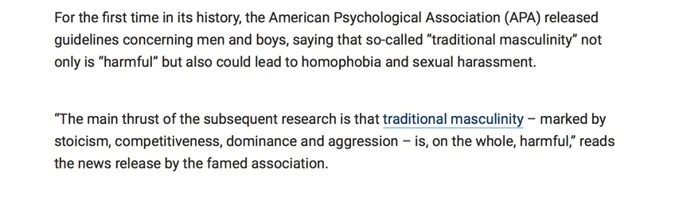
foxnews.com January 9, 2019

Slide 78
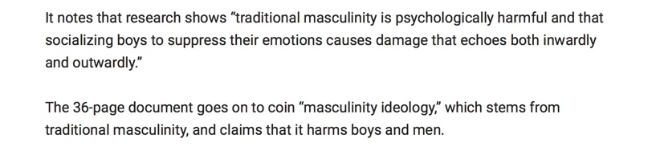
foxnews.com January 9, 2019

Slide 79
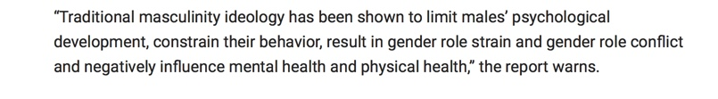
foxnews.com January 9, 2019

Slide 80

Published in 1950 By Members of the Frankfurt School

Slide 81
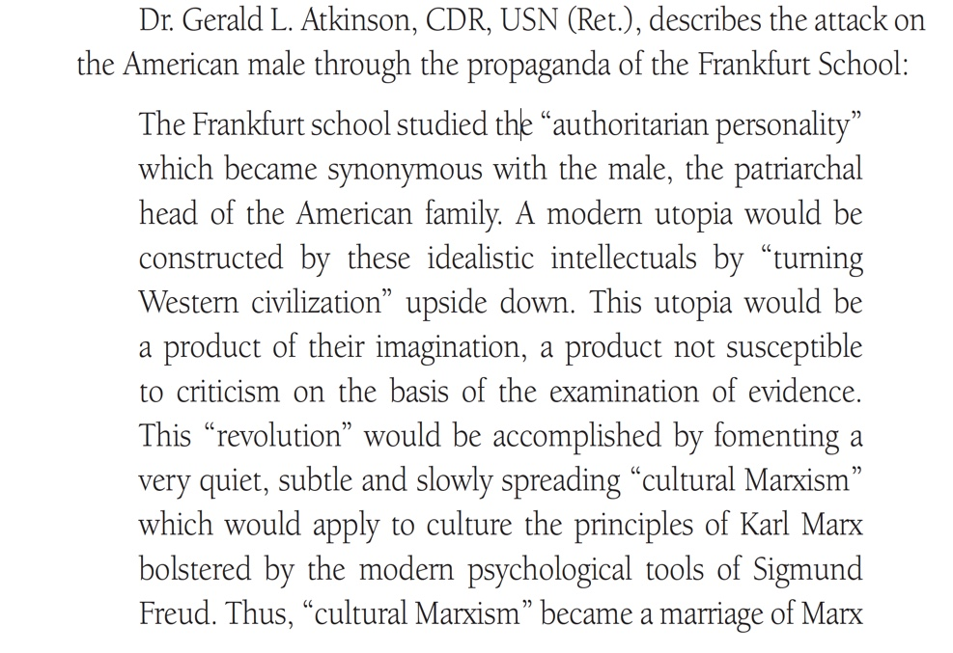
The Frankfurt School & Authoritarianism
From Grave Influence

Slide 82
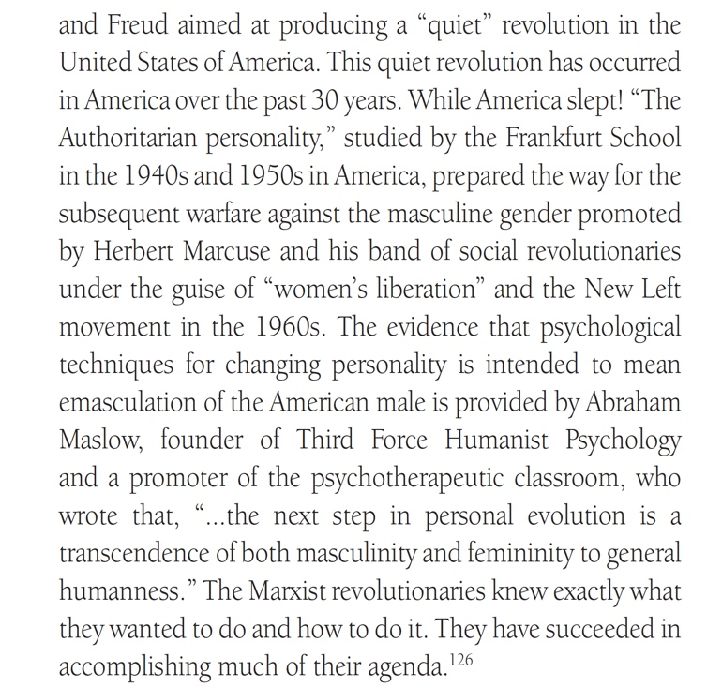

Slide 83

Psychologist World,
source: https://www.psychologistworld.com/influence-personality/authoritarian-personality

Slide 84
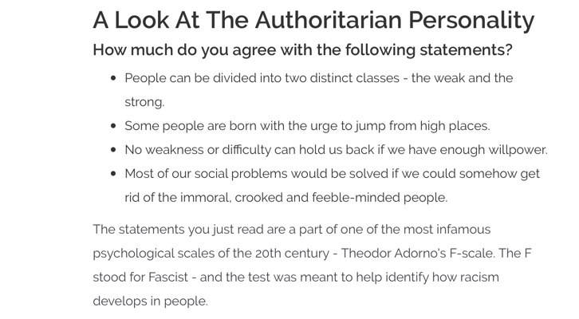
Psychologist World,

Slide 85
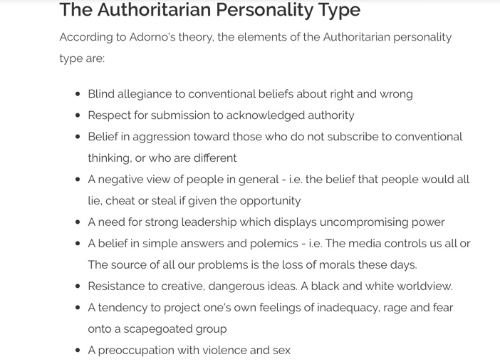
Psychologist World,

Slide 86
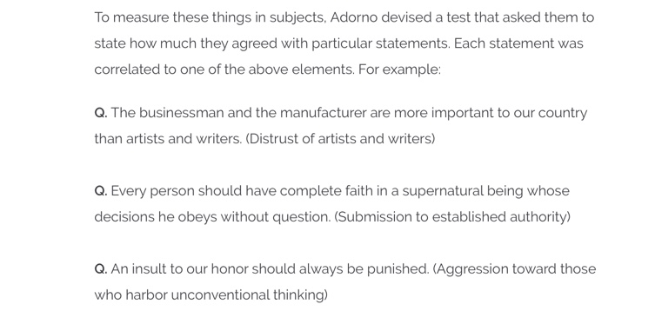
Psychologist World,

Slide 87


Slide 88
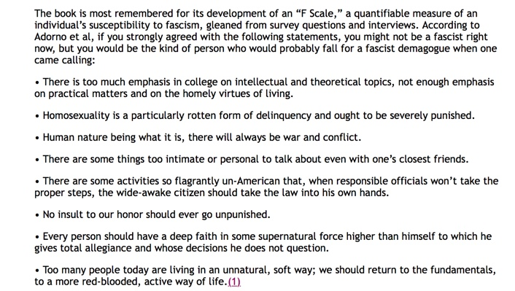
From Solidarity: A Socialist, Feminist, Anti-Racist Organization

Slide 89
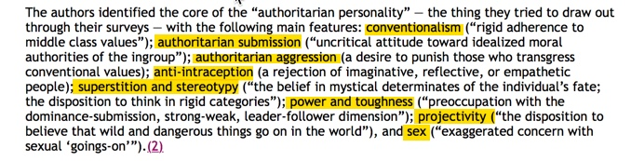
From Solidarity: A Socialist, Feminist, Anti-Racist Organization

Slide 90
Brainwashed America: Part 3

Slide 91
1. Remove or discredit leaders that are principled,
courageous, and people of convictions and morality.

Slide 92
Published in 1950 By Members of the Frankfurt School

Slide 93

Politico, January 17, 2016

Slide 94
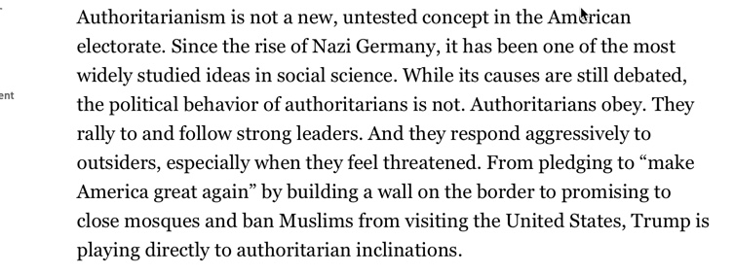
Politico, January 17, 2016

Slide 95
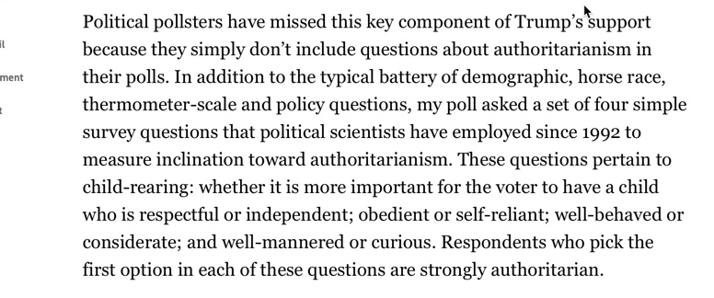
Politico, January 17, 2016

Slide 96
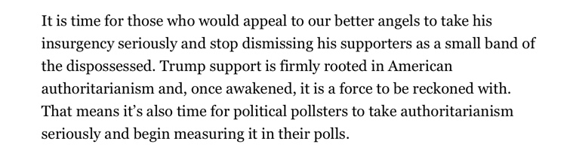
Politico, January 17, 2016

Slide 97

Christian Post, March 12, 2016

Slide 98
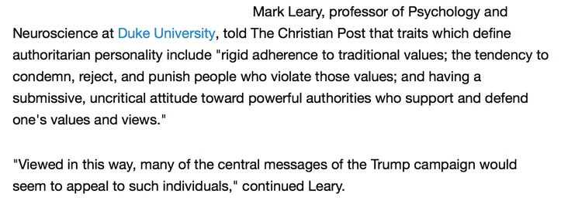
Christian Post, March 12, 2016

Slide 99
William E. Mayer:
November 27, 1956 Speech:
Now the weapon they used was deceptively simple. Before they could put it into effect, they had to segregate leaders — which they did very simply by putting them into what was reactionary camps. They put into reactionary camps, reactionaries. People who tried to be leaders. People who showed what the Communists called “poisonous individuals.”

Slide 100
If you had the temerity to try to organize anything, off you went to the reactionary camp. You were obviously hopeless. Other reactionaries were people with a higher education, who were considered automatically pretty reactionary unless they volunteered to cooperate & some did.

Slide 101

U.S Department of Justice, October 26, 2017

Slide 102
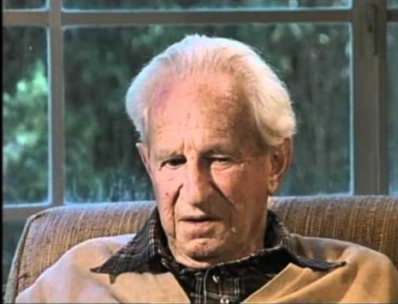
Herbert Marcuse of the Frankfurt School

Slide 103
Repressive Tolerance
by Herbert Marcuse (1965)
They would include the withdrawal of toleration of speech and assembly from groups and movements which promote aggressive policies, armament, chauvinism, discrimination on the grounds of race and religion, or which oppose the extension of public services, social security, medical care, etc.

Slide 104
Repressive Tolerance
by Herbert Marcuse (1965)
Liberating tolerance, then, would mean intolerance against movements from the Right and toleration of movements from the Left. As to the scope of this tolerance and intolerance: ... it would extend to the stage of action as well as of discussion and propaganda, of deed as well as of word.

Slide 105
A Code of Conduct
For Men of Character & Leadership

Slide 106
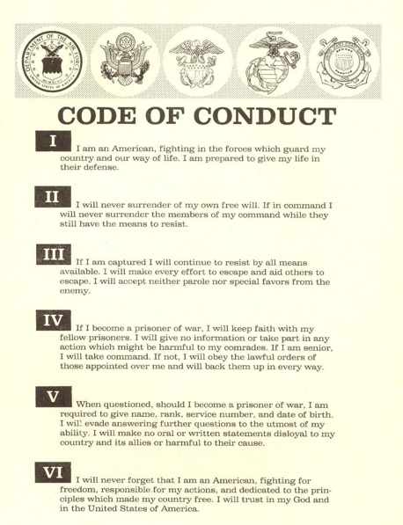

Slide 107
William E. Mayer:
November 27, 1956 Speech:
We didn’t find men dying trying to resist communism. We found a lot of men died. As a matter of fact, out of every ten men captured, approximately four died in captivity. Four out of ten. Thirty-eight percent to be precise. That, ladies and gentle is the highest death rate of Americans in any kind of captivity in any prison in any war since the American Revolution. But they didn’t die, as we thought, because of mass executions or systematic starvation. It’s true, the diet wasn’t good enough, the medical care was non-existent. These were contributing factors in every death in Korea.

Slide 108
But the specific reasons why men died were disturbing ones. They died because of some failures and lack, relative to the development of character, the development of loyalties, the development of leadership that you and I, are responsible for, not the communists…We saw another kind of surrender in Korea. We saw a kind of psychological surrender that was fatal. There was a disease there that killed hundreds of American troops,

Slide 109
which the medical service had no name for. So the prisoners named it. They called it “Giveupitis.” Doesn’t sound like much. It was a disease of the passive, the dependent, the rather inadequate, the kid who was awfully insecure who couldn’t tolerate this being isolated from other soldiers or from his unit. The kid who cried himself to sleep at night; he talked about his mother a lot. Who brooded. Who threw down the dirty bowl of food

Slide 110
because even though it would keep you alive it was dirty and he didn’t like it. And he’d crawl up into a corner by himself and pull his blanket over his head and in 48 hours he was dead. Dead. Not starved to death. No physical disease present. Just dead. Hundreds of Americans died in this fashion. they were not psychotic. They were not insane. They knew what they were doing.

Slide 111
They made the most profound of all human surrenders…We’ve never before seen it among 18 to 22 year old adult males. Never surrender. Well, aren’t we trying to teach perseverance? Aren’t we trying to teaching fighting against odds and obstacles? And is the Army or Navy really the place to teach this? Isn’t this an old fashioned American characteristic? Its in the Code of Conduct because not enough of these people exercised it.

Slide 113
William E. Mayer:
November 27, 1956 Speech:
…Another point in the Code of Conduct says something about what we’re doing with leadership. And it’s the most blistering comment upon the quality of leadership among us. And I mean leadership at the foreman level, at the squad leader level, at the gun crew level, at the supermarket level. Because now the Code of Conduct finds it necessary to say to Americans: Soldier, if You’re

Slide 114
captured by an enemy, and you’re the senior man, take command. And if you’re not the senior man, support and back up the man who is. Because, we tell ‘em, your life depends upon it. And it literally does. In combat or in captivity. Under any kind of stress. And yet authority seems to be in disrepute and leadership is undertaken on the basis of popularity contests now…So, something has to be done about leadership in the shop, in homes, in schools, in boy scouts. That’s were it starts.

Slide 115
No Leaders
No Standards
No Discipline
No Organization
No Resistance
No Opposition
No Hope
= Surrender

Slide 116
William E. Mayer:
November 27, 1956 Speech:
We know that the man who exercises discipline within the military establishment is the man who has the best chance of surviving in combat or in captivity. But discipline’s a dirty word…Discipline, somehow, has become synonymous with abandoning your own — your own self-respect. Abandoning your individualism and becoming a helpless machine. The only kind of discipline that really exists and really works is an internalized system of values, a set of standards existing within the individual which characterize and guide his behavior whether there’s a cop or a shore patrolman standing there or not. And it’s the kind of discipline we have to seek from people. This is the kind of discipline that makes

Slide 117
individuals able to join a team. Individuals able to respond to competent leadership. And individuals able to have the intestinal fortitude necessary to be leaders. To Set limits to [administer] punishment and reward. And that includes even to our children. And naturally, of course, this is where the problem mainly lies. Discipline is not taught when a kid is 18 years old. It’s taught in homes, and Sunday Schools sometimes, in churches.

Slide 118
It’s taught partly in the military. It’s taught mainly in the family. It’s taught from the cradle onward or it’s not ever adequately taught at all. It’s taught at a parent’s knee, and even possibly across a parent’s knee. It has to be taught throughout the educational process.

Slide 119
William E. Mayer:
November 27, 1956 Speech:
So, something has to be done about leadership in the shop, in homes, in schools, in boy scouts.
That’s were it starts.

Slide 120

New York Daily News, May 3, 2018

Slide 121
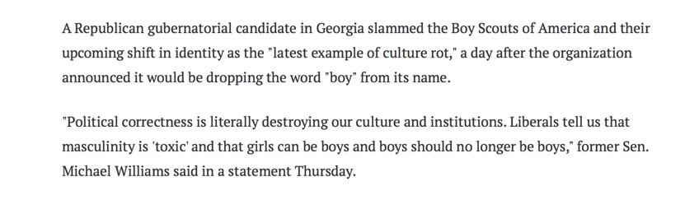
New York Daily News, May 3, 2018

Slide 122
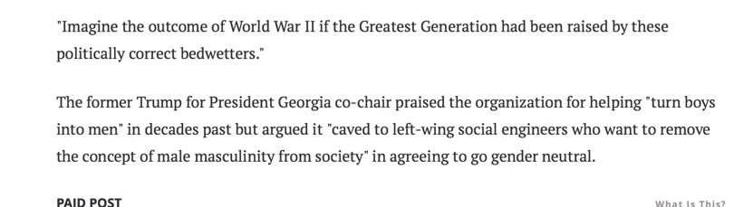
New York Daily News, May 3, 2018

Slide 123
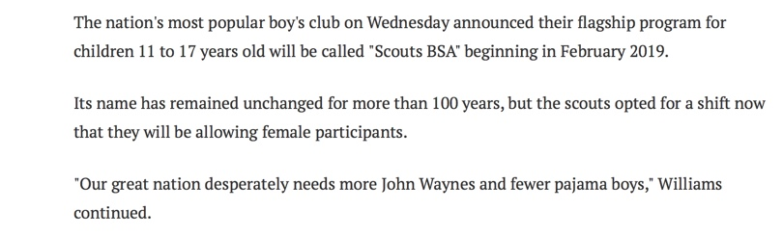
New York Daily News, May 3, 2018

Slide 124

Washington Times, May 4, 2017

Slide 125
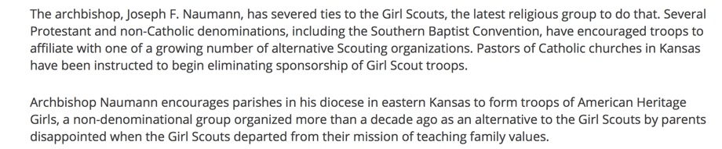
Washington Times, May 4, 2017

Slide 126
Washington Times, May 4, 2017

Slide 127

Washington Times, May 4, 2017

Slide 128
Herbert Marcuse:
One can rightfully speak of a cultural revolution, since the protest is directed toward the whole cultural establishment; including the morality of existing society…there is one thing we can say with complete assurance. The traditional idea of revolution and the traditional strategy of revolution has ended. These ideas are old-fashioned…what we must undertake is a type of diffuse and dispersed disintegration of the system.

Slide 129
Three Powerful Institutions
For Brainwashing:
Education
Media
Religion

Slide 130
2. Entice the brainwashing subjects into questioning
and doubting their foundational worldview, values,
& convictions.

Slide 131
Testimony of Mr. Edward Hunter on March 13, 1958 Before the Committee on Un-American Activities:
I spent 30 years, a little bit more perhaps, in countries under various forms of Communist pressure an attack. What I am witnessing in America is not different from what I saw in those other countries. I am often referred to as someone who has made phenomenal predications that proved correct on things to come. Actually, I have never made a predication in my life. I have only predicted in the manner that one predicts the total of 4 after seeing the figures of 2 plus 2.

Slide 132
I have been watching developments under communism in other parts of the world, and now I see exactly the same developments here in America. They include, first of all, the penetration of our leadership circles by softening up and creating a defeatist state of mind.

Slide 133
This includes penetration of our educational circles by a similar state of mind…I see primarily, as part of this softening up process in America, the liquidation of our attitudes on what we used to recognize as right and wrong, what we used to accept as absolute moral standards. We now confuse moral standards with the sophistication of dialectal materialism, with a Communist

Slide 134
crackpot theology which teaches that everything changes, and that what is right or wrong, good or bad, changes as well. So nothing they say is really good or bad. There is no such thing as truth or a lie; and any belief we actually held was simply our being unsophisticated. They don’t say this in so many words, except to those who are already indoctrinated in communism.

Slide 135
What they do say to the rest of us is to be objective; and then they twist that word “objective” into meaning what they mean by dialectical materialism.

Slide 136
Dialectical Materialism:
All that exist is the natural or material world
the world evolved, man evolved, society evolves, morals evolve
Society & morals evolve through continues conflict of opposing ideas that synthesis through a dialectical process
Matter proceeded the mind = Darwinian Evolution
The mind is the brain & thoughts are a product of the material world

Slide 137
Dialectical Materialism:
There are no absolute truths as there is constant change
Judeo-Christian values will give way to collective & situational values
Family will give way to communal living
Marriage will give way to communal wives

Slide 138
Dialectical Materialism:
Man is a product of his environment that is always changing
Man’s material state determines his values & behavior & thus creates society
The State should own or control the means of production for the common good

Slide 139
Dialectical Materialism:
Capitalism will give way to socialism
Nationalism will give way to globalism
Nation states will give way to world government
Evolution and revolution is a never ending process

Slide 140


Slide 141


Slide 142


Slide 143


Slide 144


Slide 145


Slide 146


Slide 147


Slide 148


Slide 149
Testimony of Mr. Edward Hunter on March 13, 1958 Before the Committee on Un-American Activities:
I have been watching developments under communism in other parts of the world, and now I see exactly the same developments here in America. They include, first of all, the penetration of our leadership circles by softening up and creating a defeatist state of mind.

Slide 150
This includes penetration of our educational circles by a similar state of mind…I see primarily, as part of this softening up process in America, the liquidation of our attitudes on what we used to recognize as right and wrong, what we used to accept as absolute moral standards. We now confuse moral standards with the sophistication of dialectal materialism, with a Communist

Slide 151
crackpot theology which teaches that everything changes, and that what is right or wrong, good or bad, changes as well. So nothing they say is really good or bad. There is no such thing as truth or a lie; and any belief we actually held was simply our being unsophisticated. They don’t say this in so many words, except to those who are already indoctrinated in communism.

Slide 152
What they do say to the rest of us is to be objective; and then they twist that word “objective” into meaning what they mean by dialectical materialism.

Slide 153
Brainwashed America: Part 4

Slide 154
2. Entice the brainwashing subjects into questioning
and doubting their foundational worldview, values,
& convictions.

Slide 155
Report Written During the Korean War by the Chief of Intelligence of the Chinese People’s Voluntary Army to Peiping:
The American soldier has weak loyalty to his family, his community, his country, his religion, and to his fellow solider. His concepts of right and wrong are hazy and ill-formed. Opportunism is easy for him. By himself he feels frightened and insecure. He underestimates his own worth, his own strength and his ability to survive.

Slide 156
Report Written During the Korean War by the Chief of Intelligence of the Chinese People’s Voluntary Army to Peiping:
There is little understanding of American political history and philosophy, the federal, state, and community organizations, state and civil rights, freedom safeguards, checks and balances and how these things allegedly operate within his own system. He fails to appreciate the meaning of and the necessity for military or any other form of organization.

Slide 157
John Stormer in None Dare Call it Treason Wrote:
“Indoctrination and re-education” was accomplished in simple “discussion periods.” American-produced books and texts were used which emphasized all that was bad in America. The 12-page course “outline” given each man was prepared in America, at a Communist-operated school, the Jefferson School of Social Science in New York City.

Slide 158
John Stormer in None Dare Call it Treason Wrote:
If the “student” didn’t have a solid foundation in American history, government, and economics, much of the material made sense and sounded reasonable.

Slide 159
Three Powerful Institutions
For Brainwashing:
Education
Media
Religion

Slide 160
The Communists, The Islamists & The United Nations
Hijack American Education For Indoctrination

Slide 161
American Communist Party Leader
William Z. Foster in His 1932,
Toward Soviet America, Wrote:
Among the elementary measures the American Soviet government will adopt to further the cultural revolution are the following; the schools, colleges and universities will be coordinated and grouped under the National Department of Education and its state and local branches…The studies will be revolutionized being cleansed of religious, patriotic and other features of the bourgeois ideology. The students will be taught on the basis of Marxian dialectical materialism, internationalism and the general ethics of the new Socialist society.

Slide 162


Slide 163
Julian Huxley 1946:
The task is to help the emergence of a single world culture…at the moment, two opposing philosophies of life confront each other….You may categorize the two philosophies as super nationalism, or as individualism versus collectivism…or as capitalism versus communism, or as Christianity verses Marxism. Can these opposites be reconciled, this antithesis be resolved in a higher synthesis? I believe not only that this can happen, but that, through the inexorable dialectic of evolution, it must happen.

Slide 164
In 1963 Newsweek interviewed the Marxist, United Nations Secretary General U Thant Who Declared:
I believe in the philosophy of thesis, antithesis, and synthesis. From its present antithesis, I believe the world is moving towards a new synthesis.

Slide 165
John Stormer in
None Dare Call it Treason Wrote:
Newsweek did not tell its readers, but Thant’s “philosophy” is a simple restatement of Hegel’s dialectic, the basis or root of Karl Marx’s dialectical materialism. Thant has also adopted another Marxist idea to finance the “synthesis” toward which he sees the world moving — the one-world socialistic government financed by the United States.

Slide 171
American Communist Support For
The Founding of the United Nations

Slide 172
In April 1945, The Communist Party USA Used Their Journal To Call For Support of the Formation of the U.N.
Great popular support and enthusiasm for the United Nations policies should be built up, well organized and fully articulate. But it is also necessary to do more than that. The opposition must be rendered so impotent that it will be unable to gather any significant support in the Senate against the U.N. Charter and the treaties which will follow

Slide 173
John Stormer in None Dare Call it Treason Wrote:
The communists knew in advance that the structure of the UN could be used to prevent it from ever acting against the Communists. They knew what few Americans realize even today…In 1948, when Alger Hess was exposed as a Communist agent, the web of protective propaganda which guards the UN prevented most Americans from learning that he had been the UN chief architect.
p. 277

Slide 174
2. Entice the brainwashing subjects into questioning
and doubting their foundational worldview, values,
& convictions.

Slide 175
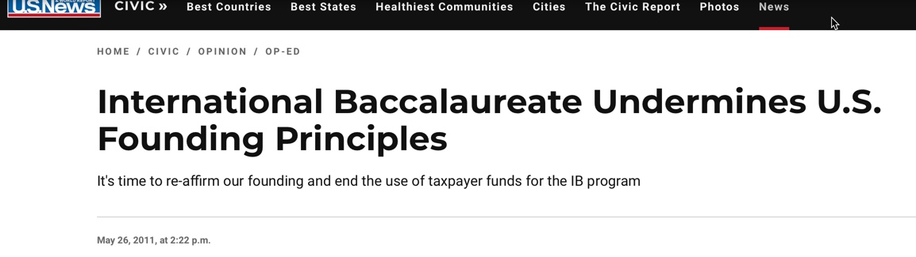
In 1968 UNESCO Helped To Found
The International Baccalaureate

Slide 176
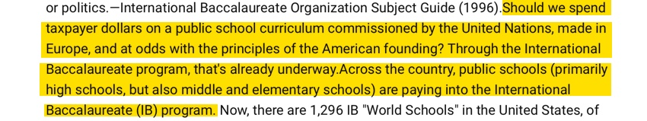

Slide 177
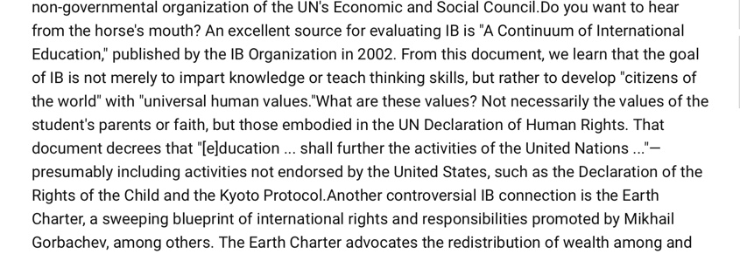

Slide 178
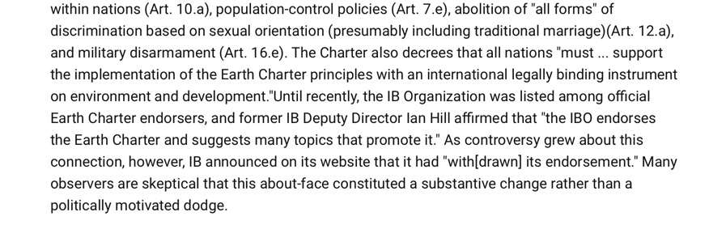

Slide 179
Therese Maurette: Founder of
The International Baccalaureate Declared:
The concept of “nationality” must be minimized in order to encourage students to develop a picture of the whole world…History should not be taught until well into adolescence because, for the younger student, it inevitably consists of a series of stories and myths glorifying violence and misrepresenting events by giving them a nationalistic bias.”

Slide 180
“IB is Showing the Way,” Was published by IB World, stated in May of 2008 and Declared:
“Young people need to feel first of all global citizens, second national citizens and third local citizens. Among my generation, it is the other way around. Change will be difficult, but schools are already thinking about curriculum changes.”

Slide 181
Ileana Johnson Writes in an Article Titled “The Link Between Declining National Education Quality and UN Agenda 2030”:
With grants and taxpayer dollars, students are brainwashed into “global citizenship, social justice, intercultural understanding and respect”—in other words, submission to one-world socialist government.

Slide 182


Slide 183


Slide 184

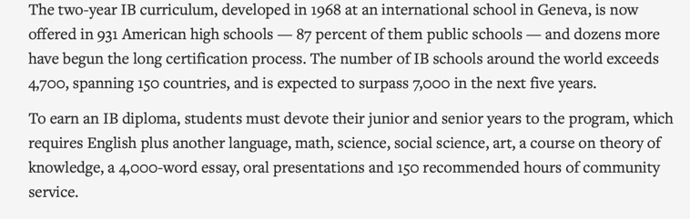

Slide 185


Slide 186
United Nations Secretary General & Marxist U Thant in a
Speech in 1962 Declared:
The concept of taxing the rich according to their capacity to pay, in order to cater to the poor according to their needs, is now well established as a simple cannon of social justice in all democratic countries. It requires only a little imagination to lift this concept to a higher plane, namely the international plane, and to extend its scope from the country to the universe.

Slide 187
In the 1946 book, The World Charter and Road to Peace by Stuart Chevalier we find this statement:
"Peace is not the absence of war. Peace is the presence of justice."

Slide 188
Brainwashed America: Part 5

Slide 189
Brainwashing by Edward Hunter
Published in 1956

Slide 190
Edward Hunter Interview with
Captain Zach W. Dean
U.S. Air Force
Korean P.O.W.
The Reds were able to break a man’s mind only when they accomplished two things, he said. They had to deprive him of clarity of thought and upset his sense of values.

Slide 191
2. Entice the brainwashing subjects into questioning
and doubting their foundational worldview, values,
& convictions.

Slide 192
Teach Thinking Skills
Based on Feelings Not Facts

Slide 193
Millennials Would Rather Live in Socialist or Communist Nation than Under Capitalism: Poll
Washington Times,
November 4, 2017
The majority of millennials would prefer to live in a socialist, communist or fascist nation rather than a capitalistic one, [58%] according to a new poll.

Slide 194
Thomas Sowell: "Indoctrinating the Children,"
Forbes, February 1, 1993, p. 65.
"The techniques of brainwashing developed in totalitarian countries are routinely used in psychological conditioning programs imposed on American school children. These include emotional shock and desensitization, psychological isolation from sources of support, stripping away defenses, manipulative cross-examination of the individual's underlying moral values, and inducing acceptance of alternative values by psychological rather than rational means."

Slide 195
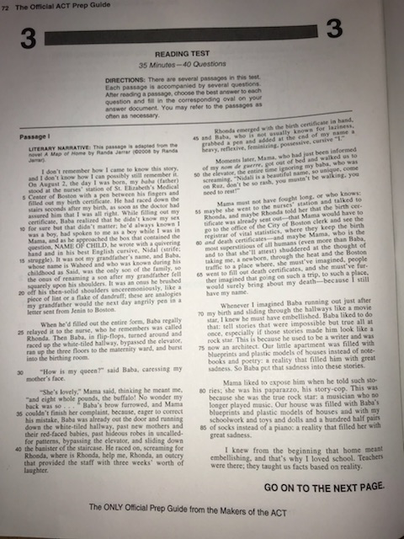
ACT Prep Guide

Slide 196

ACT Prep Guide

Slide 197
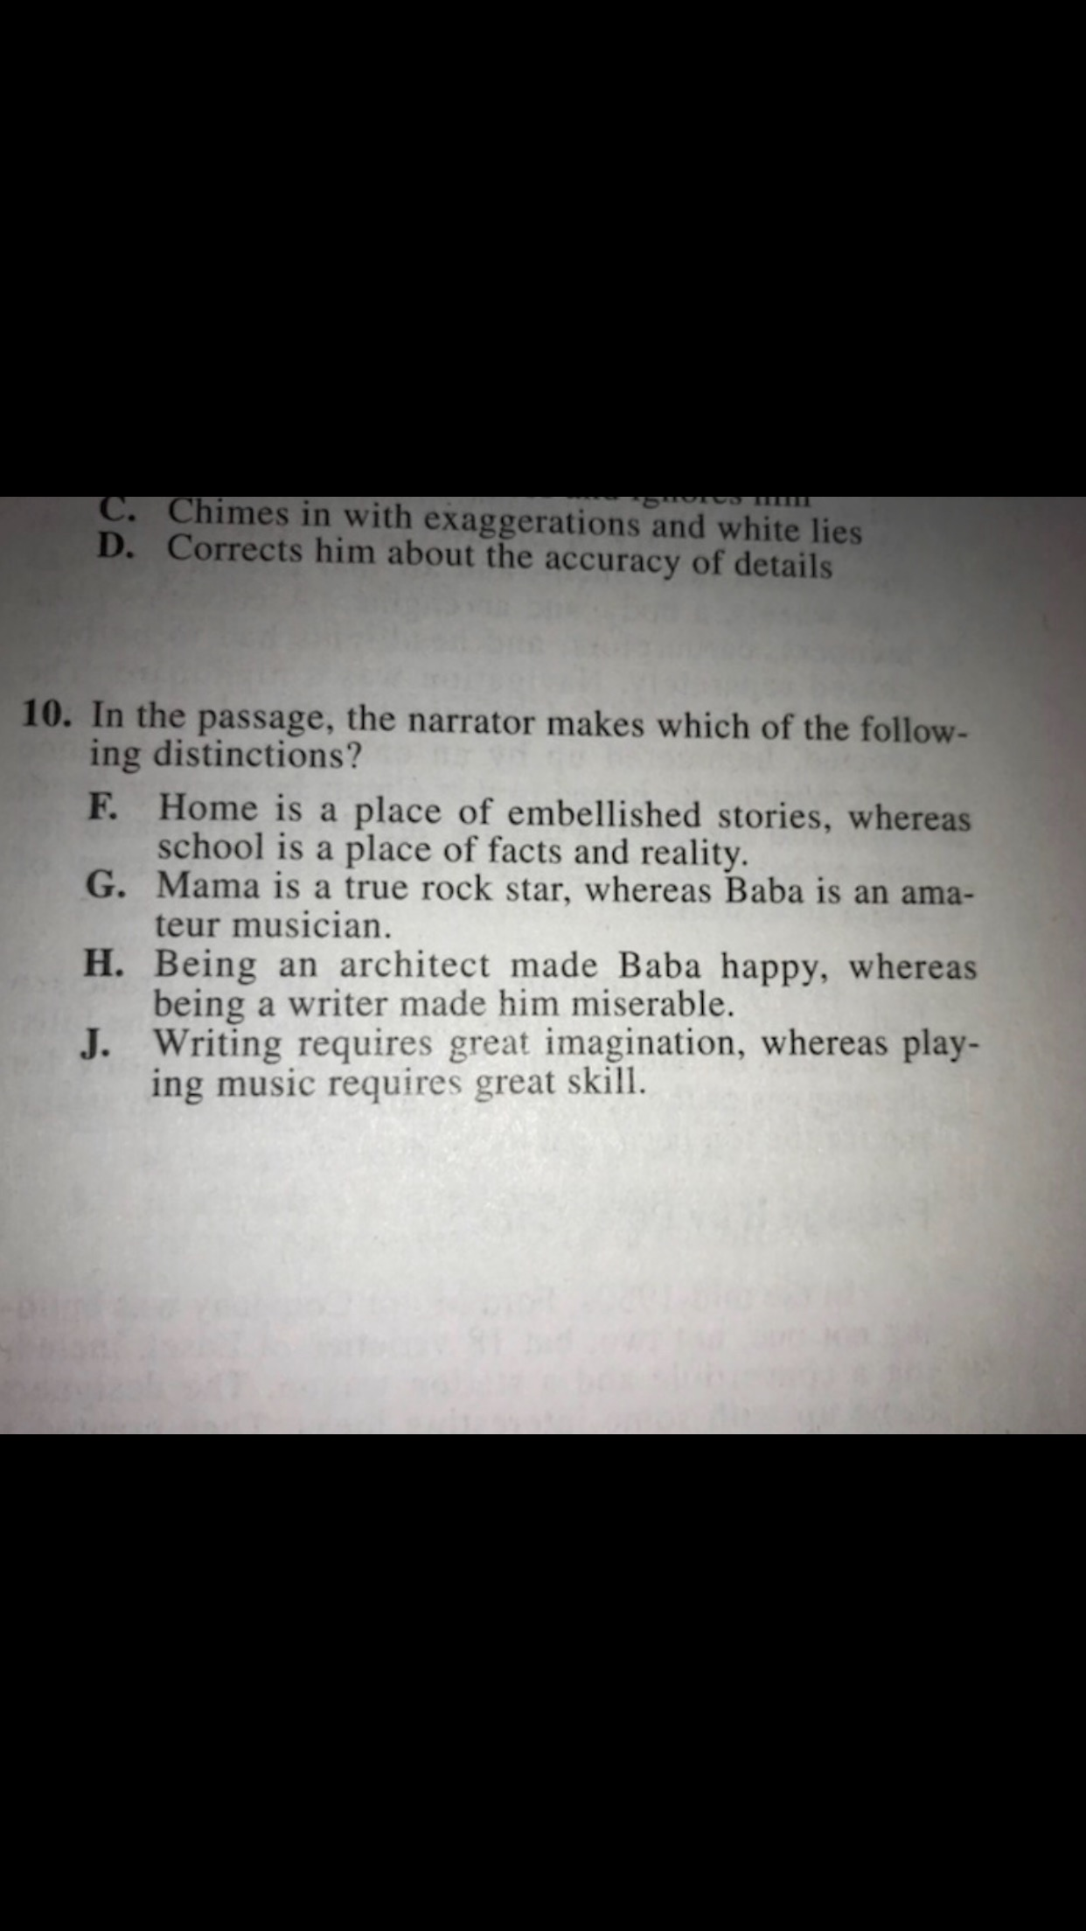

Slide 198
Thomas Sowell:
Parents are the greatest obstacle to any brainwashing of children…If parents cannot be gotten out of the picture or at least moved to the periphery, the whole brainwashing operation is jeopardized.

Slide 199
Carolyn Warner Was Arizona Superintendent of Public Instruction When She Declared:
Those who educate are more to be honored than those who bear the children. The latter gave them only life, the former teach them the art of living.

Slide 200
In Her Book, The Story of the Trapp Family Singers Maria Trapp Recalls:
This morning we were told [by the Nazis] at the [school] assembly that our parents are nice, old-fashioned people who don’t understand the new Party. We should leave them alone and not bother. We are the hope of the nation, the hope of the world. We should never mention at home what learn at school.

Slide 201
Nebraska State Senator (future U.S. Congressman)
Peter Hoagland, on April 12, 1982
on Channel 6 television, in Omaha declared:
"What we are most interested in, of course, are the children themselves. I don't think any of us in the legislature have any quarrel with the right of the Reverend (Everett Sileven) or the members of his flock to practice their religion, but we don't think that they should be entitled to impose decisions or religious philosophies on their children, which could seriously undermine those children's ability to deal
in this complicated world when they grow up."

Slide 202
This Statement by John Dunphy Was First Published in the January/February 1983 Humanist Magazine:
I am convinced that the battle for humankind’s future must be waged and won in the public school classroom by teachers…These teachers must embody the same selfless dedication as the most rabid fundamentalist preachers for they will be ministers of another sort,

Slide 203
utilizing a classroom instead of a pulpit to convey humanist values in whatever subject they teach, regardless of the education level — preschool, day-care or large state university. The classroom must and will become an arena of conflict between the old and the new — the rotting corpse of Christianity, together with all its adjacent evils and misery, and the new faith
of humanism. Humanism will emerge triumphant.
It must if the family of humankind is to survive.

Slide 204
March 20, 1952, Congressional Record
U.S. Senator William Jenner:
I want to make one thing clear. This war against our Constitution is not being fought way off in Madagascar or in Mandalay. It is being fought here — in our schools, our colleges, our churches, our women’s clubs. It is being fought with our money, channeled through the State Department.

Slide 205
It is being fought twenty-four hours a day — while we remain asleep. How many of you Senators know what the U.N. is doing to change the teaching of the children in your own hometown? The UN is at work there, every day and night, changing the teachers, changing the teaching materials, changing the very words and tones — changing all the essential ideas

Slide 206
which we imagine our schools are teaching to our young folks. How in the name of heaven are we to sit here, approve these programs, appropriate our own peoples’ money — for such outrageous “orientation” of our own children, and of the men and women who teach our children, in this nation’s schools?

Slide 207
October 1947, NEA Journal
“On the Waging of Peace” by William Carr:
As you teach about the United Nations, lay the ground for a stronger United Nations by developing in your students a sense of world community. The United Nations should be transformed into a limited world government. The psychological foundations for wider loyalties must be laid…

Slide 208
Teach about the various proposals that have been made for strengthening the United Nations and the establishment of world law. Teach those attitudes which will result ultimately in the creation of a world citizenship and world government…We cannot directly teach loyalty to a society that does not yet exist,

Slide 209
but we can and should teach those skills and attitudes which will help to create a society in which world citizenship is possible.

Slide 210

Dr. Ian Hill, Deputy Director General of the IBO Deputy Director General from 2000 until July 2012.

Slide 211


Slide 212
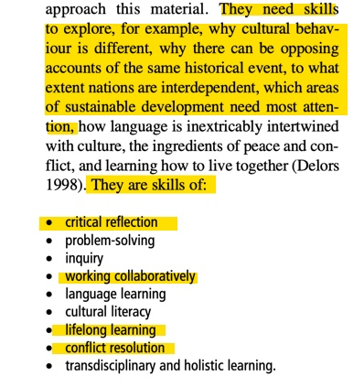

Slide 213
Dr. Raymond English, in a speech before the National Advisory Council on Educational Research and Improvement on April 2, 1987, defined critical thinking:
Critical thinking means not only learning how to think for oneself, but it also means learning how to subvert the traditional values in your society. You're not thinking critical if you're accepting the values that mommy and daddy taught you. That's not critical.

Slide 214
Dr. Chester M. Pierce:
Every child who enters school at the age of five is mentally ill because he enters school with an allegiance toward our elected officials, our founding fathers, our institutions, the preservation of this form of government that we have, patriotism, nationalism, sovereignty. All this proves that the children are sick, because a truly well individual is one who has rejected all of those things, and is what I would call the true international child of the future.

Slide 216

Written in 1995

Slide 217
In 1977, Assistant Secretary of Education Mary Frances Berry of the Carter Administration delivered a speech at the University of Illinois in which she outlined the newest forms of education form. And where did she get these new reforms? From the four pillars of the Chinese model of lifelong learning and community education.

Slide 218
The Four pillars of the Chinese model laid out by Ms. Berry are:
1. Eliminate test and grades
2. Make truth a relative concept
3. Make education serve the masses
4. Combine education with labor - or in other words, combine education with industrial production.

Slide 219
National Educator, August 1978 Reported:
Red China has eliminated testing and grades. The U.S. is rapidly going the same route. Testing is being downgraded and scoffed at, and grades, where they do exist are just about meaningless. For the Red Chinese, according to Ms. Berry, truth is a relative concept. In the U.S. schools students are taught the same thing in “values clarification.”

Slide 220
It’s called situational ethics and it means it’s okay to lie or cheat or steal or kill when it suits your purpose. In Red China, according to Ms. Berry, education must serve the masses. Ditto the U.S. Only the semantics are different here. In the U.S. education is not designed for the benefit of individuals, but for society. “Society” or “masses”—what’s the difference?

Slide 221
In In Red China, according to Ms. Berry, education must be combined with productive labor and starts at six years of age, with children working at least one hour a day producing voice boxes for dolls. At the middle school level, children make auto parts as part of the school day. We are not at this low level, but Secretary Berry frankly admits, “We will draw on the Chinese model…” We are fast approaching the Chinese model. We have work/study programs and the U.S. Office of Education is working on development of Lifelong Learning programs—another Chinese import.

Slide 222
Such programs will enable people to work and study their entire lives for the benefit of the state. Ms. Berry admitted U.S. Lifelong Learning programs are indeed drawn on the Chinese experience, that such programs are expected to meet “needs for intellectual fulfillment and social growth. It is here that the Chinese have set the pattern for the world to follow…”

Slide 223
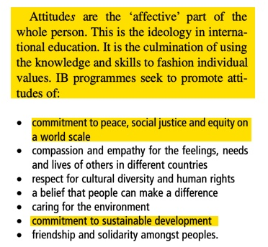

Slide 224
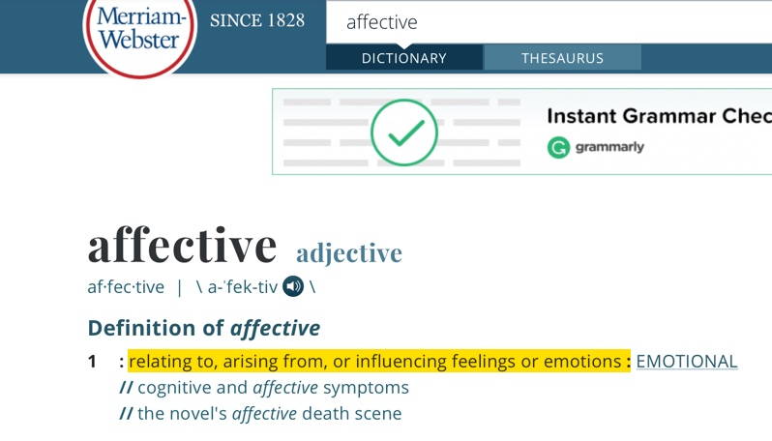

Slide 225
Best known as the author of Brave New World, Aldous Huxley outlines steps toward total social transformation.

Slide 226
1. Rewrite history to discredit nationalism and promote globalism.
2. Teach thinking skills based on feelings and experience, not facts and reason.
3. Encourage loyalty to peers and teachers, not family and churches.

Slide 227
4. Immerse students in global beliefs and values.
5. Block opposition to the new global paradigm.
6. Condition students to serve a "greater whole."

Slide 228
At The 1989 Governor's Conference on Education in Kansas, Dr. Shirley McCune, then head of the Mid-Continent Regional Educational Laboratory, Declared:
“The revolution… in curriculum is that we no longer are teaching facts to children…. We no longer see the teaching of facts and information as the primary outcome of education.

Slide 230
Benjamin Bloom of Bloom’s Taxonomy:
The careful observer of the classroom can see that the wise teacher as well as the psychological theorist use cognitive behavior and the achievement of cognitive goals to attain affective goals. . . .

Slide 231
Bloom's Own Words:
[A] large part of what we call "good teaching" is the teacher's ability to attain affective objectives through challenging the student's fixed beliefs.

Slide 232
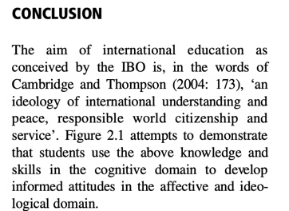
Dr. Ian Hill, Deputy Director General of the IBO Deputy Director General from 2000 until July 2012.

Slide 233
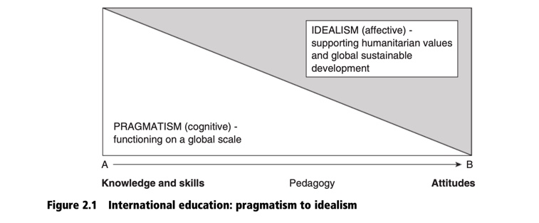

Slide 234
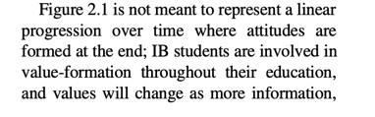
Dr. Ian Hill, Deputy Director General of the IBO Deputy Director General from 2000 until July 2012.

Slide 235
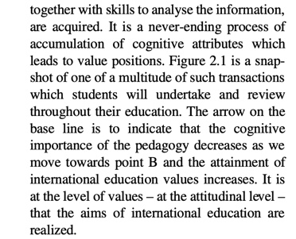
Dr. Ian Hill, Deputy Director General of the IBO Deputy Director General from 2000 until July 2012.

Slide 236
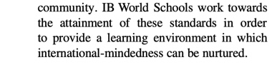
Dr. Ian Hill, Deputy Director General of the IBO Deputy Director General from 2000 until July 2012.

Slide 237
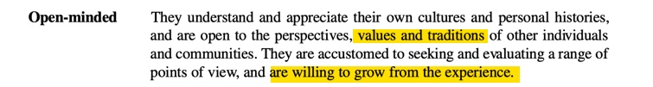
Dr. Ian Hill, Deputy Director General of the IBO Deputy Director General from 2000 until July 2012.

Slide 238
Sustainable Development =
Global Values For Global Governance

Slide 239
2. Entice the brainwashing subjects into questioning
and doubting their foundational worldview, values,
& convictions.

Slide 241
The end game of sustainable development is global governance.
Consider the words of the Commission on Global Governance, an organization allied with the United Nations:

Slide 242
The Commission on Global Governance, Our Global Neighborhood
(Oxford: Oxford University Press, 1995), 208.
The environment, perhaps more than any other issue, has helped to crystallize the notion that humanity has a common future.
The concept of sustainable development is now widely used and accepted as a framework within which all countries, rich and poor, should operate.

Slide 243
The aspect that particularly concerns us is the global governance implications.
The Commission on Global Goverance, Our Global Neighborhood (Oxford: Oxford University Press, 1995), 208.

Slide 244
Maurice Strong, who was head of the 1992
Earth Summit in Rio proclaimed:
“Isn’t the only hope for the planet that the industrialized civilizations collapse?
Isn’t it our responsibility to bring that about?”
Maurice Strong, quoted in Daniel Wood, "The Wizard of Baca Grande," West, May, 1990, 47.

Slide 245
Maurice Strong also extolled the need to destroy the concept of individual sovereign nations:
It is simply not feasible for sovereignty to be exercised unilaterally by individual nation-states, however powerful. It is a principle which will yield only slowly and reluctantly to the imperatives of global environmental cooperation.
Maurice Strong, quoted in Henry Lamb, "Conspiracy Theories Laid to Rest as U.N. Announces Plan for 'Global Neighborhood'," Hope for the World Update, Fall 1996, 2.

Slide 246
In a corollary to Strong’s position, Helen Caldicott of the Union of Concerned Scientists has declared the “horrors” of free-market capitalism:
Free enterprise really means rich people get richer. They have the freedom to exploit and psychologically rape their fellow human beings in the process…Capitalism is destroying the earth.
Brannon Howse, Reclaiming a Nation at Risk: The Battle for Your Faith, Family and Freedoms
(Bridgestone Multimedia Group, 1995), 190.

Slide 247
The editors of Empowerment for Sustainable Development: Toward Operational Strategies acknowledge the vital role education plays in brainwashing students with their radical worldview:
Education has been advanced as significant in bringing about changes in attitudes, behavior, beliefs, and values…In order to redirect behavior and values towards institutional change for sustainable development there is a need to investigate strategic options in relations to educational philosophies, scope for propagation and adoption, and groups most likely susceptible to change.

Slide 248
Brainwashed America: Part 6

Slide 249
Agents For Social Change

Slide 250
In 2003, Monique Seefried, president of the IB Council of Foundation gave a speech entitled, "IBO, a World of Givers" declared:
At the core of an IB education, starting with our youngest students is the aim to develop caring young people with a commitment to action and service…This is the most

Slide 251
idealistic part of the education our students receive…It is also essential in developing in them the drive to become an agent of social change in our ever evolving societies where there is still so much to do to reach an ideal of social justice.

Slide 252


Slide 253
The UN Agenda 2030 Document States:
“Children and young women and men are critical agents of change and will find in the new Goals a platform to channel their infinite capacities for activism into the creation of a better world.”

Slide 254
President George HW Bush's news conference in Rio de Janeiro, Brazil June 13, 1992:
“We've signed a climate convention. We've asked others to join us in presenting action plans for the implementation of the climate convention…Let me be clear on one fundamental point. The United States fully intends to be the world's preeminent leader in protecting the global environment.”

Slide 255

September 27, 2015

Slide 256
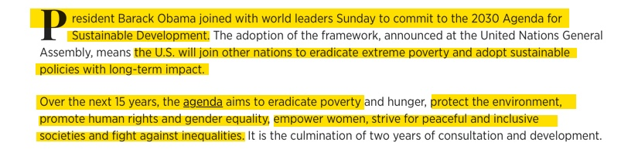
International Business Times
September 27, 2015

Slide 257

Breitbart, September 18, 2018
By Dr. Susan Berry

Slide 258
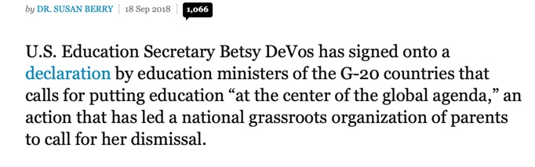
Breitbart, September 18, 2018
By Dr. Susan Berry

Slide 259
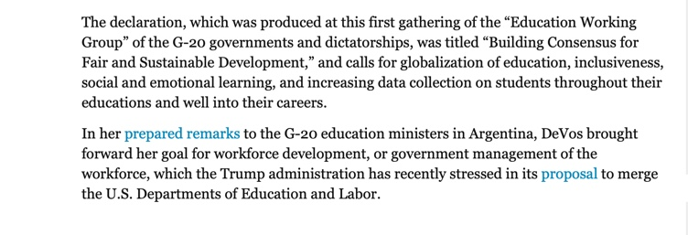
Breitbart, September 18, 2018
By Dr. Susan Berry

Slide 260
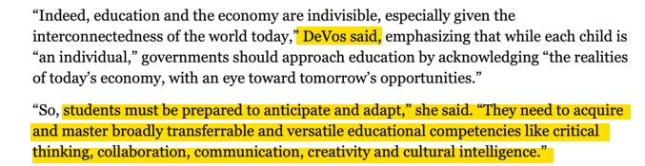
Breitbart, September 18, 2018
By Dr. Susan Berry

Slide 261
Breitbart, September 18, 2018
By Dr. Susan Berry

Slide 262
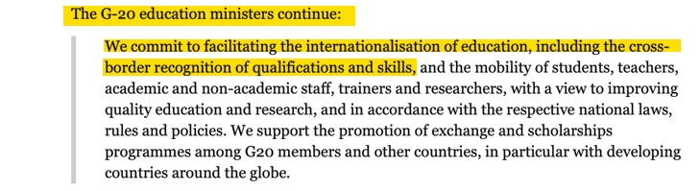
Breitbart, September 18, 2018
By Dr. Susan Berry

Slide 263

Breitbart, September 18, 2018
By Dr. Susan Berry

Slide 264
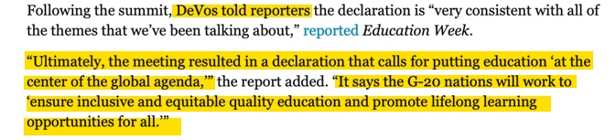
Breitbart, September 18, 2018
By Dr. Susan Berry

Slide 265
The Four pillars of the Chinese model laid out by Ms. Berry are:
1. Eliminate test and grades
2. Make truth a relative concept
3. Make education serve the masses
4. Combine education with labor - or in other words, combine education with industrial production.

Slide 266
John Dewey, a Fabian Socialist, signer of the Humanist Manifesto I, founding member of the American Civil Liberties Union, and president of the League for Industrial Democracy—the American counterpart of the British Fabian Society. was the leading force behind bringing a group of German intellectuals-from the “Frankfurt School”—to America.

Slide 267
John Dewey, Karl Marx, Aldous Huxley, B. F. Skinner, and Benjamin Bloom were interested in a student’s academic achievement only if it would in some way benefit the State.

Slide 268
In his book, My Pedagogic Creed, John Dewey explains:
I believe the true center of correlation on the school subjects is not science, nor literature, nor history, nor geography, but the child's social activities. . . . I believe that the school is primarily a social institution. . . .

Slide 269
The teacher's business is simply to determine, on the basis of the larger experience and riper wisdom, how the discipline of life shall come to the child. . . . All these questions of the grading of the child and his promotion should be determined by reference to the same standard. Examinations are of use only so far as they test the child's fitness for social life.

Slide 270
Best known as the author of Brave New World, Aldous Huxley outlines steps toward total social transformation.

Slide 271
1. Rewrite history to discredit nationalism and promote globalism.
2. Teach thinking skills based on feelings and experience, not facts and reason.
3. Encourage loyalty to peers and teachers, not family and churches.

Slide 272
4. Immerse students in global beliefs and values.
5. Block opposition to the new global paradigm.
6. Condition students to serve a "greater whole."

Slide 273
Brainwashing by Edward Hunter
Published in 1956

Slide 274
Brainwashing by Edward Hunter
Published in 1956:
The long-range objective of brainwashing is to win converts who can be depended on to react as desired at any time anywhere…Even when he stands by himself, the truly indoctrinated communist must be part of the collective. He must be incapable of hearing opposing ideas and facts, no matter how convincing or how forcibly they bombard his senses.

Slide 275
Brainwashing by Edward Hunter
Published in 1956:
A trustworthy communist must react in an automatic manner without any force being applied. Only then is he the ‘new Soviet man’ that Lenin foresaw.

Slide 276
Brainwashed America: Part 7

Slide 277
Chinese Communist Change Agents
Openly Invited into American Schools

Slide 278
2. Entice the brainwashing subjects into questioning
and doubting their foundational worldview, values,
& convictions.

Slide 279
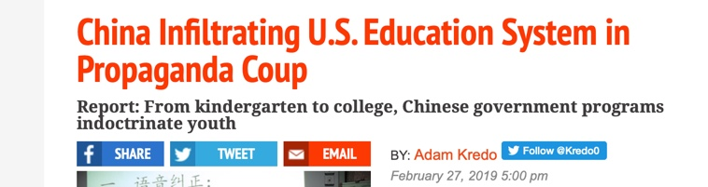
freebeacon.com, February 27, 2019

Slide 280
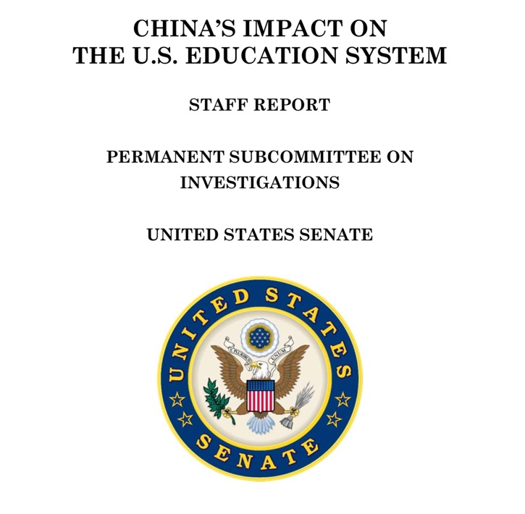

Slide 281
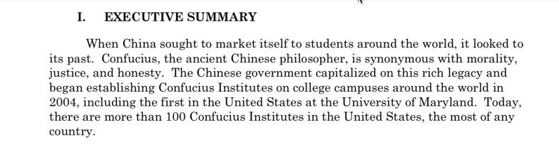

Slide 282
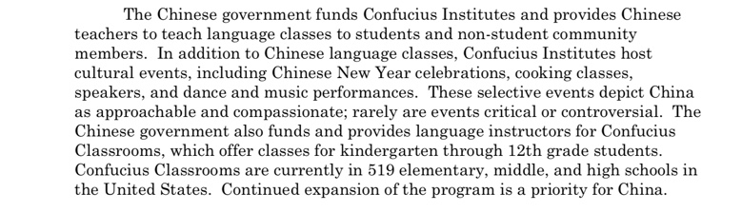

Slide 283
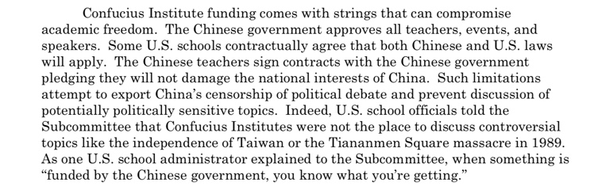

Slide 284
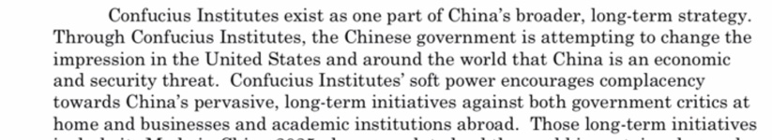

Slide 285


Slide 286


Slide 287


Slide 288


Slide 289


Slide 290


Slide 291

National Geographic March 25, 2015

Slide 292


Slide 293
3. Teach moral relativism and situational ethics in order to destroy morality and character.

Slide 294
Brainwashing by Edward Hunter
Published in 1956

Slide 295
Testimony of Mr. Edward Hunter on March 13, 1958 Before the Committee on Un-American Activities:
I spent 30 years, a little bit more perhaps, in countries under various forms of Communist pressure and attack. What I am witnessing in America is not different from what I saw in those other countries…

Slide 296
I have been watching developments under communism in other parts of the world, and now I see exactly the same developments here in America…

Slide 297
…I see primarily, as part of this softening up process in America, the liquidation of our attitudes on what we used to recognize as right and wrong, what we used to accept as absolute moral standards. We now confuse moral standards with the sophistication of dialectal materialism, with a Communist

Slide 298
crackpot theology which teaches that everything changes, and that what is right or wrong, good or bad, changes as well. So nothing they say is really good or bad. There is no such thing as truth or a lie; and any belief we actually held was simply our being unsophisticated. They don’t say this in so many words, except to those who are already indoctrinated in communism.

Slide 299
What they do say to the rest of us is to be objective; and then they twist that word “objective” into meaning what they mean by dialectical materialism.

Slide 300
Edward Hunter Interview with
Captain Zach W. Dean
U.S. Air Force
Korean P.O.W.
The Reds were able to break a man’s mind only when they accomplished two things, he said. They had to deprive him of clarity of thought and upset his sense of values.

Slide 301
Statement of Ed Hunter on March 13, 1958
U.S. Congressional Committee on Un-American Activities
The patient first has to be deprived of his bearings, to be shaken loose from whatever belief and convictions he formally held. Until he loses faith in them entirely. We contributed to the enemy’s success by brining up our young men and women without real convictions except to “get ahead.”

Slide 302
Statement of Ed Hunter on March 13, 1958
U.S. Congressional Committee on Un-American Activities
The Reds first lured the individual into believing the Red tenet in the pseudoscientific Marxian philosophy which teaches constant change, even in such basic conceptions as truth and falsity, good and bad…Note I use the word “patient” in referring to the prisoner. I do so deliberately, because brainwashing can only be properly understood from the clinical viewpoint; it is a treatment, as evil as a black mass.

Slide 303
Moral Relativism &
Situational Ethics

Slide 304

Joseph Fletcher
“Father of Situational Ethics”

Slide 305
Joseph Fletcher:
Episcopalian Priest Who Later Became An Atheist
Active in the Euthanasia Society of America and the American Eugenics Society
Signed the Humanist Manifesto II in 1973
“Father of Situational Ethics”
Published Situation Ethics in 1966

Slide 306

New York Times October 30, 1991

Slide 307


Slide 308


Slide 309


Slide 310


Slide 311


Slide 312

Published in 1966

Slide 313

April 1966

Slide 314

Page 43

Slide 315

Page 95

Slide 316

Page 95

Slide 317


Slide 318
Brainwashed America: Part 8

Slide 319
3. Teach moral relativism and situational ethics in order to destroy morality and character.

Slide 320

February 1956, 81 Page Report By The CIA on Brainwashing

Slide 321
February 1956, 81 Page Report By
The CIA on Brainwashing of POWs
It should be noted that brainwashing, so defined, does not emphasize what happens to the individual, but what happens within him. The change represents a more or less complete re-education of his value-system. This change is brought about in a rigidly controlled environment using pressure designed to create and sharpen internal conflict within the individual. The individual is forced to resort to a problem-solving behavior, and the net effect is the brainwashed state…characterized by a progressive deterioration and demobilization of the individual’s critical and judging capacities. In a true sense the individual loses all sense of perspective.

Slide 322
February 1956, 81 Page Report By
The CIA on Brainwashing on POWs
The process of process of brainwashing is essentially one in which two paths are being followed. One is the demoralizing process, the result of which is to reduce the victim’s critical faculties to the point of where he no longer discriminates clearly between true and false, logical and illogical. The other is the re-organizing process, in which he is required to construct his confession, elaborate it, defend it, and believe it.

Slide 323

New York Jewish Life, April 4, 2017

Slide 324

New York Jewish Life, April 4, 2017

Slide 325

The Dailywire, April 5, 2017

Slide 326

The Dailywire, April 5, 2017

Slide 327

The Dailywire, April 5, 2017

Slide 328

The Dailywire, April 5, 2017

Slide 329

Los Angeles Times, January 27, 2002

Slide 330

Los Angeles Times, January 27, 2002

Slide 331

aish.com, October 6, 2003

Slide 332

aish.com, October 6, 2003

Slide 333
Joseph Fletcher
“Father of Situational Ethics”

Slide 334
Published in 1966

Slide 335
Joseph Fletcher:
Episcopalian Priest Who Later Became An Atheist
Active in the Euthanasia Society of America and the American Eugenics Society
Signed the Humanist Manifesto II in 1973
“Father of Situational Ethics”
Published Situation Ethics in 1966

Slide 336
Page 95

Slide 338
I John 4:8:
“God is Love”

Slide 339
Utilitarian Peter Singer:
Christianity is our foe. If animal rights is to succeed, We must destroy the Judeo-Christian religious tradition.

Slide 340
Utilitarian Peter Singer in Rethinking Life and Death Declares:
Human babies are not born self-aware or capable of grasping their lives over time. They are not persons. Hence their lives would seem to be no more worthy of protection than the life of a fetus.

Slide 341
Utilitarian Peter Singer in
Rethinking Life and Death Declares:
We may not want a child to start on life’s uncertain voyage if the prospects are clouded. When this can be known at a very early stage in the voyage, we may still have a chance to make a fresh start. This means detaching ourselves from the infant who has been born,

Slide 342
Utilitarian Peter Singer in
Rethinking Life and Death Declares:
cutting ourselves free before the ties that have already begun to bind us to our child have become irresistible. Instead of going forward and putting all our effort into making the best of the situation, we can still say no, and start again from the beginning.

Slide 343
Utilitarian Peter Singer in
Rethinking Life and Death Declares:
When we reject belief in God we must give up the idea that life on this planet has some preordained meaning. Life as a whole has no meaning. Life began, as the best available theories tell us, in a chance combination of gases; it then evolved through random mutation and natural selection. All this just happened; it did not happen to any overall purpose.

Slide 344
Utilitarian Peter Singer in
Rethinking Life and Death Declares:
Now that it has resulted in the existence of being who prefer some states of affairs to others, however, it may be possible for particular lives to be meaningful. In this sense some atheists can find meaning in life.

Slide 345
In a 1995 article in the London Spectator entitled “Killing Babies Isn’t Always Wrong,” Singer declared:
“…when Copernicus proved that the earth is not at the center of the universe. It is ridiculous to pretend that the old ethics make sense when plainly they do not. The notion that human life is sacred just because it’s human is medieval.

Slide 346



Slide 347

American Thinker, February 1, 2019

Slide 348

James F. Childress in Writing the Introduction of Joseph Fletcher’s Book Situation Ethics Writes:

Slide 349
Fabian Socialist Julian Huxley Became the First Director General of the United Nations Educational, Science, and Cultural Organization and Authored UNESCO: Its Purpose and Its Philosophy (1948) in Which He Declared:

Slide 350
Julian Huxley:
Even though it is quite true that any radical eugenic policy will be for many years politically and psychologically impossible, it will be important for UNESCO to see that the eugenic problem is examined with the greatest care, and that the public mind is informed of the issues at stake so that much that is now unthinkable may at least become thinkable.

Slide 351
Dr. Andrew Ivy, A Nuremberg prosecutor’s medical assistant, has stated that if it were not for the already established, physician-assisted death programs:
"it is conceivable that the entire idea and technique of death factories for genocide would not have materialized.”

Slide 352
Professor John Hardwig
Department of Philosophy at University of Tennessee Wrote a 13 Page Report Entitled “Is There a Duty to Die?” He Makes The Case That There is a Duty to Die:
“…when continuing to live will impose significant burdens — emotional burdens, extensive care giving, destruction of life plans, and, yes, financial hardship—on your family and loves ones. This is the fundamental insight underlying a duty to die.

Slide 353


Source: https://biography.yourdictionary.com/joseph-francis-fletcher

Slide 354

Richard Henry “R.H.” Tawney
November 30, 1880 to January 16, 1962

Slide 355



Slide 356
Facts About Joseph Fletcher
Source: https://biography.yourdictionary.com/joseph-francis-fletcher

Slide 357

Fabian Socialist & Father of the Social Gospel Movement Walter Rauschenbusch Declared:
The only power that can make socialism succeed, if it is to be established, is religion, It cannot work in an irreligious country.

Slide 358
Facts About Joseph Fletcher
Source: https://biography.yourdictionary.com/joseph-francis-fletcher

Slide 359


source: https://www.encyclopedia.com/people/philosophy-and-religion/protestant-christianity-biographies/washington-gladden

Slide 360
Facts About Joseph Fletcher
Source: https://biography.yourdictionary.com/joseph-francis-fletcher

Slide 361



Slide 362


Slide 363
3. Teach moral relativism and situational ethics in order to destroy morality and character.

Slide 364
Brainwashing by Edward Hunter
Published in 1956

Slide 365
Brainwashing by Edward Hunter
Published in 1956
Without convictions, a man was soft clay in the hands of the Reds. I heard of no case where anyone without convictions was able to resist brainwashing in an effective manner once the communists began to apply the heat.

Slide 366

New York Times, August 20, 1955

Slide 367
Brainwashing by Edward Hunter
Published in 1956
Claude Batchelor was a tragic example of this lack. His lawyer asked me for a deposition, which I wrote after prolonged sessions with his client in the modern prison at old Fort Sam Houston. I summarized my conclusions in two paragraphs. Indeed, only one phrase was needed to tell the whole dismal story: “A lack of settled convictions and with no depth of feeling given to humbly home, church, or school.” Not once in the many hours I spent with him did Batchelor allude to positive convictions. The words “I believe…” seemed no part of him.

Slide 368
William E. Mayer:
November 27, 1956 Speech:
There was a case in New York last year, tried and convicted of murder, a man who’d thrown two other men out of a hut. Now the facts were that the hut was in the mountains in North Korea, they were prisoners. The two men had diarrhea, very severe dysentery, and were smelling up the hut. So the fellow threw them out. It was 30 degrees below zero outside the hut. And so the men died almost immediately.

Slide 369
William E. Mayer:
November 27, 1956 Speech:
What we’re worried about is the 40 American soldiers who were in the hut at the time. Because when we asked them about this incident we would say, soldier did you see the man throw him out —throw these people out of the hut? Oh, yes sir, they would say. Well, what were you doing at the time?

Slide 370
William E. Mayer:
November 27, 1956 Speech:
Well, I was huddling together with the rest of the guys in there to try to keep warm; it’s the only way you could keep warm. Oh, then you knew it would destroy these men to throw them out. Well, sure. Well, what were you doing about it? I wasn’t doing anything except trying to keep warm. Why didn’t you do something about it soldier? Because, the answer would come, it wasn’t any of my business.

Slide 371
Statement of Ed Hunter on March 13, 1958
U.S. Congressional Committee on Un-American Activities
The Communist inquisitors in the POW camps depended first of all on a screening process to provide them with the men most likely to succumb to brainwashing. They picked the ones they figured would be the most useful to them from among these. Cunning was all that was needed, along with a complete disregard for ethics; no special intelligence. This should be stressed. They have based their technique primarily on the complete abandonment of morality.

Slide 372
Brainwashed America: Part 9

Slide 373
4. Teach the importance of group consensus and
collectivism, and the danger & consequences
of individuality.

Slide 374
William E. Mayer:
November 27, 1956 Speech:
Once they had the leaders segregated, they invoked the techniques which have become universal throughout the Communist world. These techniques, psychologically, are of tremendous interest for the simple reason that they’re all designed with one objective in mind. All of these things are directed at making members of a group stay with a group and yet feel that they are apart, that they are isolated in a very real emotional, or psychological way from the other members of the group. Now that’s a very important thing to achieve if you want to run a dictatorship.

Slide 375
The Delphi Technique

Slide 376
William E. Mayer:
November 27, 1956 Speech:
They weren’t trying to make Communists or spies or security risks or anything like that. They were simply trying to plant some of the ideas that in the long run are going to help ‘em. And they were trying to pare down the character traits of individuals which are the severest road block toward the progress of Communism in any group.

Slide 377
Statement of Ed Hunter on March 13, 1958
U.S. Congressional Committee on Un-American Activities
I remember when I was a young man, every personnel department was looking for leadership qualities. What was sought was a man’s capacity as an individual to achieve new things. Today, that is not even considered by personnel departments in their employment policies. They ask, instead, if the man “gets along” with everybody. They do not ask what is his individuality; they ask how he conforms. When we raise a young man to believe that at all costs he must get on with everyone, we have put him into a state of mind that almost guarantees, if he falls into the hands of an enemy such as the Communists, that he will react as he has been raised, to try “to get on,” because he must not be “antisocial.”

Slide 378
Statement of Ed Hunter on March 13, 1958
U.S. Congressional Committee on Un-American Activities
Being “antisocial” has become the cardinal sin in our society. We have to again go back to characteristics of ours which made us, as individuals, say that what is right is right, and whether or not it is antisocial makes no difference. The young man who broadcast for the Red Chinese was simply “getting along” as he had been taught to do by our educators.

Slide 379
Anti-Social = Not Conforming to
Group Consensus or Being:
Judgemental
Intolerant
Individualistic
Divisive
Closed Minded

Slide 380
Statement of Ed Hunter on March 13, 1958
U.S. Congressional Committee on Un-American Activities
A closed mind does not mean narrow-mindedness or fanaticism. What it does mean is that you have already reached a conclusion on a specific matter in question and under the circumstances there is no earthly use in discussing it…One doesn’t have to prove himself objective or fair-minded by discussing those matters…The difference between a closed mind and fanaticism is that one shuts the door in the former case, locks it, and puts the key in one’s pocket. You can open the door if you wish, but there’s no logical reason to do so.

Slide 381
Statement of Ed Hunter on March 13, 1958
U.S. Congressional Committee on Un-American Activities
They have succeeded in softening up a large element of the American population, particularly among those whom we look for guidance, our so-called intellectuals and our so-called liberal circles. They have succeeded in making the United States think and talk of a coexistence period, as if that were an end in itself; while in other parts of the world, as in India, the Reds frankly explained that this coexistence is merely intended to give the Americans an easy way to choose their road toward communism.

Slide 382

Congressman B. Carroll Reece of the Reece Committee

Slide 383

The Reece Committee
Report on Foundations (1954)

Slide 384


Slide 385

President Ronald Reagan’s Committee on The State of America’s Educational System (1983)

Slide 386
A Nation At Risk Report Stated:
“If an unfriendly foreign power had attempted to impose on
America the mediocre education performance that exists today,
we might well have viewed it as an act of war.”

Slide 387
Statement of Ed Hunter on March 13, 1958
U.S. Congressional Committee on Un-American Activities
The Reds always operate with an immediate as well as a long-range objective. They have a worldwide objective for brainwashing, just as they had a local objective in the POW camps; the same as they have a global operation going on all the time in brainwashing, adjusted in Communist countries to the non-Communist peoples, as in the United States. In the POW camps, they put an emphasis on the softening up process, exactly as they are doing now in America, because that was what gave them what they wanted at once for immediate needs of war.

Slide 388

From Robert Muller’s Website

Slide 389
World Core Curriculum Manual (Robert Muller School, Arlington TX: 1986); Preface.
The underlying philosophy upon which the Robert Muller School is based will be found in the teachings set forth in the books of Alice A. Bailey by the Tibetan teacher, Djwhal Khul (published by Lucis Publishing Company).

Slide 390

Alice Bailey

Slide 391
Alice Bailey & Her Demon Wrote:
“This coming age will be as predominantly the age of group interplay, group idealism and group consciousness…for the will of the individual will voluntarily be blended into group will.”

Slide 392
The Tibetan made a number of provocative claims about the future. It will be about socialism—collectivism, or group-thinking— not individualism or dissent:

Slide 393

Alice Bailey, The Rays and the Initiations:
“This coming age will be as predominantly the age of group interplay, group idealism and group consciousness…for the will of the individual will voluntarily be blended into group will.”

Slide 394

Author Edgar Bundy explains in
Collectivism in the Churches that:
...we have seen how Dr. Walter Rauschenbusch...
and the leaders of the social-action movements in the churches decided to do away with Christian individualism and turn
to outright collectivism, using the church as their instrument....

Slide 395
Religion was only a means toward achieving socialism. And, like all other false prophets
who have infiltrated religion through the centuries, [Rauschenbusch] used a “front” or disguise.
This disguise, as we have seen,
was “'The Kingdom of God.”

Slide 396
The Kingdom was not pictured as a spiritual society
into which men and women had to be born as individuals through a personal relationship with Jesus Christ as Savior, but as a collectivist society which would be brought about by... eradication of poverty, redistribution of wealth...
and “economic justice.”

Slide 397
John D. Rockefeller:
“Would that I had the power to bring to your minds
the vision as it unfolds before me!
I see all denominational emphasis set aside…
I see the church molding the thought of the world
as it has never done before, leading in all great movements as it should. I see it literally
establishing the Kingdom of God on earth.”

Slide 398
Brainwashed America: Part 10

Slide 399
4. Teach the importance of group consensus and
collectivism, and the danger & consequences
of individuality.

Slide 400
The Goal Does Not Have to
Be Communism But:
Collectivism
Non-Judgementalism
Moral Relativism
Utilitarianism
Liberalism

Slide 401
In 1959 U.S. Secretary of Agriculture For President Eisenhower Was Ezra Taft Benson. In 1966 He Described A Revealing Conversation He Had With Communist Leader Nikita Khrushchev:
“Your children will live under communism.” Khrushchev said. “On the contrary,” said Secretary Benson. “My grandchildren will live in freedom as I hope that all people will.” Khrushchev replied, “You Americans are so gullible. No, you won’t accept Communism outright; but we’ll keep feeding you small doses of Socialism until you will finally wake up and find that you already have Communism. We won’t have to fight you; we’ll so weaken your economy, until you fall like overripe fruit into our hands.”

Slide 402
Richard Wurmbrand in His 1966
Congressional Testimony Warned:
Rumanian Communists are very interested in the fact that you have here in the States, something like 300,000 [liberal clergy] on their side. They can't very well win them for Communism, but they can win them for a leftwing Christianity which supports Communism.

Slide 403
William E. Mayer:
November 27, 1956 Speech:
They weren’t trying to make Communists or spies or security risks or anything like that. They were simply trying to plant some of the ideas that in the long run are going to help ‘em. And they were trying to pare down the character traits of individuals which are the severest road block toward the progress of Communism in any group.

Slide 404
Statement of Ed Hunter on March 13, 1958
U.S. Congressional Committee on Un-American Activities
A great proportion of people in the POW camps, as in any Communist country, did not believe the Red line, and never did believe it. We should not regard this as proof that the Communists failed, which some of us are doing, but as indication of the Communist technique. They never expected the mass of soldiers to be Communists. They didn’t need them as true believers. It wasn’t necessary.

Slide 405
Statement of Ed Hunter on March 13, 1958
U.S. Congressional Committee on Un-American Activities
Hungary has shown an example of a population which appeared satisfied with Red control, seeming to believe in it doctrines. In Hungary, we saw overnight the people who acted and talked as if they were Communists reveal themselves as unbelievers, furiously fighting to the death with their bare hands against communism. Yet, such a population is pointed out as pro-Red. What is important to the Communist hierarchy from its power standpoint is that others act and talk as pro-Red. That is what happened inside the POW camps. Very few people in any Communist country are Red. We should never forget this. The Reds believe basically in power, in what individuals say and what they do. So long as people do what they are told, and go through the verbalisms and motions attached to belief, that is satisfactory to a power faction such as the Kremlin constitutes.

Slide 406

Janos Kadar
General Secretary of the Hungarian Socialist Workers’ Party
October 1956 to May1988

Slide 407
“He who is not against us is with us”

Slide 408
Statement of Ed Hunter on March 13, 1958
U.S. Congressional Committee on Un-American Activities
A certain element must become deeply indoctrinated, especially those who have thrown their interests irrevocably into the Red camp, and these constitute the activists, the hard core of the party. They are a small minority, and the constant purges even in their ranks shows how untrustworthy even these are. In any area under communism, so long as the Reds are able to maintain a controlled environment, and are indisputably in power, the population comes to talk and act as pro-Communist. The people follow orders, even to the expression of the Communist point of view. That is how it is in any Communist country and how it was in the POW environment.

Slide 409
Statement of Ed Hunter on March 13, 1958
U.S. Congressional Committee on Un-American Activities
The Red objective against the United States is not the conversion of the American people to communism any more than it was to make true Communists out of the American prisoners of war in Korea…The objective of all Communist conquest is simply use for power. They seek to conquer the United States in a manner so that it “voluntarily” falls into the Red orbit. If we have to be conquered by destructive nuclear-age weapons, it will be considered a setback by the Kremlin. Their objective is to make the same use of the American people as they make of the Czechs in the uranium mines in Czechoslovakia, and as they make of the Chinese in the mills of China. We are to become subjects of a “New World Order” for the benefit of a mad little knot of spots in the Kremlin.

Slide 410
4. Teach the importance of group consensus and
collectivism, and the danger & consequences
of individuality.

Slide 411
America Needs Leaders Committed to Individual Liberties &
Not Group Facilitators Committed to Collectivism
*We don’t elect leaders we elect politicians
*We don’t elect men of character but men of convenience
*We don’t elect men for moral principles but self-interests
*Leadership has been replaced by popularity

Slide 412
5. Set up a system of rewards, honor, recognition,
& advancement for those who embrace the
worldview & values of the brainwashing program.

Slide 413
William E. Mayer:
November 27, 1956 Speech:
If you want to play baseball in a Communist society you’ve got to understand something. You don’t get educated a few hours a day and the rest of the time you go around developing your personality like we do in our country. You get educated all the time. So, if you want to play baseball, you don’t play because you are a good pitcher, you know. You play because you’re a progressive and advanced student. You’re developing a good sense of social responsibility. You’re becoming a member of the people. You deserve to play. And to demonstrate your deserving qualities, you take part in the political rally before the ballgame starts — the rally during which you

Slide 414
William E. Mayer:
November 27, 1956 Speech:
march around the field and carry banners and slogans and sing rousing old fashioned folk songs, like the Communist Internationale, and then you get to play baseball. And after the game, another rally.

Slide 415
William E. Mayer:
November 27, 1956 Speech:
And the Communist viewpoint was very clearly and categorically expressed to the effect that you and I, us average Americans, are number one, materialistic and opportunistic…He [the Communist] said the American will make a deal, always, he’s got a price. You can buy this guy. Make it attractive enough and he’ll do what you want.

Slide 416
New York Times International
March 16, 1992
[A] file opened on each urban citizen when he or she enters elementary school, and it shadows the person throughout life, moving on to high school, college, employer…the dangan contains political evaluations that affect career prospects and permission to leave the country..the file is kept by one’s employer.

Slide 417
New York Times International
March 16, 1992
The dangan affects promotions and job opportunities…any prospective employer is supped to examine an applicant’s dangan before making hiring decisions.

Slide 418


Slide 419


Slide 420


Slide 421


Slide 422


Slide 423

United States Holocaust Memorial Museum

Slide 424
Breitbart, September 18, 2018
By Dr. Susan Berry

Slide 425
Breitbart, September 18, 2018
By Dr. Susan Berry

Slide 426
Breitbart, September 18, 2018
By Dr. Susan Berry

Slide 427
Breitbart, September 18, 2018
By Dr. Susan Berry

Slide 428
Breitbart, September 18, 2018
By Dr. Susan Berry

Slide 429
Breitbart, September 18, 2018
By Dr. Susan Berry

Slide 430

This Exhibit Traveled With Brannon Howse For Over 20 Years As He Presented it to Audiences He Spoke Before

Slide 432

Chattanooga Free Press, March 16, 1996

Slide 433

Chattanooga Free Press, March 21, 1996

Slide 434

Chattanooga Free Press, March 22, 1996

Slide 435

Chattanooga Free Press, March 22, 1996

Slide 436

Chattanooga Free Press, March 22, 1996

Slide 437

The Chattanooga Times, March 23, 1996

Slide 438


Slide 439


Slide 440


Slide 441


Slide 442


Slide 443


Slide 444


Slide 445


Slide 446
Chester Finn
Former Assistant Secretary of Education:
Perhaps the best way to enforce this standard is to confer valuable benefits and privileges on people who meet it, and to withhold them from those who do not. Work permits, good jobs and college admission are the most obvious, but there is ample scope here for imagination in devising carrots and sticks.

Slide 447
Chester Finn
Former Assistant Secretary of Education:
Driver's licenses could be deferred, so could eligibility for professional athletic teams. The minimum wage paid to those who earn their certificates [of mastery] might be a dollar higher.

Slide 448
In 1997, then Governor Roy Romer of Colorado, while serving as a board member of the Goals 2000 panel, was asked how to enforce national standards. He replied:

Slide 449
Governor Roy Romer of Colorado, While Serving as a Board Member of the Goals 2000 Panel:
I believe if you were to get all employers of this country saying that we would not hire anybody unless we see a high school graduate certificate that has on it the results of this potential employee’s record.…Then I think this nation will come to the realization that there is no job for them, there is no life for them.…There is the motivation.

Slide 450


Slide 451


Slide 452
Brainwashed America: Part 11

Slide 453
5. Set up a system of rewards, honor, recognition,
& advancement for those who embrace the
worldview & values of the brainwashing program.

Slide 454


Slide 455
School-to-work Program May Sound Appealing, But They Aren’t
By Lynn Cheney
Wall Street Journal, February 3, 1998

Slide 456

Lynne Cheney, February 3, 1998,
Wall Street Journal

Slide 457

Lynne Cheney, February 3, 1998,
Wall Street Journal

Slide 458

Lynne Cheney, February 3, 1998,
Wall Street Journal

Slide 459

Lynne Cheney, February 3, 1998,
Wall Street Journal

Slide 460
Richmond Times-Dispatch
February 2, 1997
By Dr. D.L. Cuddy
Former Senior Associate with the
U.S. Department of Education in
Washington D.C. from 1982 to 1988 Wrote:

Slide 461
Out in Las Vegas, Rene Tucker tells me that her daughter, Darcy, recently was pulled out of a geography class — without parental consent — to be administered a computerized assessment of career possibilities. Darcy wants to become a veterinarian. But the computer said she out to become a bartender or waitress, and it spat out a list of courses she out to take in high school toward that end.

Slide 462
Mrs. Tucker…[said]: “We’re Christians, and the school stepped on my toes as a parent. It is my job to direct my child’s career path, and it would not be in her best interest to be a bartender.”
Ah, but it might be in Nevada’s best interest, you see, given the huge hospitality needs driven by the gambling and entertainment industry.

Slide 463
Aldous Huxley’s classic story of government oppression, Brave New World, explains the motivation for government control:
A really efficient totalitarian state would be one in which the all-powerful executive political bosses and their army of managers control a population of slaves who do not have to be coerced because they love their servitude....

Slide 464
Aldous Huxley:
To bring about the revolution we require…enabling government managers to assign any given individual to his or her proper place in the social and economic hierarchy. Round pegs in square holes tend to have dangerous thoughts about the social system and to infect others with their discontents.

Slide 465
According to B.F. Skinner in Beyond Freedom and Dignity, his vision postulates a new sort of Have’s and Have-not’s:
[Man] plays two roles: one as a controller, as the designer of a controlling culture, and another as the controlled, as the products of a culture.

Slide 466
Professor Kenneth Goodman, former president of the International Reading Association, wrote to President Jimmy Carter denouncing programs based on the philosophies of B. F. Skinner because many were being funded by the U.S. Department of Education.

Slide 467
Goodman explained to President Carter exactly what B. F. Skinner's programmed learning was all about:
In behavior management, outcomes are assumed or arbitrarily determined and the behavior of human learners is shaped, conditioned, reinforced, extinguished, rewarded or punished until the learners achieve the target behavior.

Slide 468
1963:
1963, National Education Association’s
Technological Development Project:
Another area of potential development in computer applications is the attitude changing machine. Dr. Bertram Raven in the Psychology Department at the University of California in Los Angeles is in the process of building a computer-based device for changing attitude.

Slide 469
1969:
In a 1969 speech before the 22nd Annual Teachers Education Conference at the University of Georgia, Dean Corrigan predicted that Skinner's:
“teaching machines will pace a student's progress, diagnose his weaknesses and make certain that he understands a fundamental concept before allowing him to advance to the next lesson.”

Slide 470
1970:
Dallas Morning News
December 12, 1970
“School Survey to Begin,” an article by Karen Elliott:
By 1972, administrators expect to have complete computerized records on each of the 180,000 students in the district. When this is completed. . .they will begin compiling information on Dallas teachers and on students’ home life and socioeconomic background.

Slide 471
1970:
The April 15, 1970 Washington Star featured an article titled, "Set Up Data Banks, Allen Urges Schools" by John Matthews. Matthews quotes then-U.S. Commissioner of Education James Allen as encouraging local school systems to have a central diagnostic center:

Slide 472
. . . to find out everything possible about the child and his background. . . . (The Center) would know just about everything there is to know about the child—his home and family background, his cultural and language deficiencies, his health and nutrition needs and his general potential as an individual.

Slide 473
Allen suggests that professionals would write a "prescription" for the child "and if necessary, for his home and family as well." And how would the professionals determine which children need a prescription?

Slide 474
According to Allen's plan, each child would:
"be evaluated before 6 years of age, then again at 11 and 15.“

Slide 475
1972:
Dr. Chester M. Pierce, Professor of Education at Harvard, addressing the Association for Childhood Education International in April, 1972, proclaimed:

Slide 476
Dr. Chester M. Pierce:
Every child who enters school at the age of five is mentally ill because he enters school with an allegiance toward our elected officials, our founding fathers, our institutions, the preservation of this form of government that we have, patriotism, nationalism, sovereignty. All this proves that the children are sick, because a truly well individual is one who has rejected all of those things, and is what I would call the true international child of the future.

Slide 477


1984:

Slide 478
1994:
In 1994, The Institute of Electrical and Electronic Engineers Published a Summary of the Abuses Occurring From Data Collection
1. The collecting of psychological, medical, sociological data on students and their families without their knowledge or consent via the NAEP, the National Assessment of
Educational Progress.

Slide 479
2. The "going on line" of the education supercomputer, the Elementary and Secondary Integrated Data System in 1989. This system linked the U.S. Department of Education with all 50 state education departments.

Slide 480
3. Promoting the above under the rubric of "educational restructuring" under names like Outcome-Based Education while withholding from the public the nature and extent of the data collection.

Slide 481
1999:
Phyllis Schlafly’s 1999, article in Education Reporter offered an update on the progress of tracking students:
The Massachusetts Department of Education (DOE) will begin issuing ID numbers to about one million public school children this fall through a computerized tracking system called the Student Information Management System (SIMS). The system will require school districts to provide at least 35 bits of information on each student, including scores on the Massachusetts Comprehensive Assessment System (MCAS) tests, career plans, race, and other personal data.

Slide 482
The Massachusetts Department of Education's own handbook points out that SIMS data may be shared with other state or local agencies without consent, and that it will be possible for federal agencies to subpoena the state for information.

Slide 483
Massachusetts officials point out that their state is not the only one introducing such a system. "About 20-25 other states have implemented or are developing similar systems."

Slide 484

May 17, 2019:

Slide 485


Slide 486


Slide 487


Slide 488
5. Set up a system of rewards, honor, recognition,
& advancement for those who embrace the
worldview & values of the brainwashing program.

Slide 490
Revelation 13:16-17:
And he causes all, the small and the great, and the rich and the poor, and the free men and the slaves, to be given a mark on their right hand or on their forehead, and he provides that no one will be able to buy or to sell, except the one who has the mark, either the name of the beast or the number of his name.

Slide 491


Slide 492

Official United Nations Agenda 2030 Document

Slide 493


Slide 494


Slide 495



Slide 496


Slide 497


Slide 498

The World Bank & Bank For International Settlements Working Together on a Global Payment System

Slide 499
Brainwashed America: Part 12

Slide 500
5. Set up a system of rewards, honor, recognition,
& advancement for those who embrace the
worldview & values of the brainwashing program.

Slide 506
The World Bank & Bank For International Settlements Working Together on a Global Payment System

Slide 507
1930, The New York Times article quoting Rep. Louis McFadden (chairman of the House Committee on Banking and Currency):
The Federal Reserve Bank of New York is eager to enter into a close relationship with the Bank for International Settlements…The conclusion is impossible to escape that the State and Treasury Departments are willing to pool the banking systems of Europe and America, setting up a world financial power independent of and above the Government of the United States…The United States under present conditions will be transformed from the most active of manufacturing nations into a consuming and importing nation with a balance of trade against it.

Slide 508
Bill Clinton in His 1992 Democratic Nation Convention Acceptance
Speech Spoke of His Georgetown Professor Carroll Quickly:
As a teenager, I heard John Kennedy’s summons to citizenship. And then, as a student at Georgetown, I heard that call clarified by a professor named Carroll Quigley, who said to us that America was the greatest Nation in history because our people had always believed in two things—that tomorrow can be better than today and that every one of us has a personal moral responsibility to make it so.

Slide 509

Carroll Quigley:
“Tragedy and Hope”
Published in 1966
The power of financial capitalism had another far reaching plan, nothing less than to create a world system of financial control in private hands able to dominate the political system of each country and the economy of the world as a whole. This system was to be controlled

Slide 510
in a feudalistic fashion by the central banks of the world acting in concert, by secret agreements arrived at in frequent meetings and conferences. The apex of the system was to be the Bank for International Settlements in Basle, Switzerland, a private bank owned and controlled by the world’s central banks, which were themselves private corporations.

Slide 511
Each central bank, in the hands of men like
Montagu Norman of the Bank of England, Benjamin
Strong of the New York Federal Reserve Bank, Charles
Rist of the Bank of France, and Hjalmar Schacht of the
Reichsbank, sought to dominate its government by its ability to control treasury loans, to manipulate foreign exchanges, to influence, The level of economic activity in the country, and to influence co-operative politicians by subsequent rewards in the business world.

Slide 512

Bank For International Settlements
Picture by David Croll, taken March 17 2005 . This picture was taken from the German Wikipedia

Slide 513


Slide 514
Dick Morris’s April 7, 2009 article,
“European Socialism to Run our Financial System,”

Slide 515
Dick Morris’s April 7, 2009:
On April 2, 2009, the work of July 4, 1776 was nullified at the meeting of the G-20 in London.The joint communiqué essentially announces a global economic union with uniform regulations and bylaws for all nations, including the
United States.

Slide 516
Dick Morris’s April 7, 2009:
Henceforth, our SEC, Commodities Trading Commission, Federal Reserve Board and other regulators will have to march to the beat of drums pounded by the Financial Stability Board (FSB), a body of central bankers from each of the G-20 states and the European Union.

Slide 517
Dick Morris’s April 7, 2009:
The mandate conferred on the FSB is remarkable for its scope and open-endedness. It is to set a "framework of internationally agreed high standards that a global financial system requires.”

Slide 518
Dick Morris’s April 7, 2009:
Now we may no longer look to presidential appointees, confirmed by the Senate, to make policy for our economy. These decisions will be made internationally.

Slide 519
Dick Morris’s April 7, 2009:
And Europe will dominate them…The Europeans have been trying to get their hands on our financial system for decades. It is essential to them that they rein in American free enterprise so that their socialist heaven will not be polluted by vices such as the profit motive.

Slide 520
The developments in Europe represent what many believe is the revived Roman Empire predicted in Daniel 2:41-43. This sort of prophecy reveals the remarkable, supernatural nature of God’s Word. Scripture repeatedly predicts, years in advance, what inevitably comes to pass. We are now are watching the fulfillment of Scripture as Europe increases and America decreases.

Slide 521


Slide 522
Jean-Claude Trichet,
President of the European Central Bank,
April 26, 2010:
The evolution of global governance:
Let me turn to the question of how global governance is evolving after the crisis.

Slide 523
Jean-Claude Trichet,
President of the European Central Bank,
April 26, 2010:
Overall, the system is moving decisively genuine global governance that is much more inclusive, encompassing the key emerging economies as well as industrialized countries. The significant transformation of global governance that we are engineering today is illustrated by three examples.

Slide 524
Jean-Claude Trichet,
President of the European Central Bank,
April 26, 2010:
First, the emergence of the G20 a the prime group for global economic governance at the level of ministers, governors and heads of state or government. Secondly, the establishment of the Global Economy Meeting of central bank governors under the auspices of the BIS as the prime group for the governance of central bank cooperation.

Slide 525
Jean-Claude Trichet,
President of the European Central Bank,
April 26, 2010:
…the Global Economy Meeting (GEM), which gathers at the BIS headquarter in Basel.
Over the past few years, this forum has included 31 governors as permanent members plus a number of other governors attending on a rotating basis.

Slide 526
Jean-Claude Trichet,
President of the European Central Bank,
April 26, 2010:
The GEM, in which all systemic emerging economies’ Central Bank governors are fully participating, has become the prime group for global governance among central banks.

Slide 527
August 28th 1994, on ABC’s “This Week with David Brinkley”, commentator Cokie Roberts said:
“Global bankers are really running the world.”

Slide 528
On May 4, 1996, The Seattle Times publishes an article by syndicated columnist Alexander Cockburn in which he declares:
…there is, in emerging outline, a world government composed of the International Monetary Fund and the central banks of leading industrial nations. National sovereignty is being eroded…

Slide 529
Ten Unions Now Being Discussed or Already in Existence
Source: http://ec.europa.eu/world/where/index_en.htm
North America
Central America and Caribbean
South America
Western Europe
Eastern Europe and Central Asia
Mediterranean and Middle-East
Africa
North-East and South Asia
South-East Asia
Australia and Pacific

Slide 530
Revelation 17:12-13:
The ten horns which you saw are ten kings who have received no kingdoms as of yet, but they receive authority for one hour as kings with the beast. These are of one mind, and they will give their power and authority to the beast.

Slide 531
    6. Apply punitive consequences on any worldview
    & values that are contrary to the chosen
    worldview & values being inculcated into the
    brainwashing subjects.

Slide 532



Slide 533


Slide 534
Brainwashed America: Part 13

Slide 535
    6. Apply punitive consequences on any worldview
    & values that are contrary to the chosen
    worldview & values being inculcated into the
    brainwashing subjects.

Slide 537


Slide 538


Slide 539


Slide 540


Slide 541


Slide 542


Slide 543


Slide 544

South China Morning Post
June 2, 2019

Slide 545


Slide 546


Slide 547


Slide 548


Slide 549


Slide 550


Slide 551


Slide 552


Slide 553


Slide 554


Slide 555
Chester Finn
Former Assistant Secretary of Education:
Perhaps the best way to enforce this standard is to confer valuable benefits and privileges on people who meet it, and to withhold them from those who do not. Work permits, good jobs and college admission are the most obvious, but there is ample scope here for imagination in devising carrots and sticks.

Slide 556
Chester Finn
Former Assistant Secretary of Education:
Driver's licenses could be deferred, so could eligibility for professional athletic teams. The minimum wage paid to those who earn their certificates [of mastery] might be a dollar higher.

Slide 557
In 1997, then Governor Roy Romer of Colorado, while serving as a board member of the Goals 2000 panel, was asked how to enforce national standards. He replied:

Slide 558
Governor Roy Romer of Colorado, While Serving as a Board Member of the Goals 2000 Panel:
I believe if you were to get all employers of this country saying that we would not hire anybody unless we see a high school graduate certificate that has on it the results of this potential employee’s record.…Then I think this nation will come to the realization that there is no job for them, there is no life for them.…There is the motivation.

Slide 559
Breitbart, September 18, 2018
By Dr. Susan Berry

Slide 560
Breitbart, September 18, 2018
By Dr. Susan Berry

Slide 561
Breitbart, September 18, 2018
By Dr. Susan Berry

Slide 562
Breitbart, September 18, 2018
By Dr. Susan Berry

Slide 563
Breitbart, September 18, 2018
By Dr. Susan Berry

Slide 564
7. Teach a revisionist history that portrays America’s
capitalist free market system as the source of all
suffering & oppression.

Slide 565
Statement of Ed Hunter on March 13, 1958
U.S. Congressional Committee on Un-American Activities
They sized up each prisoner’s character to find out whether he carried a grudge against his superiors, his neighbors, or society in general…The Communist interrogators, as the brainwashers called themselves, sought to remove a man’s trust in his own side, and to convince him that he was being let down and even betrayed by his own country…

Slide 566
Herbert Marcuse of the Frankfurt School

Slide 567
Herbert Marcuse’s “Victim Coalition”:
Non-Whites
Poor
Sexual Liberation Movement
Illegal Immigrants
Radical Feminist Marxists

Slide 568
The Oppressors of Hubert Marcuse’s
Victim Coalition:
White Males
White Capitalist
White Christians
White Conservatives

Slide 569
'Favors' to Blacks
By Thomas Sowell, September 27, 2016
In 1960, before this expansion of the welfare state, 22 percent of black children were raised with only one parent. By 1985, 67 percent of black children were raised with either one parent or no parent.

Slide 570
Herbert Marcuse:
One can rightfully speak of a cultural revolution, since the protest is directed toward the whole cultural establishment; including the morality of existing society…there is one thing we can say with complete assurance. The traditional idea of revolution and the traditional strategy of revolution has ended. These ideas are old-fashioned…what we must undertake is a type of diffuse and dispersed disintegration of the system.

Slide 571
Repressive Tolerance
by Herbert Marcuse (1965)
They would include the withdrawal of toleration of speech and assembly from groups and movements which promote aggressive policies, armament, chauvinism, discrimination on the grounds of race and religion, or which oppose the extension of public services, social security, medical care, etc.

Slide 572
Instructor at the 15th Annual White Privilege
Conference in Madison, Wisconsin:
Female: “So in this particular study, it showed that if you were more inclined to free-market capitalism, you had higher tendency of holding ethnocentric values. For me, capitalism is like the all-consuming thing: capitalism maintains white supremacy, white privilege, racism, sexism, patriarchy, heteronormativity. You name it – capitalism.”

Slide 573

CNBC.com

Slide 574

CNBC.com

Slide 575

From The Gospel Coalition Website

Slide 576

From The Gospel Coalition Website

Slide 577


Slide 578


Slide 579


Slide 580



Slide 581


Slide 583



Slide 584


Slide 585


Slide 586

New York Times, April 22, 2010
By Henry Louis Gates Jr.

Slide 587


Slide 588


Slide 589


Slide 590


Slide 591
Brainwashed America: Part 14

Slide 592
7. Teach a revisionist history that portrays America’s
capitalist free market system as the source of all
suffering & oppression.

Slide 593


Slide 594


Slide 595


Slide 596


Slide 597


Slide 599


Slide 600


Slide 601
William E. Mayer:
November 27, 1956 Speech:
When you consider our traditional American attitudes toward Oriental captivity based, in large part, upon the realities of captivities under the Japanese, but partly on the basis of legends, you can see the state of mind of the average American soldier in a bunker on the front lines of Korea, face to face with the Chinese. He felt sure that if he did get captured he’d probably be degraded, spat upon, kicked around, maybe the back of his head removed, possibly tortured, very probably wouldn’t survive.

Slide 602
William E. Mayer:
November 27, 1956 Speech:
Instead of this, to his tremendous surprise and even consternation, he was met upon capture, in the majority of instances, by an English speaking Chinese who extended the hand of friendship and welcome and gave him a very strange little speech. It was quite formal, usually, and it went something like this: We welcome you, they would say, to the ranks of the people. We are happy to have the honor of having liberated you from the imperialist Wall Street warmongers.

Slide 603
William E. Mayer:
November 27, 1956 Speech:
We’ve got nothing against you. We know you don’t want to be here anymore than we do. This isn’t our war or yours. We know you didn’t start it. We know you’re nothing but a helpless tool of these imperialist warmongers. We are not going to abuse you. We are not going to work you in slave camps or coal mines or road gangs. We are going to treat you the best we can. You won’t eat well here, but you’ll eat as well as we do, and the best we can possibly afford. We ask of you only one thing, and that’s your physical cooperation.

Slide 604
We ask you to try to be neutral, to listen. To hear our side of the story of what’s going on in the world today. And that’s American fair play, isn’t it? Listen to both sides. Well, this is quite different from getting your fingernails pulled out, you’ve got to admit. And the average solider was relieved, he was surprised, he was suspicious, but he began at that point his indoctrination.

Slide 605
He began at that point to have a different outlook toward this captor-prisoner relationship than we have ever before seen.

Slide 606
8. Use informants, gossips, & tattletales to report
on noncompliance of individuals and groups.

Slide 607


Slide 608


Slide 609


Slide 610


Slide 611


Slide 612
9. Use individuals in trusted institutions & occupations
to give credibility to the worldview & values being
inculcated into the brainwashing subjects.

Slide 613


Slide 614


Slide 615


Slide 616


Slide 617


Slide 618


Slide 619
Brainwashed America: Part 15

Slide 620
9. Use individuals in trusted institutions & occupations
to give credibility to the worldview & values being
inculcated into the brainwashing subjects.

Slide 621
Take note of this incredible testimony before the Committee on Un-American Activities of the U.S. House of Representatives in July, 1953. Robert Kunzig, chief counsel for the committee, asked Manning Johnson, a former top member of the Communist Party, a series of questions:

Slide 622
KUNZIG: ...the name Harry Ward has appeared in so many of these various organizations and groups.
It seems as if there is almost an interlacing tie-up...
through various sects and denominations.
Have you any comment to make on this situation?

Slide 623
JOHNSON: Yes, I have. Dr. Harry F. Ward,
for many years, has been the chief architect
for Communist infiltration and subversion
in the religious field.

Slide 624
KUNZIG: ...could you give us a summary of the
overall manner in which the Communists have attempted
to infiltrate and poison the religious organizations
of America wherever possible?

Slide 625
JOHNSON: Once the tactic of infiltrating religious organizations
was set by the Kremlin, the actual mechanics of implementing
the “new line” was a question of following the... church movement
in Russia, where the Communists discovered that the destruction
of religion could proceed much faster through infiltration of the church by Communist agents operating within the church itself…

Slide 626
JOHNSON: The infiltration tactic in this country would have to adapt itself to American conditions....
In the earliest stages it was determined that with only
small forces available it would be necessary to concentrate Communist agents in the seminaries and divinity schools.

Slide 627
JOHNSON: The practical conclusion drawn by the
Red leaders was that these institutions would make
it possible for a small Communist minority to influence
the ideology of future clergymen….
The idea was to divert the emphasis of clerical thinking
from the spiritual to the material....

Slide 628
JOHNSON: Instead of emphasis towards the spiritual
and matters of the soul, the new and heavy emphasis
was to deal with those matters which, in the main,
led toward the Communist program
of “immediate demands”….

Slide 629
Johnson: The plan was to make the seminaries
the neck of a funnel through which thousands of potential clergymen would issue forth, carrying with them,
in varying degrees, an ideology and slant
which would aid in neutralizing the anti-Communist
character of the church and also to use the clergy
to spearhead important Communist projects....

Slide 630
Johnson: This policy was successful beyond even Communist expectations. The combination of Communist clergymen,
clergymen with a pro-Communist ideology, plus thousands
of clergymen who were sold the principle of considering
Communist causes as progressive... furnished the Soviet apparatus with a machine which was used as a religious cover
for the overall Communist operation.

Slide 631
Benjamin Gitlow, a Communist Party USA founder who turned against Communism, wrote and spoke against Communism until his death in 1965.
He, too, testified before the committee:

Slide 632
KUNZIG: What kind of an organization was the Methodist Federation for Social Action,
and how did it differ from
a Communist-front organization?

Slide 633

GITLOW: The Methodist Federation for Social Action, originally called the Methodist Federation for Social Service, was first organized by a group of Socialist, Marxist clergymen of the Methodist church headed by Dr. Harry F. Ward.

Slide 634
Dr. Ward was the organizer, for almost a lifetime its secretary, and actual leader.
He at all times set its ideological and political pattern.
Its objective was to transform the Methodist Church and Christianity into an instrument for the achievement of socialism.
It was established in 1907, 12 years before the organization
of the Communist Party in the United States in 1919.

Slide 635
When Pastors Prepare The Path For Tyranny Through Brainwashing

Slide 636

KSLA-TV in Shreveport, Louisiana Reported on
Romans 13 & Pastor Response Teams

Slide 637
On October 19, 1961, Assistant Director of the FBI William C. Sullivan Warned of Clergy:
“…making statements and drawing conclusions relative to foreign policy, economics, and domestic politics which exceed their field of competence.”

Slide 638


John MacArthur p. 6.

Slide 639

John MacArthur p. 7

Slide 640



Slide 641

John MacArthur p. 21

Slide 642

Romans 13:

Slide 643
John MacArthur p. 6.

Slide 644


Slide 645

Declaration of Independence

Slide 646
John MacArthur p. 6.

Slide 647


Slide 648


Slide 649


Slide 650


Slide 651


Slide 652


Slide 653


Slide 654
Brainwashed America: Part 16

Slide 655
9. Use individuals in trusted institutions & occupations
to give credibility to the worldview & values being
inculcated into the brainwashing subjects.

Slide 656
When Pastors Prepare The Path For Tyranny Through Brainwashing

Slide 657
On October 19, 1961, Assistant Director of the FBI William C. Sullivan Warned of Clergy:
“…making statements and drawing conclusions relative to foreign policy, economics, and domestic politics which exceed their field of competence.”

Slide 658
John MacArthur p. 6.

Slide 659
God Created Nations &
Man Creates Governments

Slide 660
John MacArthur:
Why Government Can’t Save You P. 27
Regardless of the numerous immoral, unjust, and ungodly failures of secular government, believers are to pray and seek to influence the world for Christ by godly, selfless, and peaceful living under that authority, not by protests against the government or by acts of civil disobedience.

Slide 661
John MacArthur:
Why Government Can’t Save You P. 27
In what ever form it exists, government and its authority derive directly from God and exist to benefit human society. Like marriage, government is a universal institution that is valid regardless of place, circumstance, or other considerations.

Slide 662
The Principle of Agency

Slide 663


Slide 665


Slide 666


Slide 669


Slide 670


Slide 671


Slide 672

Amendment Nine of The Constitution of the United States

Slide 673

Amendment Ten of The Constitution of the United States

Slide 674
Declaration of Independence

Slide 675
John MacArthur:
Why Government Can’t Save You P. 27
Regardless of the numerous immoral, unjust, and ungodly failures of secular government, believers are to pray and seek to influence the world for Christ by godly, selfless, and peaceful living under that authority, not by protests against the government or by acts of civil disobedience.

Slide 676

Kerby Anderson

Slide 677
Obadiah & Civil Disobedience
Against King Ahab & Queen Jezebel
&
Stolen Property & Murder of Naboth by Queen Jezebel
& God’s Judgement

Slide 678
Brainwashed America: Part 17

Slide 679
9. Use individuals in trusted institutions & occupations
to give credibility to the worldview & values being
inculcated into the brainwashing subjects.

Slide 680
Civil authority and the protection of individual rights were first entrusted to individuals & families before nations or governments existed

Slide 681

In Genesis 9:6, The First Civil Law Was Given to Individuals & Not to Government

Slide 682
John MacArthur:
Why Government Can’t Save You P. 27
Regardless of the numerous immoral, unjust, and ungodly failures of secular government, believers are to pray and seek to influence the world for Christ by godly, selfless, and peaceful living under that authority, not by protests against the government or by acts of civil disobedience.

Slide 684
John MacArthur:
Why Government Can’t Save You P. 27
Regardless of the numerous immoral, unjust, and ungodly failures of secular government, believers are to pray and seek to influence the world for Christ by godly, selfless, and peaceful living under that authority, not by protests against the government or by acts of civil disobedience.

Slide 685
John MacArthur:
Why Government Can’t Save You P. 27
In what ever form it exists, government and its authority derive directly from God and exist to benefit human society. Like marriage, government is a universal institution that is valid regardless of place, circumstance, or other considerations.

Slide 686
The Creation of Nations By God

Slide 687

Genesis 10: The Table of Nations

Slide 688

Genesis 10: The Table of Nations

Slide 689

Genesis 11: God Creates The Nations

Slide 690
When Pastors Become Useful Idiots
For The Cultural Marxists by Exceeding Their Field of Competence

Slide 691

John MacArthur p. 130.

Slide 692
God Also Did Not Call The Church to:
CEO Pastors with CEO Salaries
Huge Church Staffs
Multi-million dollar buildings
Church sponsored retirement accounts
Give pastors multi-month sabbaticals every summer
Host a conference that costs $379 to attend

Slide 693
John MacArthur p. 130.

Slide 694
Family Government:
Can A Father Be Removed From authority?

Slide 695
Church Government:
Can an Elder/pastor be removed from authority

Slide 696
Civil Government:
If a father and pastor/elder can be removed from authority then why not a government official?

Slide 697

John MacArthur p. 21.

Slide 698
John MacArthur p. 130.

Slide 699
John MacArthur p. 21.

Slide 700

John MacArthur p. 22

Slide 701

John MacArthur p. 5

Slide 702


Slide 703
John MacArthur p. 5

Slide 704
John Macarthur, 2008 Radio Interview
Interviewer:
Are you concerned about the next president of the United States,
John MacArthur, as far as what direction it’s going to take the country?
John MacArthur:
Uh, you know, I’m not concerned about that for five seconds. It has nothing to do with the Kingdom of God –– absolutely nothing to do with it. The Lord will build His church. I’m concerned about His church. I’m concerned about the name of Christ, the gospel, the glory of God, the purity of the Church, the clarity of the teaching of the Word of God.

Slide 705
John Macarthur, 2008 Radio Interview:
Uh, you know, Jesus said it as clearly as it could be said when he said to Pilate, ‘My Kingdom is not of this world. If My Kingdom were of this world, my servants would fight. His Kingdom has nothing to do with this world. You could argue that the Roman –– the Roman power was oppressive, and even deadly as indicated in Luke 13 when Pilate’s men went in and sliced up the Jews who were worshipping in the temple. You could make a case that Jesus should have done something to obliterate slavery, or overturn Roman oppression and free the people of Israel. It has nothing to do with that. He said, ‘My Kingdom has nothing to do with that. My Kingdom is not of this world.’
Obviously, as a human being, I would like to see someone who is moral—someone, I would like to see someone who is a Christian, uh, have a, uh, opportunity to influence things from the viewpoint of Christianity, but, this has nothing whatsoever to do with the advance of the Kingdom of God, and uh, and I, I, I’m much more concerned with the Kingdom that is not of this world than the kingdom that is America.

Slide 706
Does John Macarthur Not Have Even
Five Seconds of Concern Related to:
Abortion/infanticide
Euthanasia
The LGBTQ Agenda
Freedom of Speech
Freedom of Religion
Hate Crime Laws
Christian Broadcasting
Parental Authority
Sharia
Economic Freedom
Private Property
America’s Public Policy Concerning Israel
Anti-semitism

Slide 707
Brainwashed America: Part 18

Slide 708
John Macarthur, 2008 Radio Interview
Interviewer:
Are you concerned about the next president of the United States,
John MacArthur, as far as what direction it’s going to take the country?
John MacArthur:
Uh, you know, I’m not concerned about that for five seconds. It has nothing to do with the Kingdom of God –– absolutely nothing to do with it. The Lord will build His church. I’m concerned about His church. I’m concerned about the name of Christ, the gospel, the glory of God, the purity of the Church, the clarity of the teaching of the Word of God.

Slide 709
John Macarthur, 2008 Radio Interview:
Uh, you know, Jesus said it as clearly as it could be said when he said to Pilate, ‘My Kingdom is not of this world. If My Kingdom were of this world, my servants would fight. His Kingdom has nothing to do with this world. You could argue that the Roman –– the Roman power was oppressive, and even deadly as indicated in Luke 13 when Pilate’s men went in and sliced up the Jews who were worshipping in the temple. You could make a case that Jesus should have done something to obliterate slavery, or overturn Roman oppression and free the people of Israel. It has nothing to do with that. He said, ‘My Kingdom has nothing to do with that. My Kingdom is not of this world.’
Obviously, as a human being, I would like to see someone who is moral—someone, I would like to see someone who is a Christian, uh, have a, uh, opportunity to influence things from the viewpoint of Christianity, but, this has nothing whatsoever to do with the advance of the Kingdom of God, and uh, and I, I, I’m much more concerned with the Kingdom that is not of this world than the kingdom that is America.

Slide 710
Does John Macarthur Not Have Even
Five Seconds of Concern Related to:
Abortion/infanticide
Euthanasia
The LGBTQ Agenda
Freedom of Speech
Freedom of Religion
Hate Crime Laws
Christian Broadcasting
Parental Authority
Sharia
Economic Freedom
Private Property
America’s Public Policy Concerning Israel
Anti-semitism

Slide 711
Pietism is Rooted in:
* Ignorance & misinterpretation of Romans 13
*Arrogance & Lack of Empathy
*The lie of Separation of Church & State
*Separation of the Secular & the Sacred
*A Misunderstanding of the Kingdom of God

Slide 712
Northwest Ordinance of 1787:
Religion, morality, and knowledge being necessary to good government and the happiness of mankind, schools and the meaning of education shall forever be encouraged.

Slide 713
1 Timothy 2:1-2:
First of all, then, I urge that entreaties and prayers, petitions and thanksgivings be made on behalf of all men. For kings and all who are in authority, that we may lead a tranquil and quiet life in all godliness and dignity. This is good and acceptable in the sight of God our Savior.

Slide 714
Pietism is Rooted in:
* Ignorance & misinterpretation of Romans 13
*Arrogance & Lack of Empathy
*The lie of Separation of Church & State
*Separation of the Secular & the Sacred
*A Misunderstanding of the Kingdom of God

Slide 715
John MacArthur p. 130.

Slide 716
Under John MacArthur’s Thinking:
Christians should not have been involved in legislation that ended slavery
Christians should not have been involved in legislation that has limited abortions
Christians should not have been involved in legislation that has protected Christian schools and homeschools
Christians should not be involved in legislation to stop the implementation of Sharia in America

Slide 717
In Acts 22:25-29 The Apostle Paul Appealed to His Roman Citizenship & Not
His Heavenly Citizenship

Slide 718
In Acts 24:5 The Apostle Paul Confronts the Roman Governor Felix:
But as he [The Apostle Paul] was discussing righteousness, self-control, and the judgement to come, Felix became frightened and said, “Go away for the present, and when I find time I will summon you.”

Slide 719
Matthew 14:1-12:
John The Baptist confronts King Herod over his affair with his brother’s wife and tells Herod:
“it is not lawful for you to have her.”

Slide 720
Pietism is Rooted in:
* Ignorance & misinterpretation of Romans 13
*Arrogance & Lack of Empathy
*The lie of Separation of Church & State
*Separation of the Secular & the Sacred
*A Misunderstanding of the Kingdom of God

Slide 721

John MacAthur p. 12

Slide 722
Pastors That Teach This Pitestim Are Aiding in Steps
1 & 2 of Brainwashing:
1. Remove or discredit leaders that are principled,
courageous, and people of convictions and morality.
2. Entice the brainwashing subjects into questioning
and doubting their foundational worldview, values,
& convictions.

Slide 723
The systematic steps of brainwashing are successful when there is no organized opposition. Thus, a natured church that is confused, divided, silenced, leaderless, & spiritually compromised is a victory for tyrants & dictators.

Slide 724
In March of 2019 John MacArthur announced his surrender to the social justice, social gospel, religious left that are destroying our Constitutional Republic

Slide 725


Slide 726


Slide 727


Slide 728


Slide 729

John MacArthur p. 7

Slide 730
John MacArthur declares that patriotic and Constitutionally educated Christians are sinning and disobeying God by trying to resist the overthrow of our Constitutional Republic while he praises and surrenders to the religious left and his social justice, social gospel, neo-calvinist friends that are openly involved in rebellion and overthrowing our Constitutional Republic and the laws of God.

Slide 731
Definition of Politics:
Politics comes from the Greek word Politika which means “affairs of the cities”

Slide 732
John Wycliffe:
The Bible is for the government of the people, by the people, and for the people.

Slide 733
John Knox:
Resistance to tyranny is obedience to God.

Slide 734


Slide 735
Brainwashing &
The Coming Religious Reich

Slide 736


Slide 737

Article 24 of the Nazi Party Platform

Slide 739


Slide 740


Slide 741


Slide 742

Reich Bishop Muller Wearing His Nazi Badge

Slide 743


Slide 744


Slide 745


Slide 746
1. Anti-Semitism

Slide 747
2. Nationalism

Slide 748
3. Socialism

Slide 749
4. Postmodernism

Slide 750
5. Deconstructionism/Existentialism

Slide 751
6. Pragmatism/Utilitarianism

Slide 752
7. Collectivism/Collective Salvation

Slide 753
8. Evolutionism

Slide 754
9. Nihilism

Slide 755
10. Environmentalism/Pantheism

Slide 756
Brainwashed America: Part 19

Slide 757
10. Create an atmosphere & environment of chaos,
suffering, hopelessness, & danger,
and then rescue the subjects from this condition
so that the persecutor is perceived as being
a friend and protector.

Slide 758


Slide 759


Slide 760


Slide 761


Slide 762


Slide 763


Slide 764


Slide 765


Slide 766
10. Create an atmosphere & environment of chaos,
suffering, hopelessness, & danger,
and then rescue the subjects from this condition
so that the persecutor is perceived as being
a friend and protector.

Slide 767
Pulitzer Prize-winning author James MacGregor Burns was an advocate of globalism, and in his 1984 book, The Power to Lead, he reveals that a crisis will be what causes the American people to reject our founding documents, give up our sovereignty, and embrace globalism.

Slide 768
James MacGregor Burns admits when he writes:
Let us face reality. The framers [of the Constitution] have simply been too shrewd for us. They have outwitted us.

Slide 769
James MacGregor Burns:
They designed separated institutions that cannot be unified by mechanical linkages, frail bridges, or tinkering. If we are to "turn the founders upside down" we must directly confront the constitutional structure they erected.

Slide 770
James MacGregor Burns:
Others might press for major constitutional restructuring but I doubt that Americans under normal conditions could agree on the package of radical and "alien" constitutional changes that would be required. They would do so, I think only during and following a stupendous national crisis and political failure.

Slide 771
Brainwashing by Edward Hunter
Published in 1956

Slide 772
The cat-and-mouse game that the Reds played with a man’s mind was vividly described by Captain Zach W. Dean of the U.S. Air Force. He was an oil-field engineer from Oklahoma, with deep-set eyes. When I asked him how long he had been a prisoner, he said, “Two years and four days.” I almost expected him to add the hours and minutes.

Slide 773
“the Reds brought you to the point of death and then they revived you,” Zach said. “Then again they brought you to death’s door, and when you were about to enter, they pulled you back.” He gazed at me, hesitating to go on. “You may not believe what I’m going to tell you,” he said, “but after the Reds did this a few times, you were thankful to them for saving your life.

Slide 774
“You lost your sense of proportion and forgot that they were the ones who had almost killed you by starving you, not letting you sleep, beating you. You only knew that when you were about to die, they saved you. They did this often enough for it to consume your whole thinking process, until you were grateful enough to do anything they wanted.”

Slide 775
February 1956, 81 Page Report By The CIA on Brainwashing

Slide 776
The experience of the brainwashed (in our sense) differs in that the inconsistent information is forced upon him under relatively controlled conditions after the possibility of critical judgment has been reduced or removed by such measures as production of excessive fatigue, isolation, deprivation of various sorts, and sometimes

Slide 777
Physical torture. When reduced to extreme dependency and confusion, the individual is ready to react favorably to any person or idea which promises to end his painfully confused state.

Slide 778
…there appears little doubt that an individual can be brought psychologically to the point where involuntary re-education will take place…It is NOT necessary to use direct physical means to reduce a person to a state where involuntary re-education can take place.

Slide 779
The Ingredients That Soften-Up The Mind & Nation For Brainwashing

Slide 780
Selfishness
Self-victimisation
Greed
Jealousy & Class Warfare
Moral Relativism
Lack of Loyalty
Lack of Reason & Logic
A Lack of Discipline
Lack of Understanding of Competing Worldviews

Slide 781
Lack of Masculine Men with Courage
Lack of Historical Understanding
Lack of Governmental Understanding
Lack of Economic Understanding
Lack of Theological Understanding
Lack of Understanding of and Commitment to a Biblical Worldview

Slide 782
Lack of Commitment to Truth
Lack of Commitment to Individual Responsibility
Lack of Commitment to Individual Liberties
Willingness to Conform to Group Consensus
A Lack of Principled Leaders
A Commitment to Pragmatism

Slide 783
How So Many Men Avoided
Being Brainwashed

Slide 784
Major William E. Mayer (U.S. Army)
Brainwashing: The Ultimate Weapon, October 4, 1956

Slide 785
William E. Mayer:
November 27, 1956 Speech:
We found men with a real system of values who were committed to their thinking. Who had roots, who had loyalties, who actively thought about it, who resisted in some small but symbolic way. These were the men who survived in largest number, who came out almost unscathed from the experience.

Slide 786
William E. Mayer:
November 27, 1956 Speech:
We found men with a real system of values who were committed to their thinking. Who had roots, who had loyalties, who actively thought about it, who resisted in some small but symbolic way. These were the men who survived in largest number, who came out almost unscathed from the experience. But the opportunist, the guy who’s trying to look for the easy way, the person who doesn’t believe in the value of work as something in itself, who doesn’t believe in service unless there’ something in it for me— this guy’s a sitting duck.

Slide 787
William E. Mayer:
November 27, 1956 Speech:
I think the whole idea was best summed up, as I will now, with a statement made by a very adequate solider name General Lemuel C. Shephard who was then Commandant of the Marine Corps when the prisoners got back. Who studied and evaluated this problem along with many others, and who summed up, in what might seem at first like a rather vague statement, but actually a very pointed one, what we can do about it. He said this.

Slide 788
William E. Mayer:
November 27, 1956 Speech:
“In the struggle against Communism the war is no longer over when men are forced to yield. The prisoner of war stockade is only an extension of the battlefield. For they must be taught to carry on an equal struggle with the only weapons remaining to them, faith and courage.”

Slide 789
February 1956, 81 Page Report By The CIA on Brainwashing

Slide 790
February 1956, 81 Page Report By The CIA on Brainwashing:
Intelligence might be more fully protected if military and other personnel subject to capture could understand brainwashing and could be trained as well as possible to cope with it.

Slide 791
Brainwashing by Edward Hunter
Published in 1956

Slide 792


Slide 793


Slide 794


Slide 795


Slide 796


Slide 797



Slide 798


Slide 799


Slide 800


Slide 801


Slide 802


Slide 803


Slide 804


Slide 805
1. Remove or discredit leaders that are principled,
courageous, and people of convictions and morality.

Slide 806
2. Entice the brainwashing subjects into questioning
and doubting their foundational worldview, values,
& convictions.

Slide 807
3. Teach a revisionist history that portrays America’s
capitalist free market system as the source of all
suffering & oppression.

Slide 808
4. Teach the importance of group consensus and
collectivism, and the danger & consequences
of individuality.

Slide 809
5. Set up a system of rewards, honor, recognition,
& advancement for those who embrace the
worldview & values of the brainwashing program.

Slide 810
    6. Apply punitive consequences on any worldview
    & values that are contrary to the chosen
    worldview & values being inculcated into the
    brainwashing subjects.

Slide 811
7. Teach moral relativism and situational ethics in order to destroy morality and character.

Slide 812
8. Use informants, gossips, & tattletales to report
on noncompliance of individuals and groups.

Slide 813
9. Use individuals in trusted institutions & occupations
to give credibility to the worldview & values being
inculcated into the brainwashing subjects.

Slide 814
12. Create an atmosphere & environment of chaos,
suffering, hopelessness, & danger,
and then rescue the subjects from this condition
so that the persecutor is perceived as being
a friend and protector.

