Slide 1
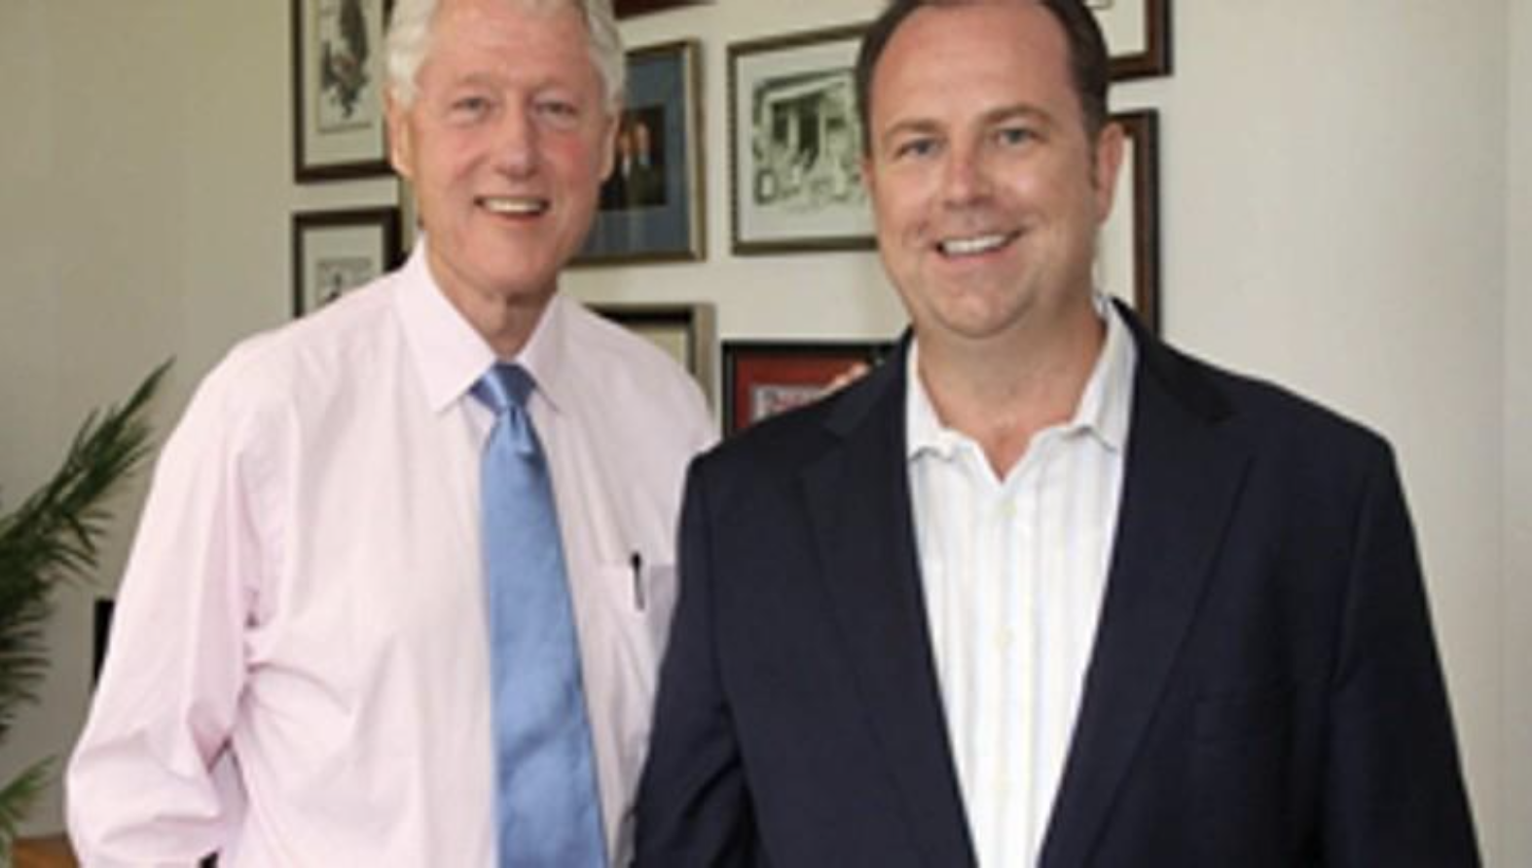
https://www.palmbeachpost.com/article/20150428/NEWS/812033930

Slide 2
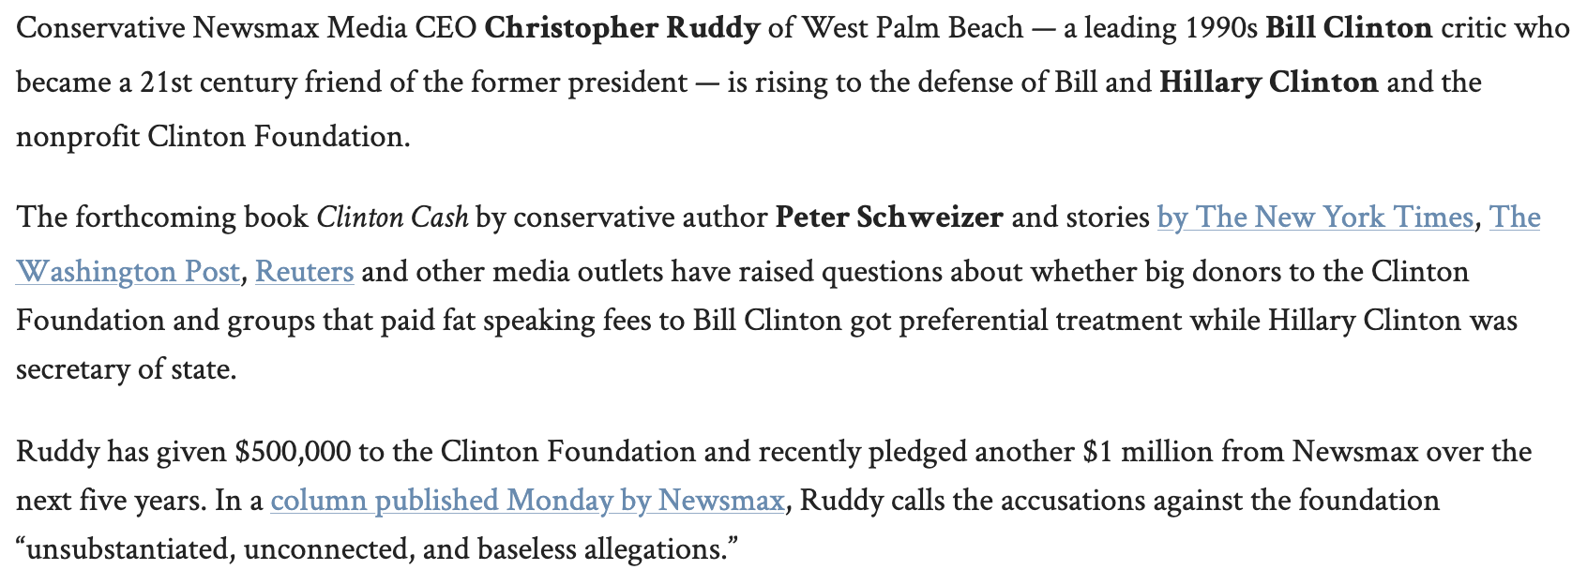
https://www.palmbeachpost.com/article/20150428/NEWS/812033930

Slide 3
https://www.palmbeachpost.com/article/20150428/NEWS/812033930

Slide 4
https://www.palmbeachpost.com/article/20150428/NEWS/812033930

Slide 5
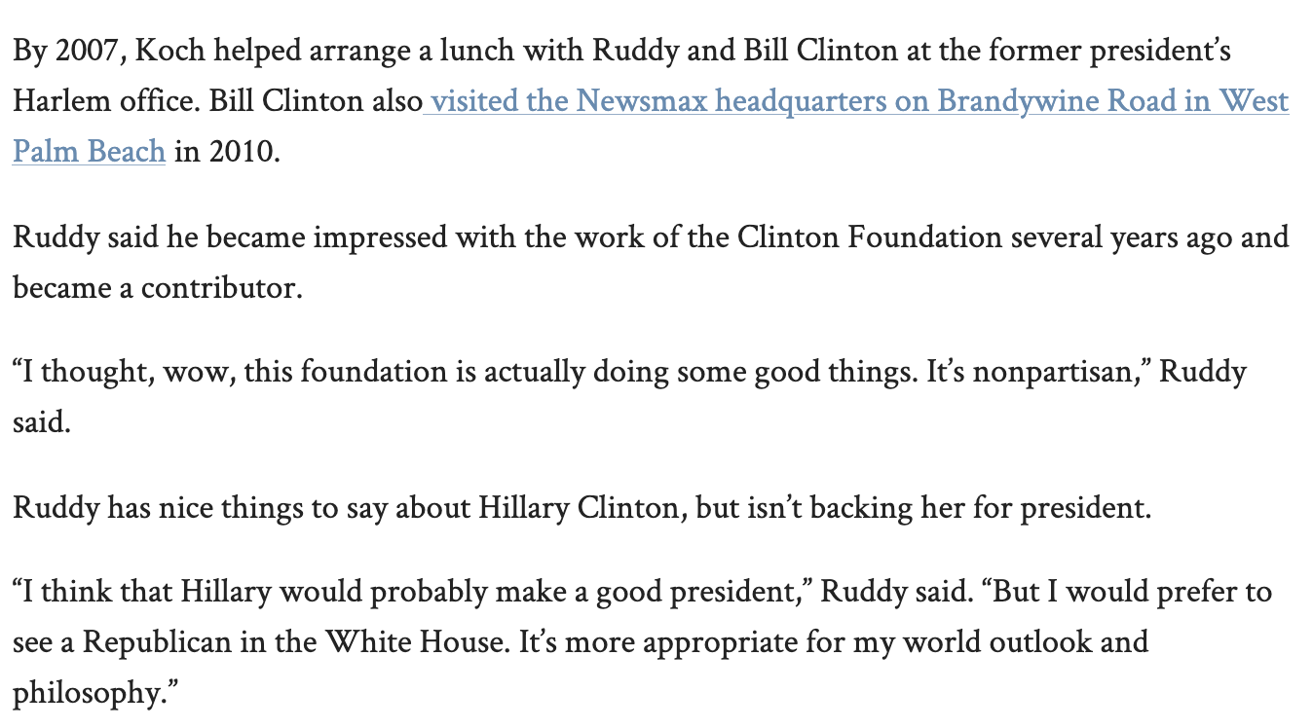
https://www.palmbeachpost.com/article/20150428/NEWS/812033930

Slide 6
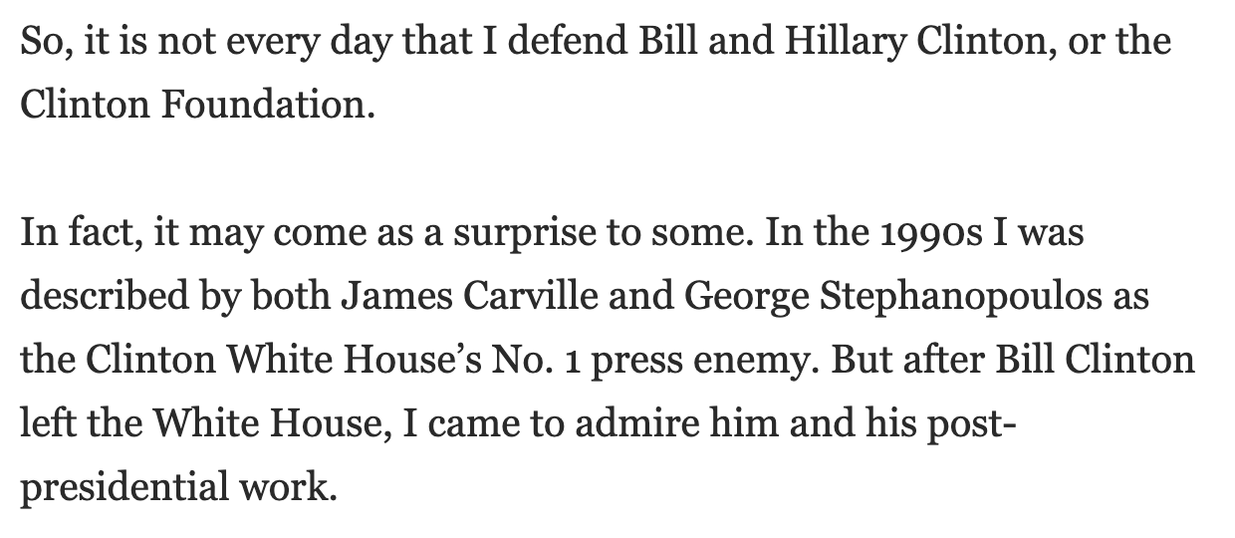
https://www.newsmax.com/Newsfront/clinton-foundation-cash-controversy/2015/04/27/id/640856/

Slide 7
https://www.newsmax.com/Newsfront/clinton-foundation-cash-controversy/2015/04/27/id/640856/

Slide 8
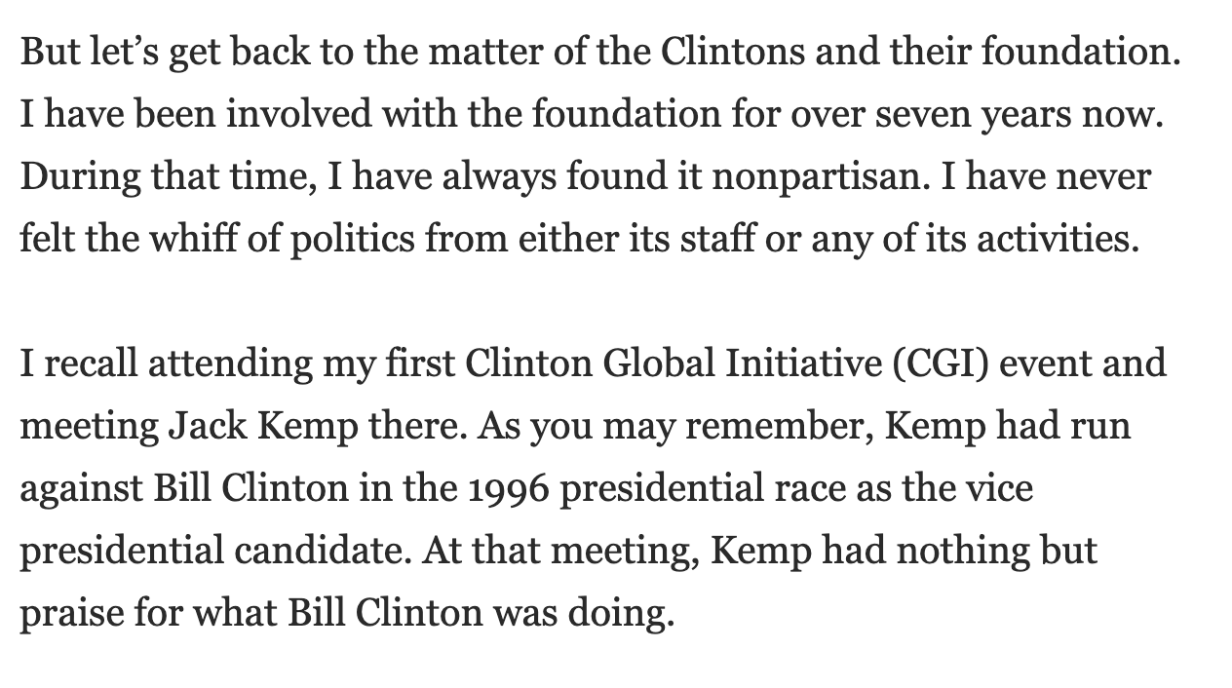
https://www.newsmax.com/Newsfront/clinton-foundation-cash-controversy/2015/04/27/id/640856/

Slide 9
https://www.newsmax.com/Newsfront/clinton-foundation-cash-controversy/2015/04/27/id/640856/

Slide 10
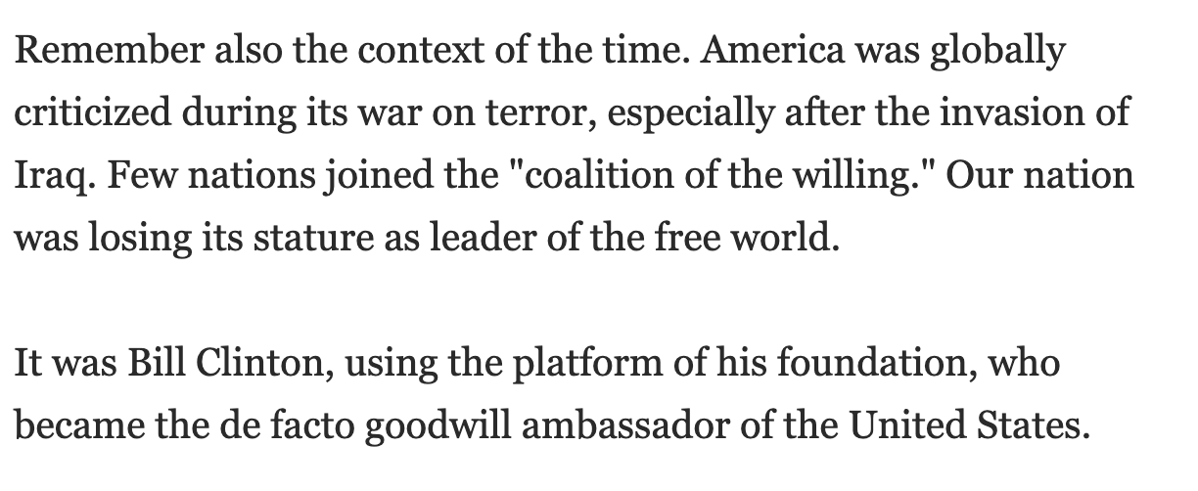
https://www.newsmax.com/Newsfront/clinton-foundation-cash-controversy/2015/04/27/id/640856/

Slide 11
https://www.eurasiareview.com/24102016-conservative-tv-networks-ceo-secretly-donated-1-million-to-clinton-oped/

Slide 12
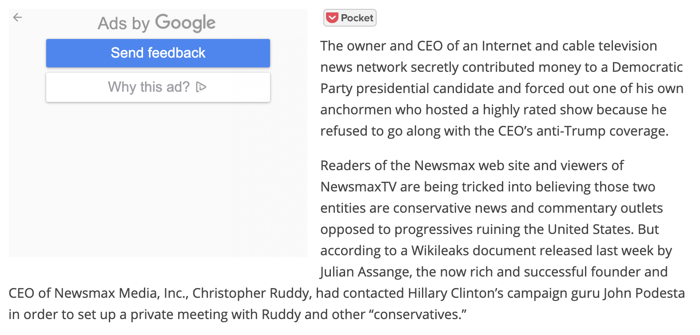
https://www.eurasiareview.com/24102016-conservative-tv-networks-ceo-secretly-donated-1-million-to-clinton-oped/

Slide 13
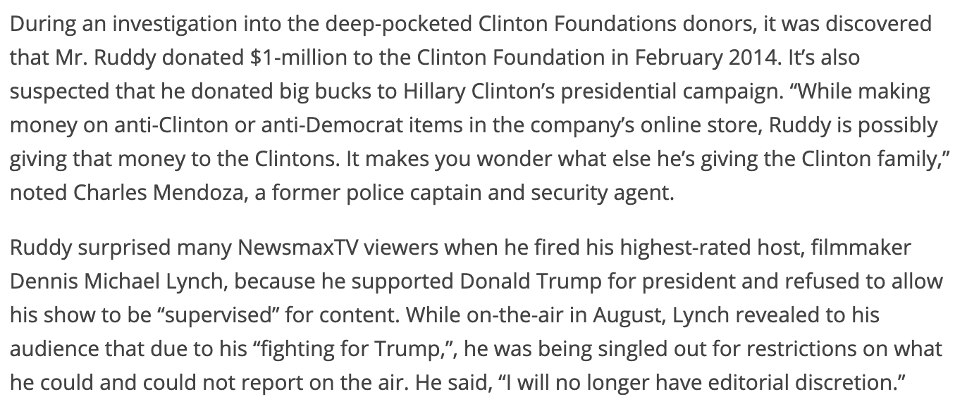
https://www.eurasiareview.com/24102016-conservative-tv-networks-ceo-secretly-donated-1-million-to-clinton-oped/

Slide 14
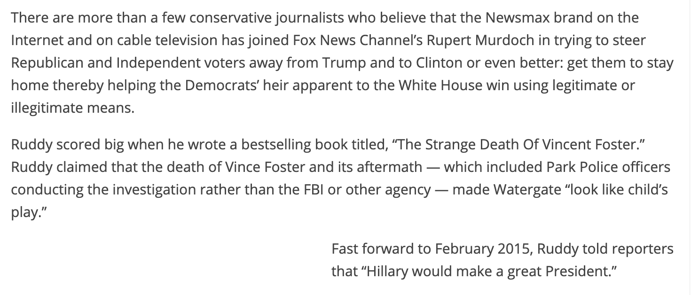
https://www.eurasiareview.com/24102016-conservative-tv-networks-ceo-secretly-donated-1-million-to-clinton-oped/

Slide 15
https://www.eurasiareview.com/24102016-conservative-tv-networks-ceo-secretly-donated-1-million-to-clinton-oped/

Slide 17
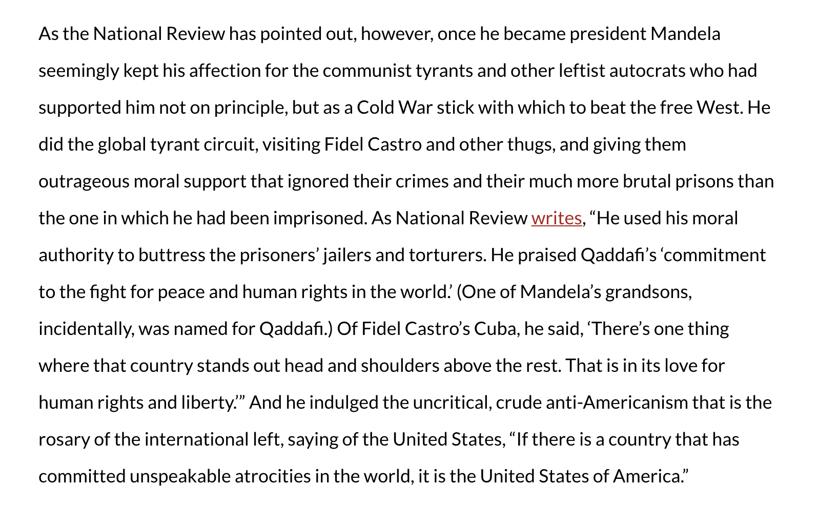
https://archives.frontpagemag.com/fpm/nelson-mandela-western-saint-bruce-thornton/

Slide 18
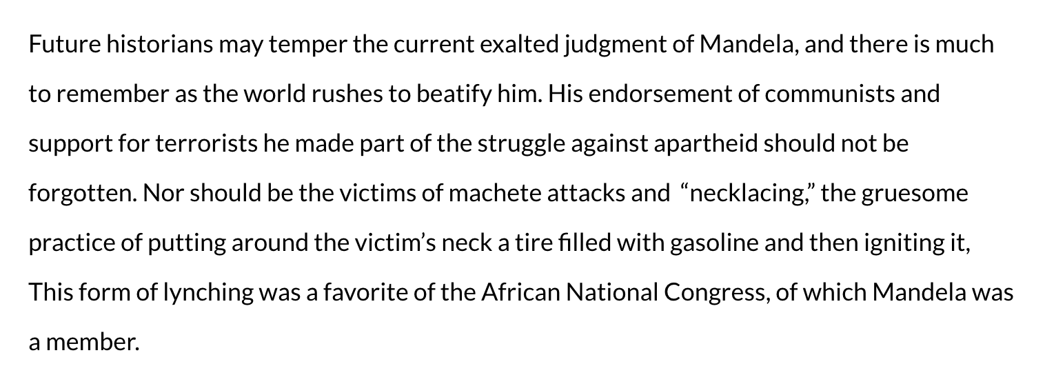
https://archives.frontpagemag.com/fpm/nelson-mandela-western-saint-bruce-thornton/

Slide 19
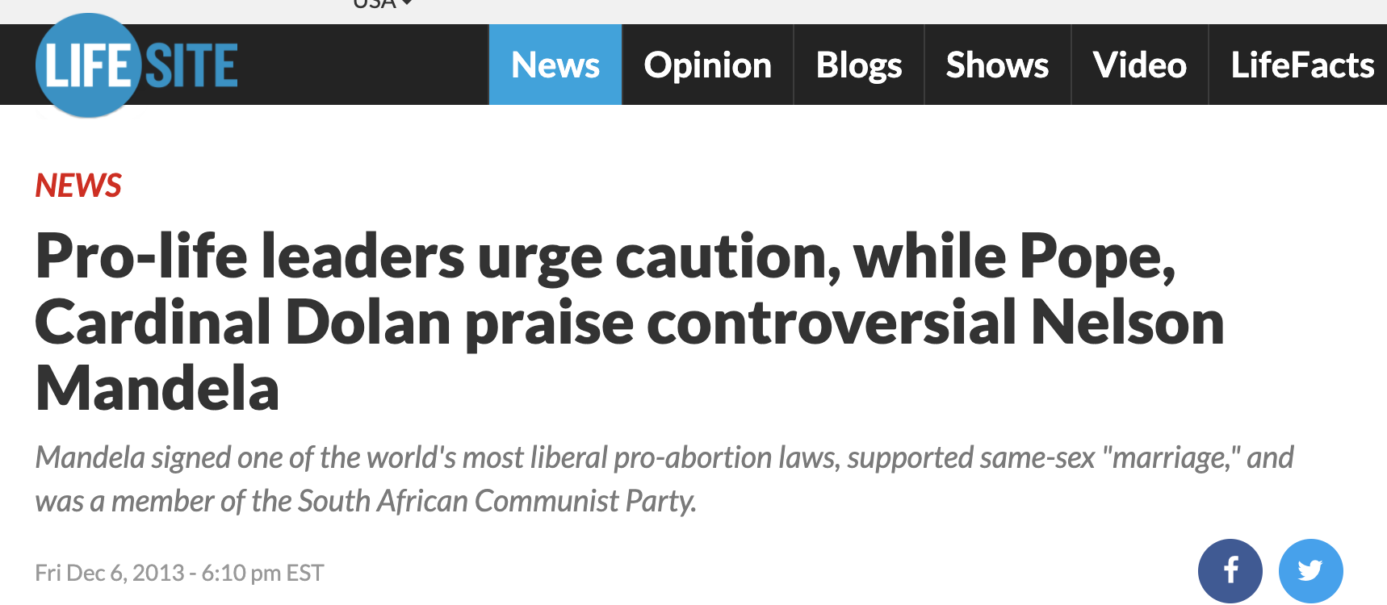
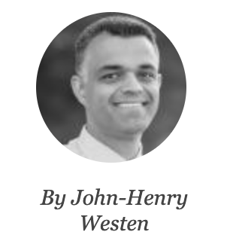
https://www.lifesitenews.com/news/pro-life-leaders-urge-caution-while-pope-and-bishops-praise-controversial-n

Slide 20
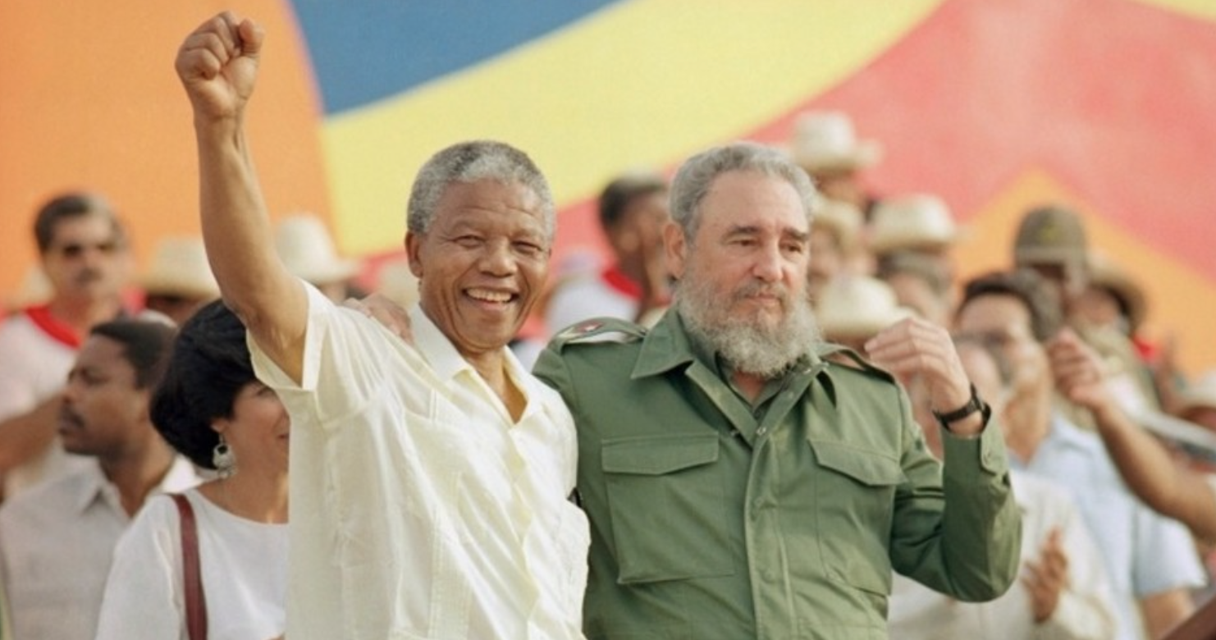
https://thenewamerican.com/south-african-communist-party-admits-mandela-s-leadership-role/

Slide 21
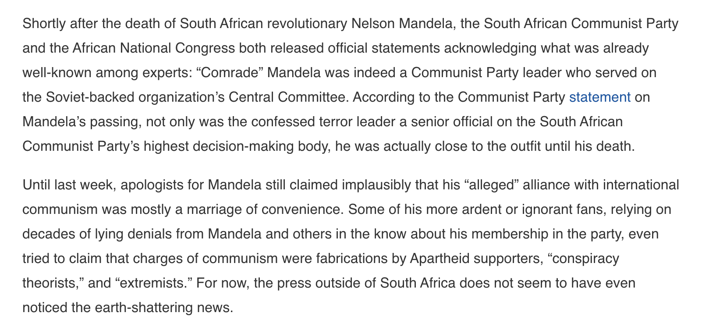
https://thenewamerican.com/south-african-communist-party-admits-mandela-s-leadership-role/

Slide 22
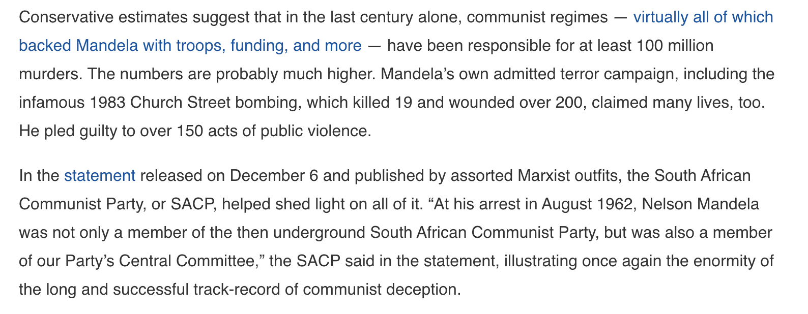
https://thenewamerican.com/south-african-communist-party-admits-mandela-s-leadership-role/

Slide 23
https://thenewamerican.com/south-african-communist-party-admits-mandela-s-leadership-role/

Slide 24
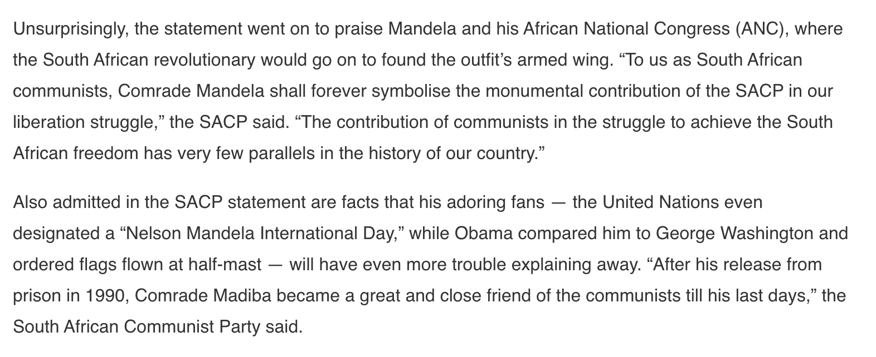
https://thenewamerican.com/south-african-communist-party-admits-mandela-s-leadership-role/

Slide 25
https://thenewamerican.com/south-african-communist-party-admits-mandela-s-leadership-role/

Slide 26
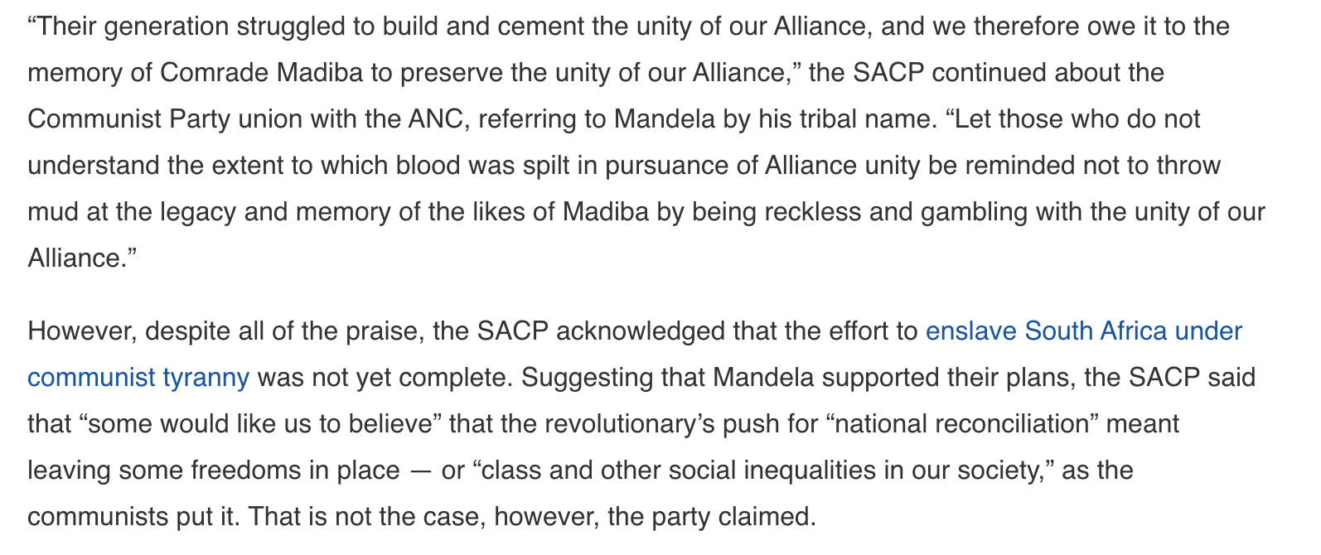
https://thenewamerican.com/south-african-communist-party-admits-mandela-s-leadership-role/

Slide 27
https://thenewamerican.com/south-african-communist-party-admits-mandela-s-leadership-role/

Slide 28
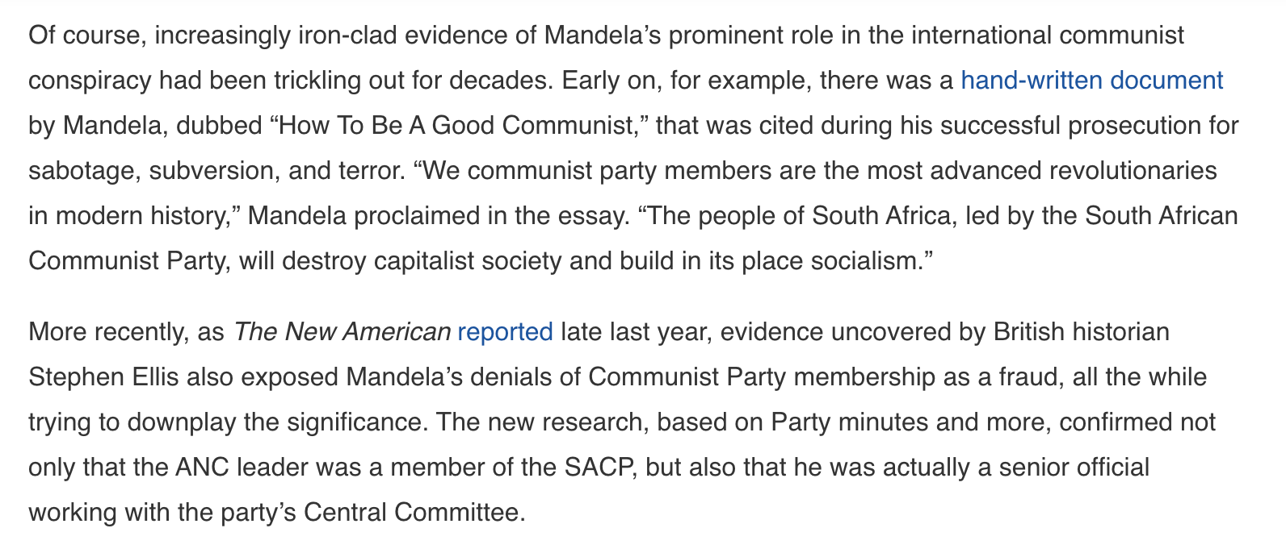
https://thenewamerican.com/south-african-communist-party-admits-mandela-s-leadership-role/

Slide 29
https://thenewamerican.com/south-african-communist-party-admits-mandela-s-leadership-role/

Slide 30
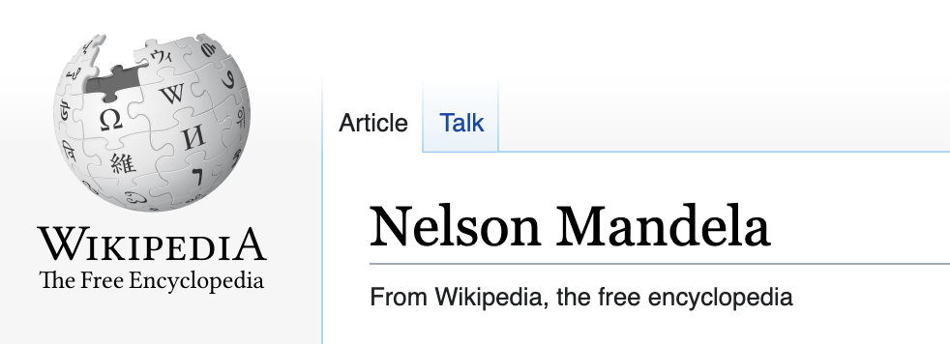
https://en.wikipedia.org/wiki/Nelson_Mandela

Slide 31
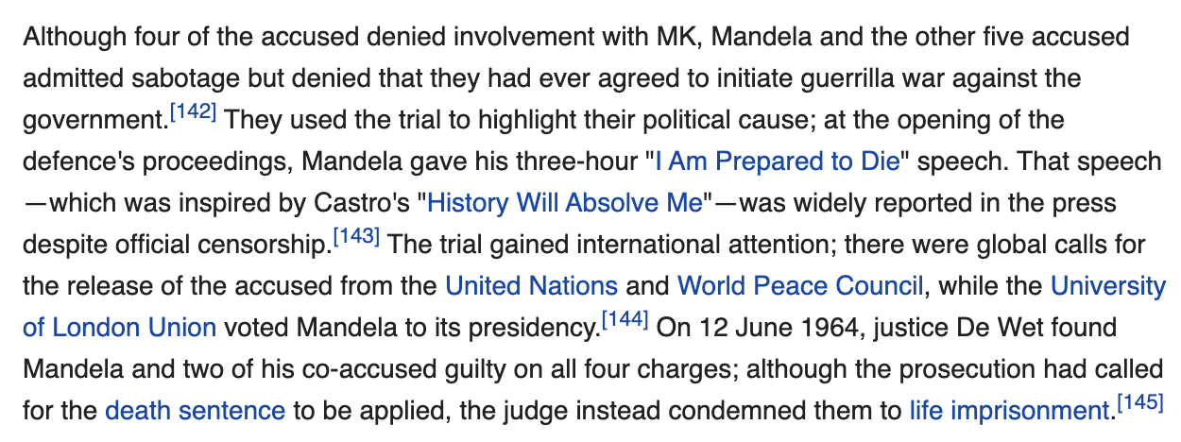
https://en.wikipedia.org/wiki/Nelson_Mandela

Slide 33
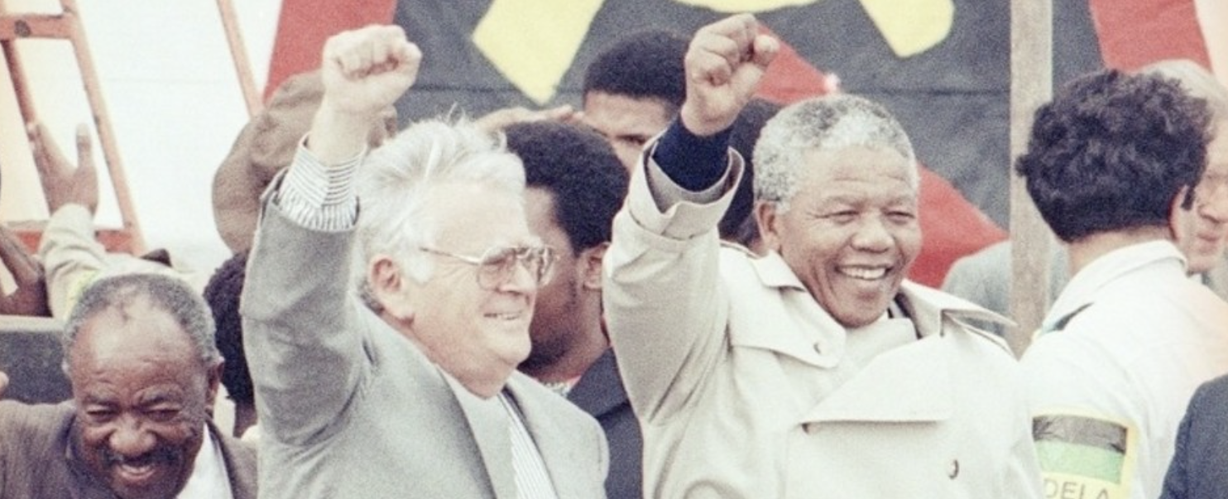
https://thenewamerican.com/new-evidence-shows-mandela-was-senior-communist-party-member/

Slide 34
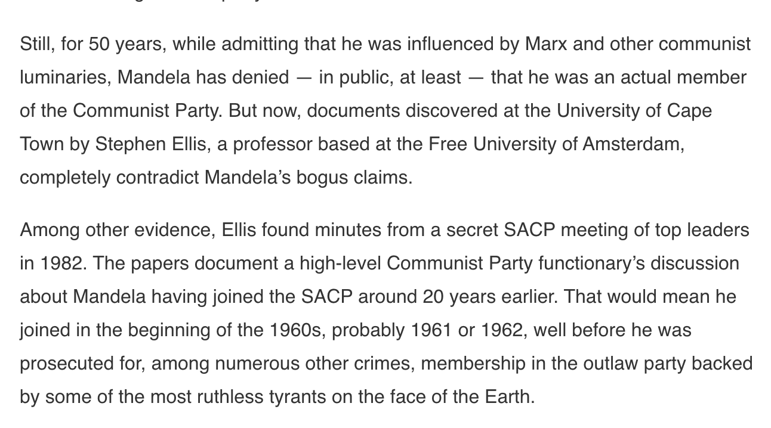
https://thenewamerican.com/new-evidence-shows-mandela-was-senior-communist-party-member/

Slide 35
https://thenewamerican.com/new-evidence-shows-mandela-was-senior-communist-party-member/

Slide 36
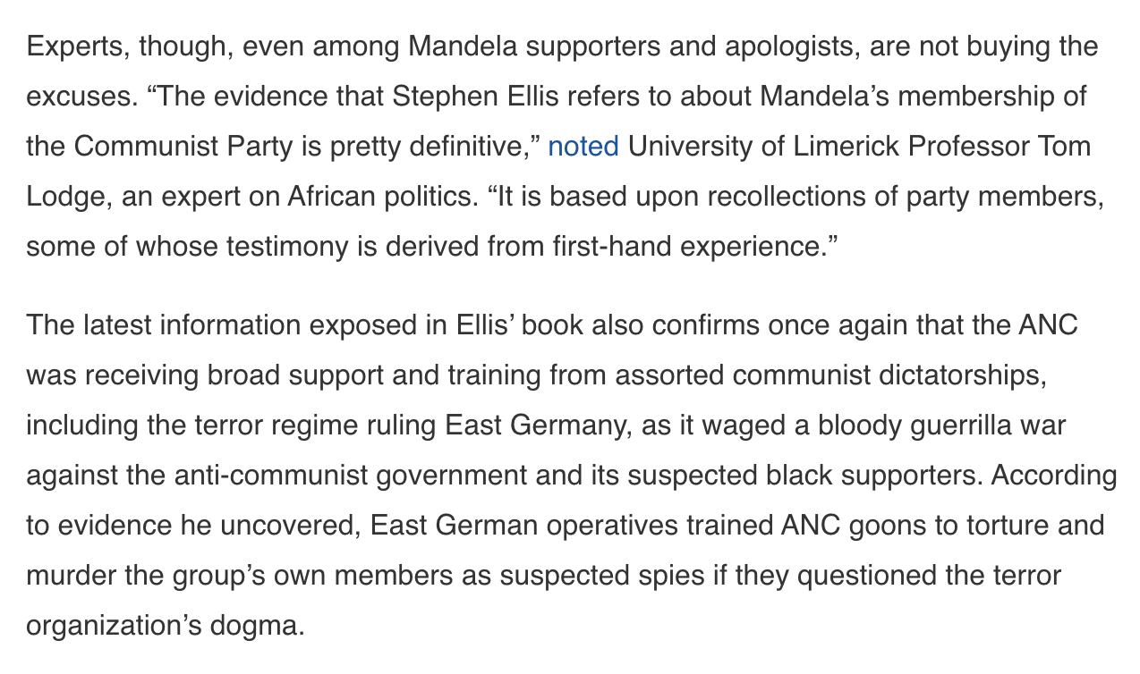
https://thenewamerican.com/new-evidence-shows-mandela-was-senior-communist-party-member/

Slide 37
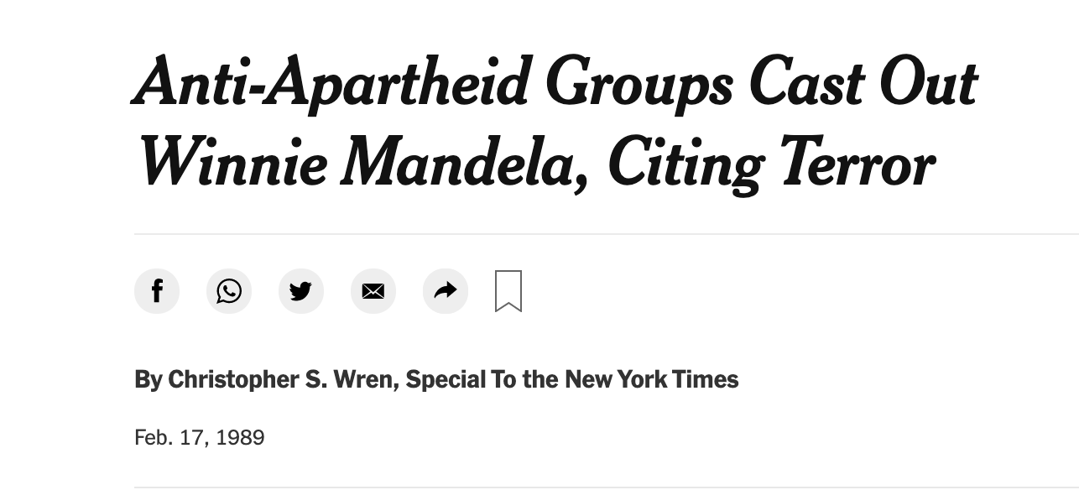

Slide 38
U.S. Has Mandela on terrorist list

Slide 40
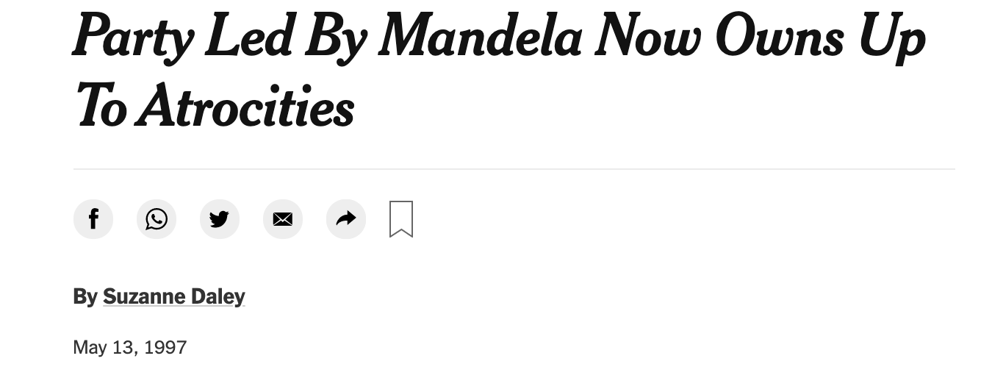

Slide 41
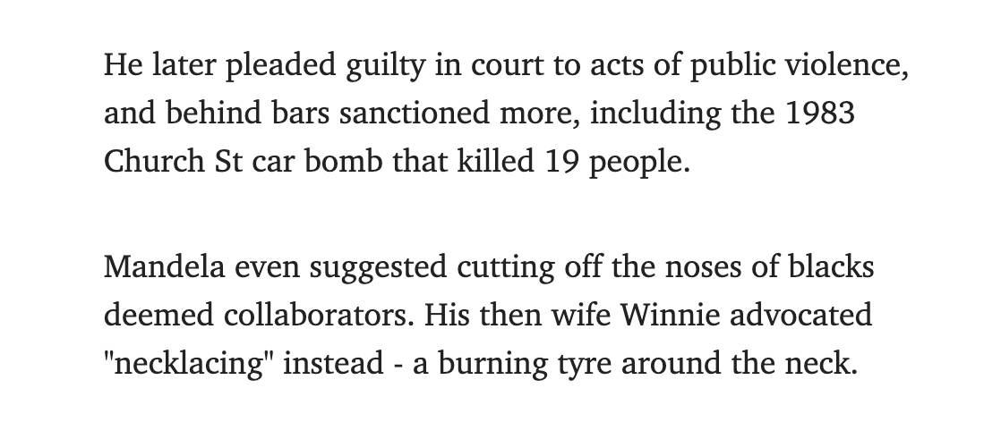
https://www.heraldsun.com.au/news/opinion/the-dark-side-of-nelson-mandela/news-story/68f4acdbf2b0b4e6c799e458a55e6cb2

Slide 42
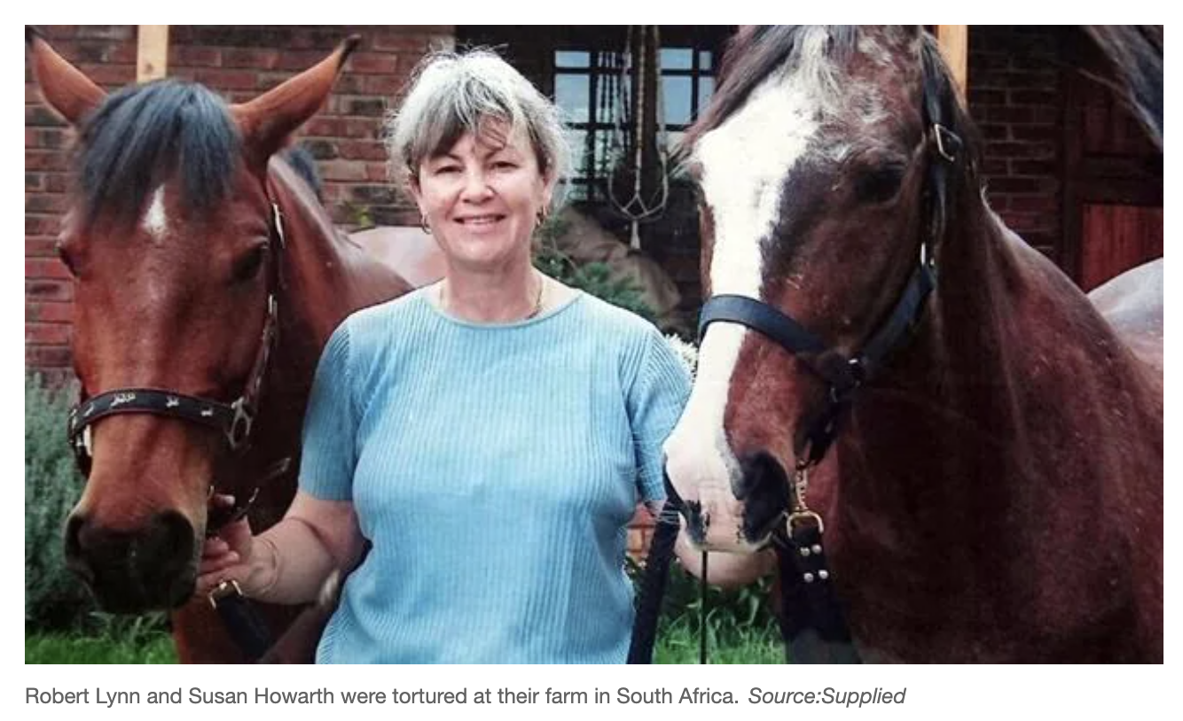
https://www.news.com.au/finance/economy/world-economy/bury-them-alive-white-south-africans-fear-for-their-future-as-horrific-farm-attacks-escalate/news-story/3a63389a1b0066b6b0b77522c06d6476

Slide 43
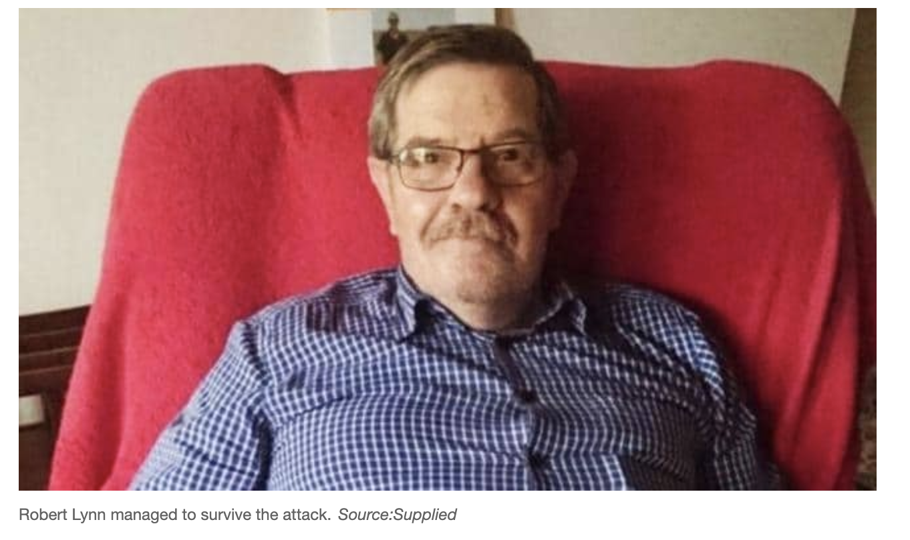
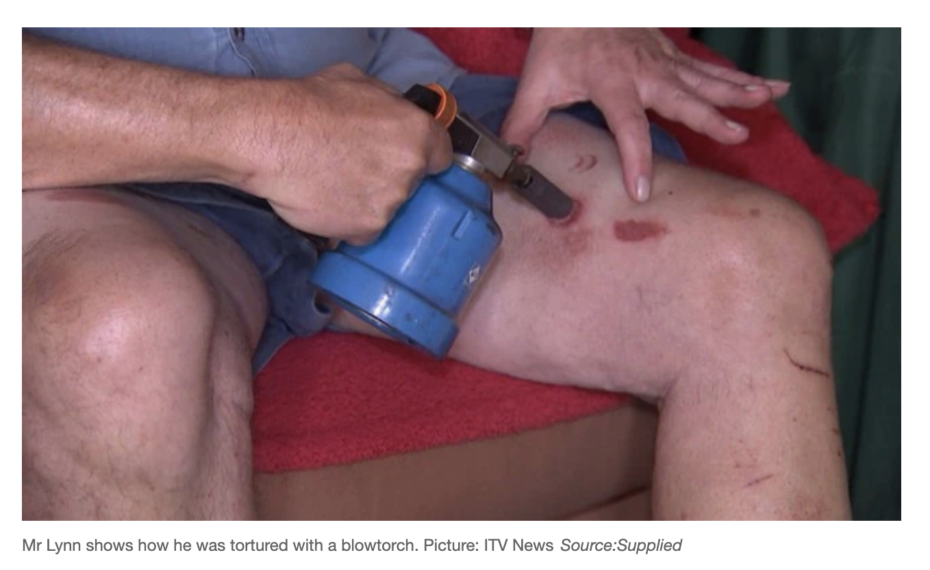
https://www.news.com.au/finance/economy/world-economy/bury-them-alive-white-south-africans-fear-for-their-future-as-horrific-farm-attacks-escalate/news-story/3a63389a1b0066b6b0b77522c06d6476

Slide 44
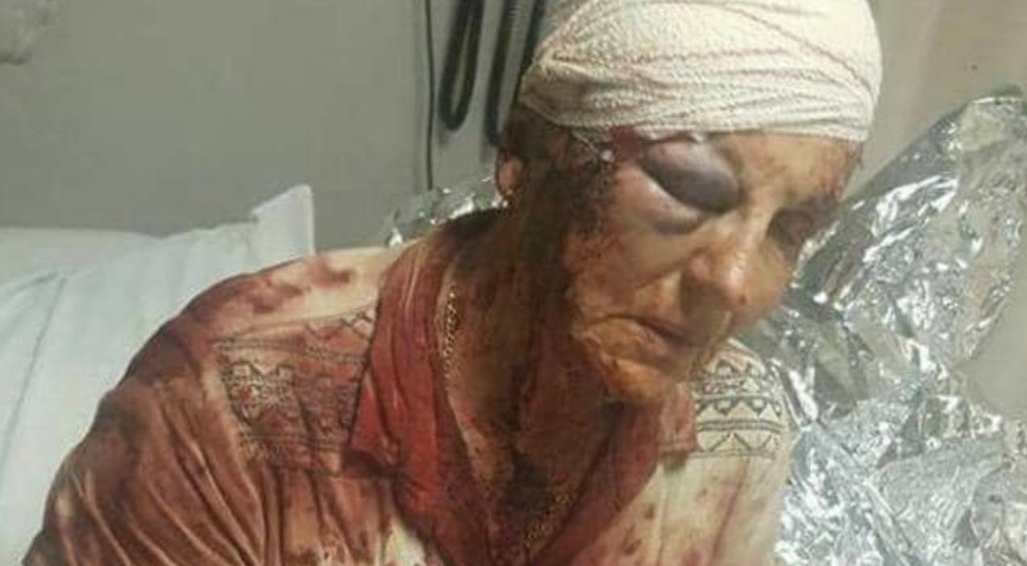
https://www.news.com.au/finance/economy/world-economy/bury-them-alive-white-south-africans-fear-for-their-future-as-horrific-farm-attacks-escalate/news-story/3a63389a1b0066b6b0b77522c06d6476

Slide 45
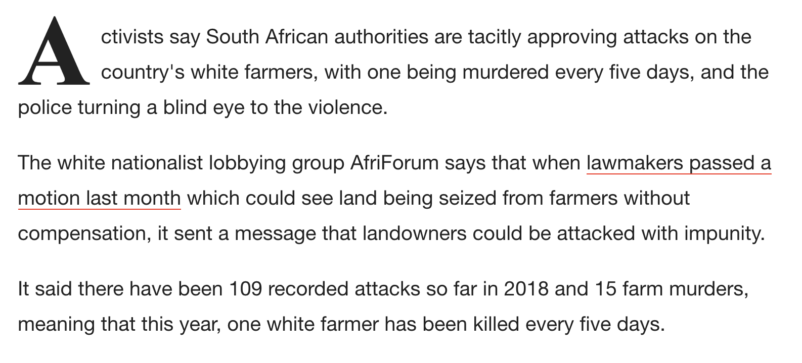
https://www.newsweek.com/white-farmer-killed-every-five-days-south-africa-authorities-do-nothing-851470

Slide 46
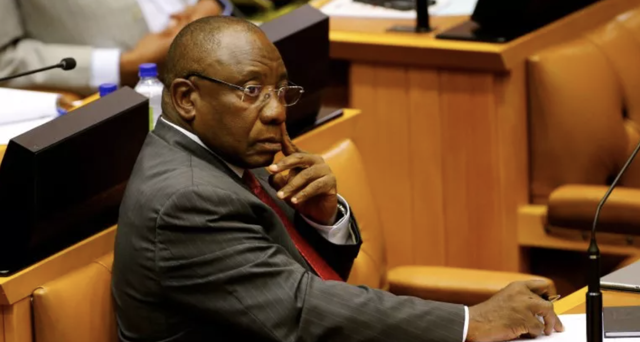
https://www.newsweek.com/white-farmer-killed-every-five-days-south-africa-authorities-do-nothing-851470

Slide 47
https://www.newsweek.com/white-farmer-killed-every-five-days-south-africa-authorities-do-nothing-851470

Slide 48
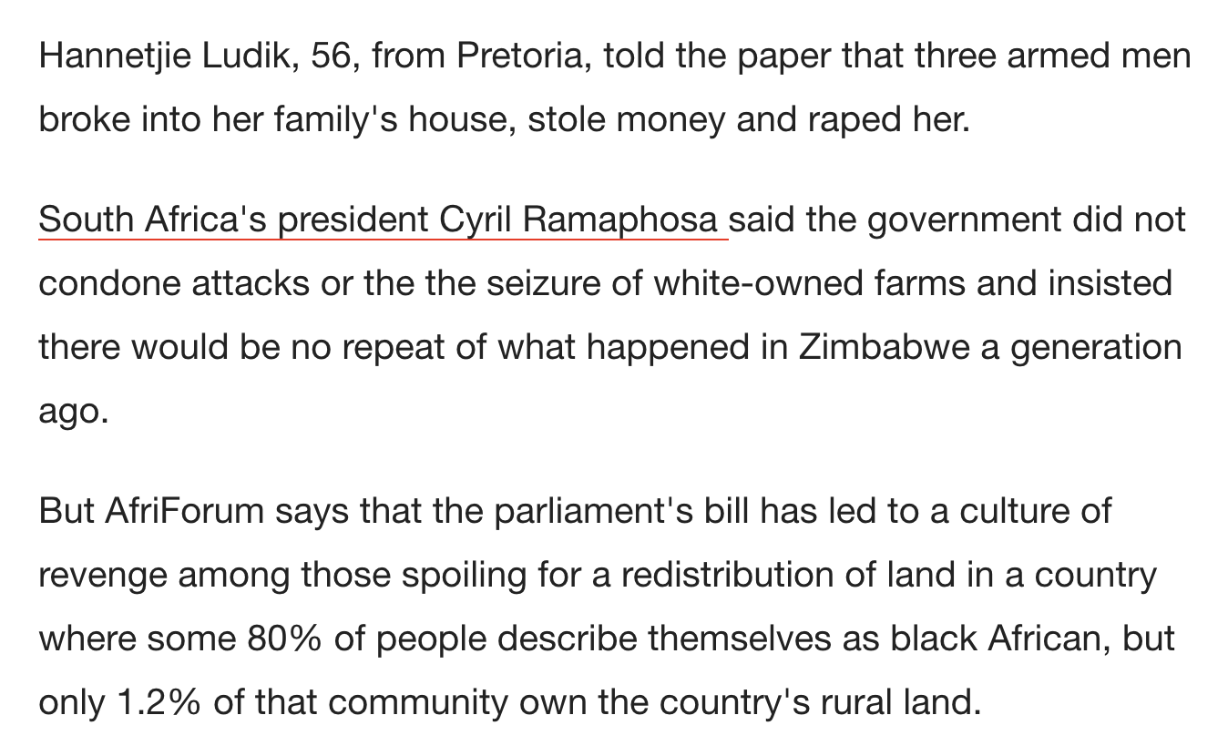
https://www.newsweek.com/white-farmer-killed-every-five-days-south-africa-authorities-do-nothing-851470

Slide 49
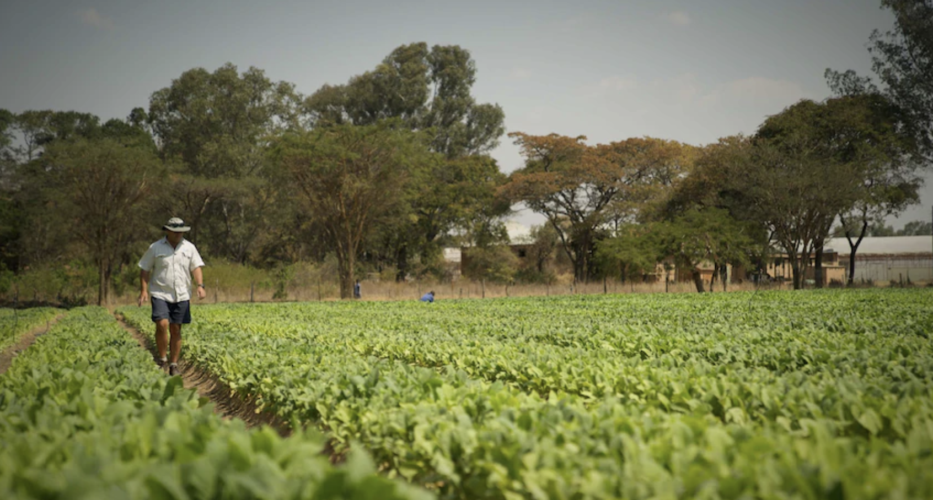
https://www.abc.net.au/news/2018-08-30/zimbabwes-white-farmers-consider-return-after-land-seizures/10176760

Slide 50
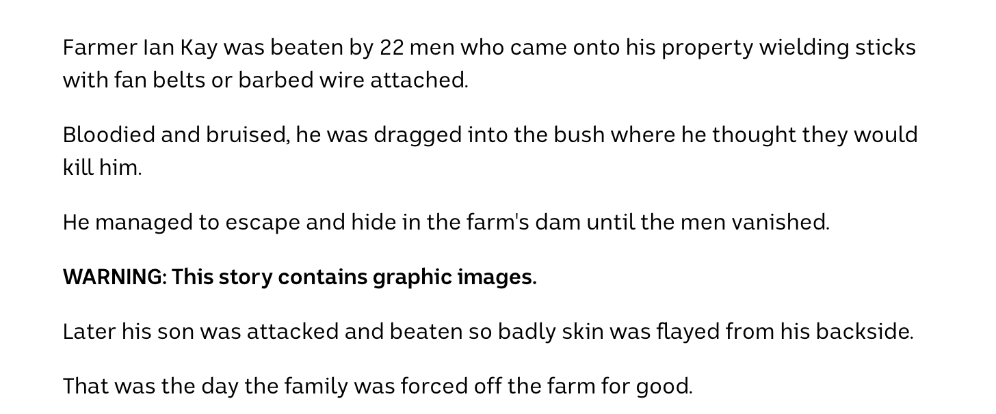
https://www.abc.net.au/news/2018-08-30/zimbabwes-white-farmers-consider-return-after-land-seizures/10176760

Slide 51
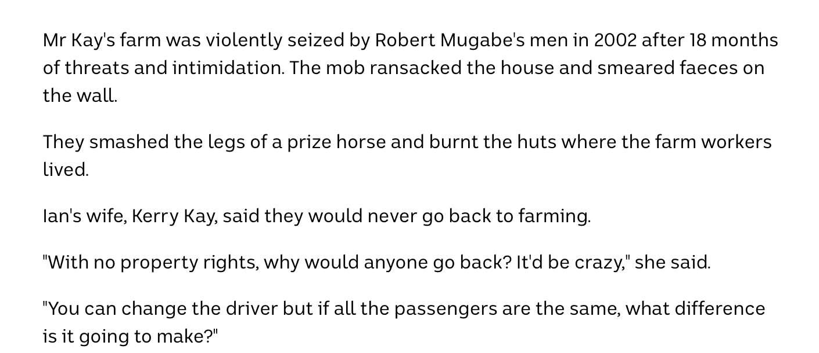
https://www.abc.net.au/news/2018-08-30/zimbabwes-white-farmers-consider-return-after-land-seizures/10176760

Slide 52
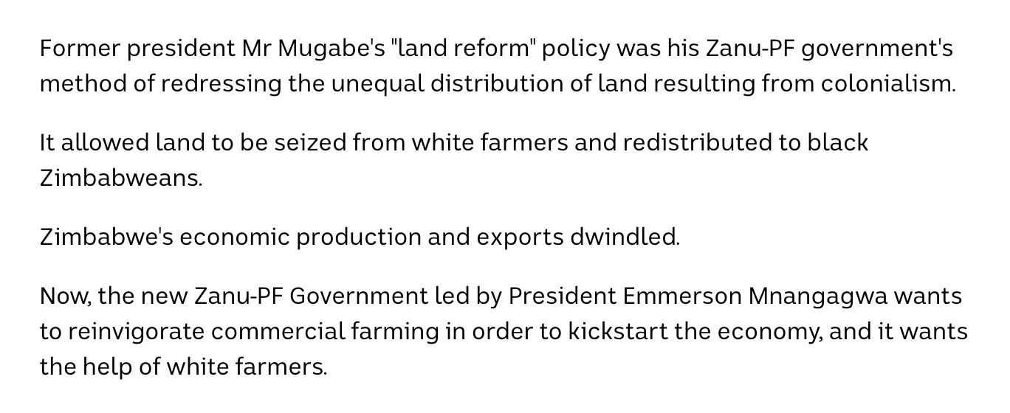
https://www.abc.net.au/news/2018-08-30/zimbabwes-white-farmers-consider-return-after-land-seizures/10176760

Slide 53
https://www.abc.net.au/news/2018-08-30/zimbabwes-white-farmers-consider-return-after-land-seizures/10176760

Slide 54
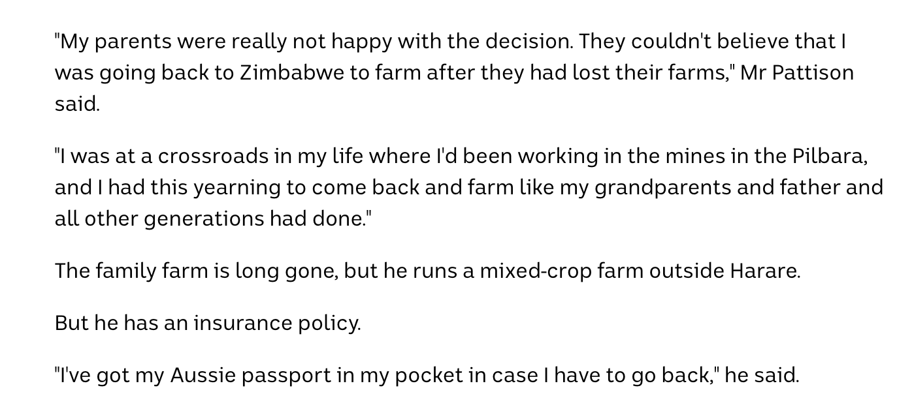
https://www.abc.net.au/news/2018-08-30/zimbabwes-white-farmers-consider-return-after-land-seizures/10176760

Slide 55
https://www.abc.net.au/news/2018-08-30/zimbabwes-white-farmers-consider-return-after-land-seizures/10176760

Slide 56
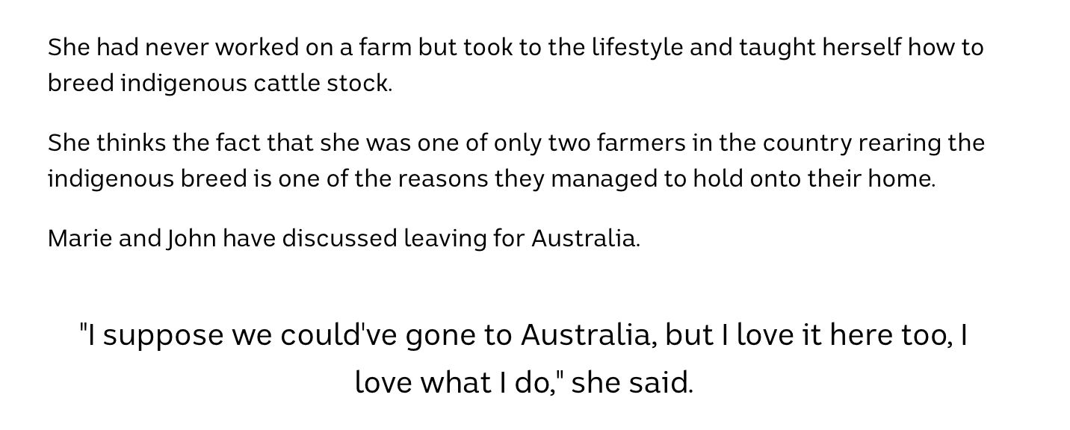
https://www.abc.net.au/news/2018-08-30/zimbabwes-white-farmers-consider-return-after-land-seizures/10176760

Slide 57
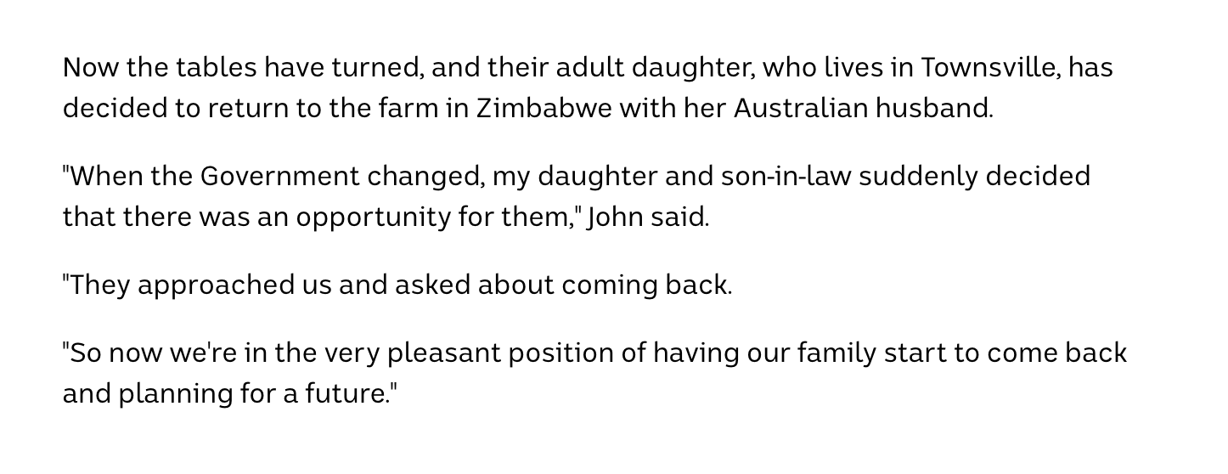
https://www.abc.net.au/news/2018-08-30/zimbabwes-white-farmers-consider-return-after-land-seizures/10176760

Slide 58
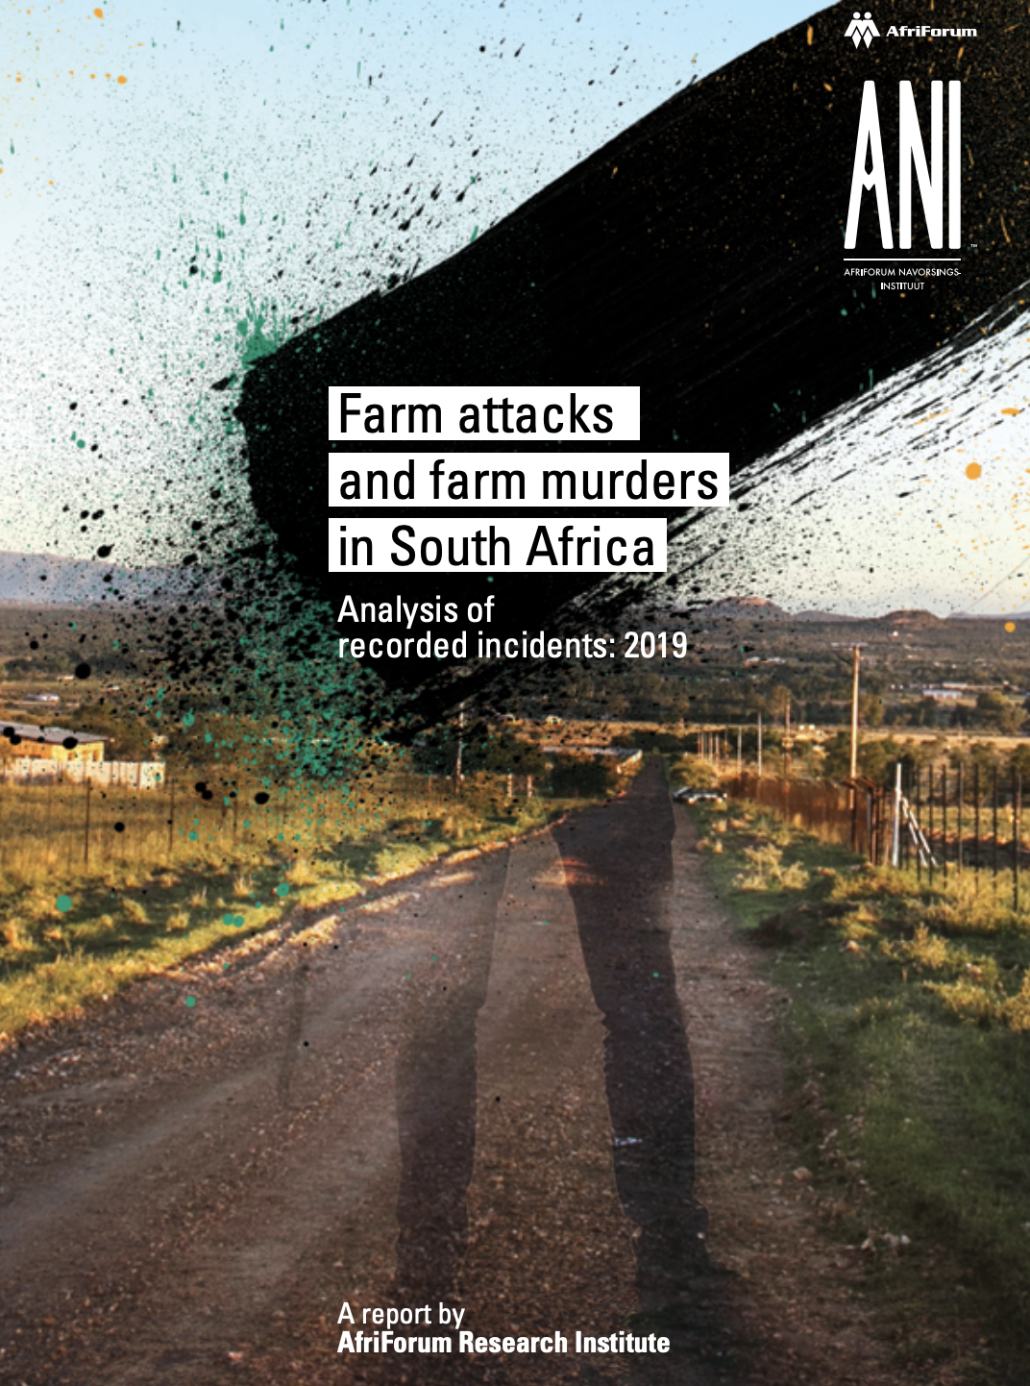
https://afriforum.co.za/wp-content/uploads/2020/07/Farm-attacks-and-farm-murders-in-South-Africa-Analysis-of-recorded-incidents-2019.pdf

Slide 59
https://afriforum.co.za/wp-content/uploads/2020/07/Farm-attacks-and-farm-murders-in-South-Africa-Analysis-of-recorded-incidents-2019.pdf

Slide 60
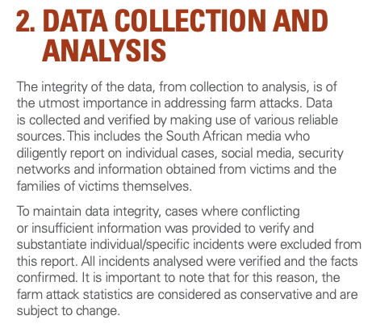
https://afriforum.co.za/wp-content/uploads/2020/07/Farm-attacks-and-farm-murders-in-South-Africa-Analysis-of-recorded-incidents-2019.pdf

Slide 61
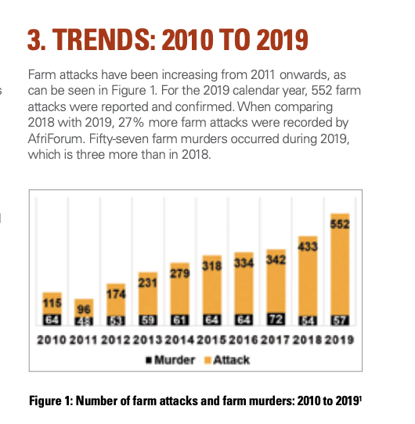
https://afriforum.co.za/wp-content/uploads/2020/07/Farm-attacks-and-farm-murders-in-South-Africa-Analysis-of-recorded-incidents-2019.pdf

Slide 62
https://afriforum.co.za/wp-content/uploads/2020/07/Farm-attacks-and-farm-murders-in-South-Africa-Analysis-of-recorded-incidents-2019.pdf

Slide 63
https://afriforum.co.za/wp-content/uploads/2020/07/Farm-attacks-and-farm-murders-in-South-Africa-Analysis-of-recorded-incidents-2019.pdf

Slide 64
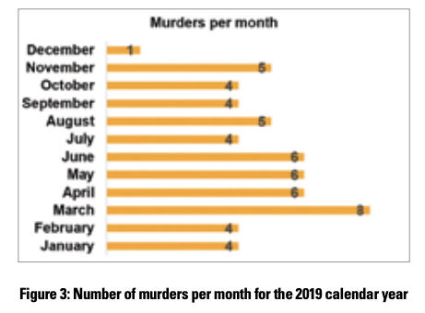
https://afriforum.co.za/wp-content/uploads/2020/07/Farm-attacks-and-farm-murders-in-South-Africa-Analysis-of-recorded-incidents-2019.pdf

Slide 65
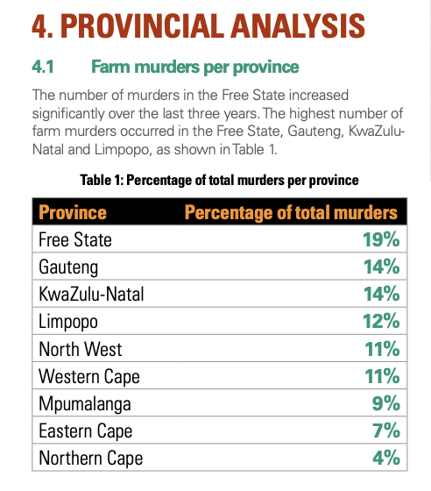
https://afriforum.co.za/wp-content/uploads/2020/07/Farm-attacks-and-farm-murders-in-South-Africa-Analysis-of-recorded-incidents-2019.pdf

Slide 66
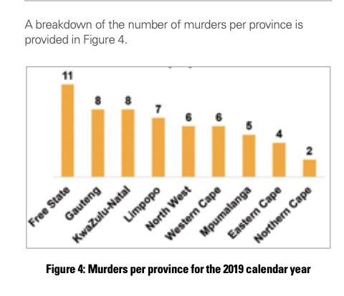
https://afriforum.co.za/wp-content/uploads/2020/07/Farm-attacks-and-farm-murders-in-South-Africa-Analysis-of-recorded-incidents-2019.pdf

Slide 67
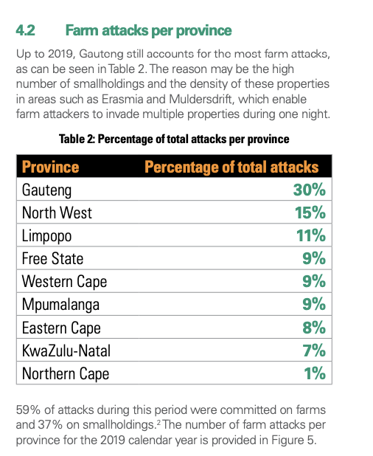
https://afriforum.co.za/wp-content/uploads/2020/07/Farm-attacks-and-farm-murders-in-South-Africa-Analysis-of-recorded-incidents-2019.pdf

Slide 68
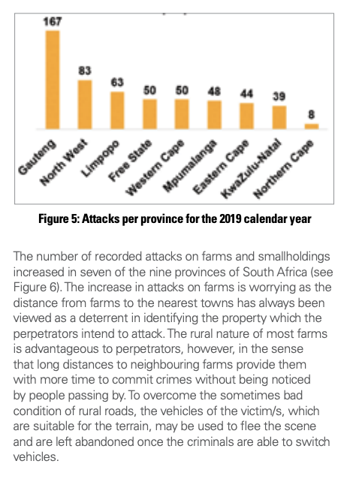
https://afriforum.co.za/wp-content/uploads/2020/07/Farm-attacks-and-farm-murders-in-South-Africa-Analysis-of-recorded-incidents-2019.pdf

Slide 69
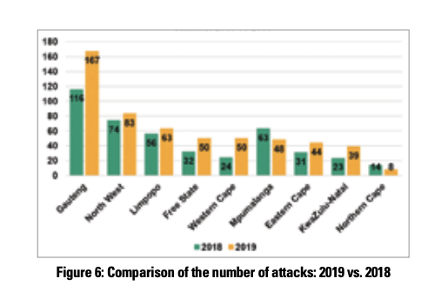
https://afriforum.co.za/wp-content/uploads/2020/07/Farm-attacks-and-farm-murders-in-South-Africa-Analysis-of-recorded-incidents-2019.pdf

Slide 70
https://afriforum.co.za/wp-content/uploads/2020/07/Farm-attacks-and-farm-murders-in-South-Africa-Analysis-of-recorded-incidents-2019.pdf

Slide 71
https://afriforum.co.za/wp-content/uploads/2020/07/Farm-attacks-and-farm-murders-in-South-Africa-Analysis-of-recorded-incidents-2019.pdf

Slide 72
https://afriforum.co.za/wp-content/uploads/2020/07/Farm-attacks-and-farm-murders-in-South-Africa-Analysis-of-recorded-incidents-2019.pdf

Slide 73
https://afriforum.co.za/wp-content/uploads/2020/07/Farm-attacks-and-farm-murders-in-South-Africa-Analysis-of-recorded-incidents-2019.pdf

Slide 74
https://afriforum.co.za/wp-content/uploads/2020/07/Farm-attacks-and-farm-murders-in-South-Africa-Analysis-of-recorded-incidents-2019.pdf

Slide 75
https://afriforum.co.za/wp-content/uploads/2020/07/Farm-attacks-and-farm-murders-in-South-Africa-Analysis-of-recorded-incidents-2019.pdf

Slide 76
https://afriforum.co.za/wp-content/uploads/2020/07/Farm-attacks-and-farm-murders-in-South-Africa-Analysis-of-recorded-incidents-2019.pdf

