Slide 1
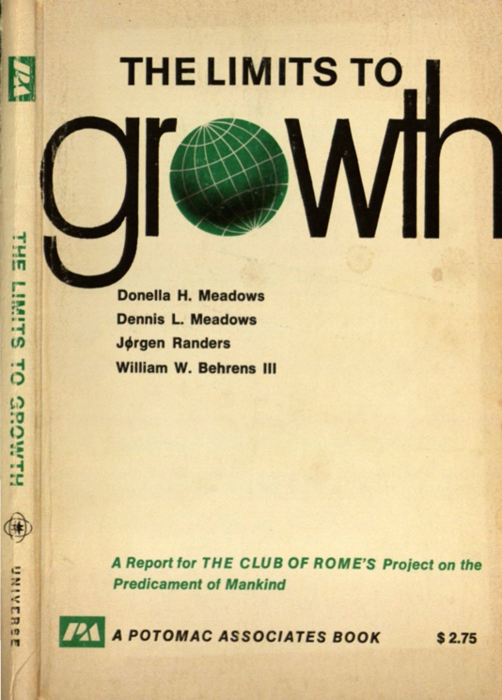
Club of Rome Published Book, 1972, Based on MIT Model

Slide 2
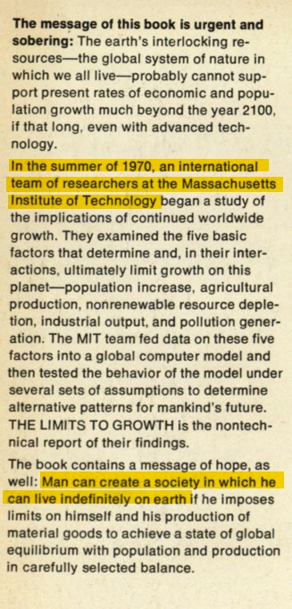
Back Cover

Slide 3
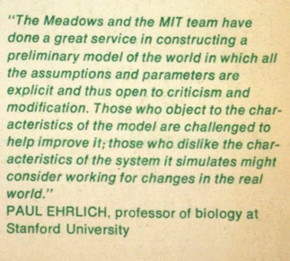
MIT & Club of Rome Published Book

Slide 4
Club of Rome Published Book, 1972, Based on MIT Model

Slide 8
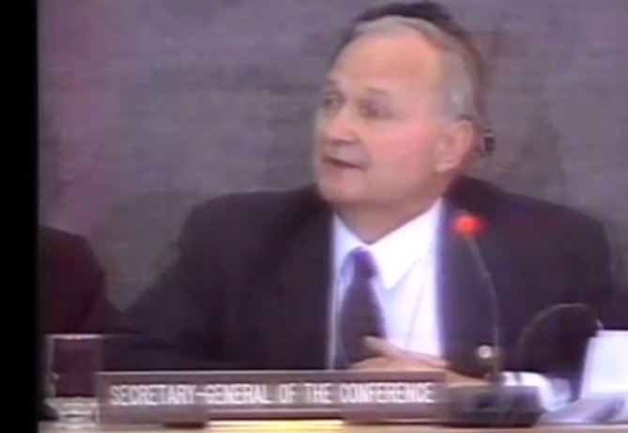
Maurice Strong
Served as director of the World Future Society, Trustee of the Rockefeller Foundation Member of The Club of Rome Secretary General of the Earth Summit in Rio in 1992

Slide 12
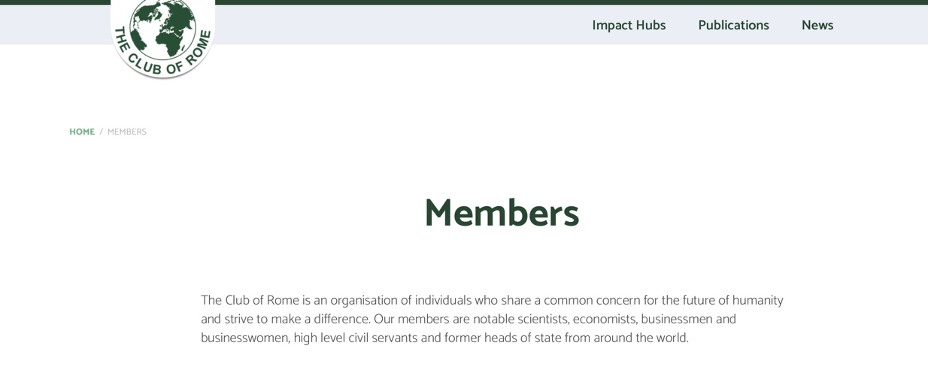

Slide 15
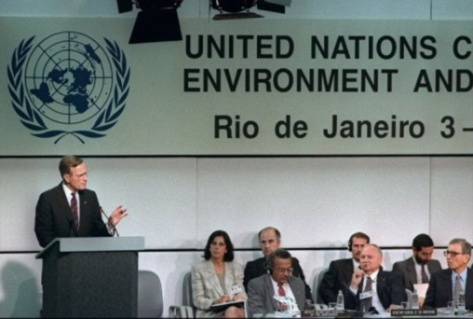
President George HW Bush news conference in Rio de Janeiro, Brazil June 13, 1992:
“We've signed a climate convention. We've asked others to join us in presenting action plans for the implementation of the climate convention…Let me be clear on one fundamental point. The United States fully intends to be the world's preeminent leader in protecting the global environment.”

Slide 16
The Aquarian Conspiracy By Marilyn Ferguson
…there are legions of conspirators…Of the Aquarian conspirators surveyed, more were involved in education than any other single category of work…A major ambition of the curriculum is autonomy. This is based on the belief that if our children are to be free, they must be free even from us—from our limiting beliefs…One veteran bureaucrat at the National Institute

Slide 17
of Mental Health said, “There are a lot of us in the woodwork.” He was referring to a loose coalition of conspirators in agencies and on Congressional staffs. Within the Department of Health, Education and Welfare, innovators have created informal rap groups to share their strategies for slipping new ideas into a resistant system and to give each other moral support. Concepts that might otherwise appear “far out” can be given legitimacy by a single federally funded program.

Slide 18
The grant-making apparatus of government determines fashion in some re-search fields. This aura of legitimacy is fostered here and there by conspirator-bureaucrats.

Slide 19
The Secret Constitution and the Need for Constitutional Change (1987) by Arthur S. Miller
…a pervasive system of thought control exists in the United States…The citizenry is indoctrinated by employment of the mass media and the system of public education…People are told what to think about…The old order is crumbling…Nationalism should be seen as a dangerous social disease…A new vision is required to plan and manage the future, a global vision that will transcend national boundaries and eliminate the poison of nationalistic “solutions.”

Slide 20
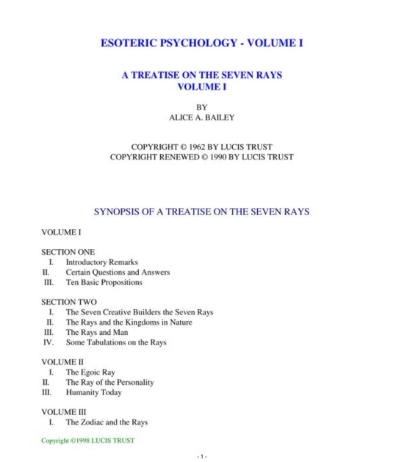

Slide 21
Alice Bailey

Slide 23
Big Business Religion/Spirituality Government

