Slide 1
Communism Under Another Name

Slide 2
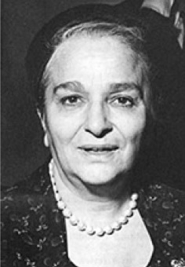
Bella Dodd:

Slide 3
Former Communist Bella Dodd:
1953 Lecture at Fordham University
There are two phases of life that communists take over. One is control over money, and two is control over words/language. They are fast taking over all the nice words, all the nice language of the Christian world, and they are taking them to themselves and giving them new connotation so that when they talk to the world they are saying one thing which is understood by their followers, but to our ears it sounds like the thing we we should be saying.

Slide 4
Former Communist Bella Dodd
Testimony to Committee on Un-American Activities, Philadelphia, PA, November 16, 1953:
I was told by Gil Green, chairman of the party in New York State, that if ever communism came to America it would not come under the Socialist label or the Communist label but it would come under a label palatable to the American people.

Slide 5
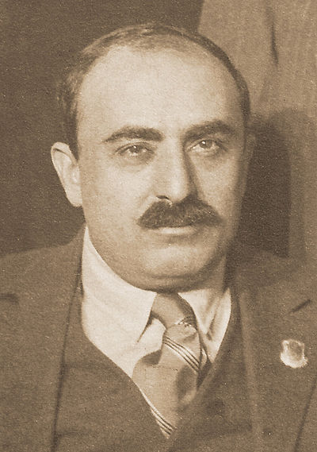
Alexander Trachtenberg at the National Convention of
Communist Parties,
Madison Square Garden, 1944
When we get ready to take the United States, we will not take it under the labels of Communism we will not take it under the label of Socialism. These labels are unpleasant to the American people, and have been speared too much. We will take the United States under labels we have made very lovable; we will take it under Liberalism, under Progressivism, under Democracy. But take it we will.

Slide 6
Former KGB Officer Yuri Bezmenov
1984 Interview with G. Edward Griffin:
The main emphasis of the KGB is not in the area of intelligence at all…only about 15% of time, money, and manpower is spent on espionage as such. The other 85% is a slow process, which we call either ideological subversion…What it basically means is that to change the perception of reality of every American, to such as extent, that despite the abundance of information, no one is able to come to sensible conclusions.

Slide 7
Former KGB Officer Yuri Bezmenov
1984 Interview with G. Edward Griffin:
A person who was demoralized, is unable to assess true information. The facts tell nothing to him. Even if I shower him with information with the authentic proof, with documents, with pictures, even if I take him to the Soviet Union and show him concentration camp, he will refuse to believe it, until he is going to receive a kick in his fat bottom.

Slide 8
Former Communist Bella Dodd
Testimony to Committee on Un-American Activities, Philadelphia, PA, November 16, 1953:
In New York State, we used them in the American Labor Party, and in the Progressive Party. There have been places where we sent them into the Democratic Party or the Republican Party to operate as Republicans and Democrats, you know, but to operate as Communists within their organizations.

Slide 9
Former Communist Bella Dodd:
1953 Lecture at Fordham University
We had men and women who were members of the State Legislature, over 100 men and women who were members of state legislature from Washington to New York. They were not elected on the Communist Party ticket, they were elected on the Republican ticket on the Democratic ticket, the Farmer Labor Party ticket, Labor Party ticket.

Slide 10
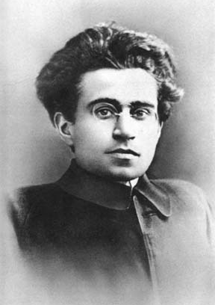
Antoni Gramsci
On of the Founders of the
Communist Party in Italy
Socialism is precisely the religion that must overwhelm Christianity . . . In the new order, Socialism will triumph by first capturing the culture via infiltration of schools, universities, churches and the media by transforming the consciousness of society. —

Slide 11
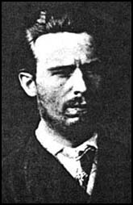
Sergey Nechayev
1847-1882
Communist Revolutionary
That Influenced Vladimir Lenin
Night and day he must have but one thought, one aim—merciless destruction…The revolutionary enters the world of the State, of the privileged classes, of the so-called civilization and he lives in this world only for the purpose of bringing about its speedy and total destruction. He is not a revolutionary if he has any sympathy for this world. He should not hesitate to destroy any position, any place, or any man in this world. He must hate everyone and everything in it with an equal hatred.

Slide 12
Former Communist Bella Dodd
Testimony to Committee on Un-American Activities,
Columbus, Ohio, June 17 & 18, 1953:
The Communist conspiracy provides for the infiltration of every phase and field of American life. Communists objectives are to create strife between labor and management and within the labor group itself, to cause people to be suspicious and distrustful of the Government and the law enforcement agencies thereof,

Slide 13
Former Communist Bella Dodd
Testimony to Committee on Un-American Activities,
Columbus, Ohio, June 17 & 18, 1953:
to make them dissatisfied with the American way of life, particularly its economic system, to create doubts concerning their religious teachings, to set class against class, minorities against minorities, and even minorities against minorities when it suits their purpose.

Slide 14
Cognitive Dissonance

Slide 15
Psychology Dictionary:
A state of conflict occurring when beliefs or assumptions are contradicted by new information.

Slide 16
From Siege The DocuMovie
At Siegethemovie.com
The theory of cognitive dissonance, in part, is that if you can convince someone to change their behavior through uncomfortable peer pressure and the change in their behavior is rewarded with a positive outcome then they are more likely to change their values to match their change in behavior. Once you change their values and behavior you have effectively changed their very worldview.

Slide 17
From Siege The DocuMovie
At Siegethemovie.com
The converse is also true. If you apply punitive consequences on the wrong behavior then the negative outcome makes it more likely they change their values to justify their change in behavior.

Slide 18
From Siege The DocuMovie
At Siegethemovie.com
The negative consequences of stress, anxiety, alienation, peer pressure, and marginalization is used to convince the subject to change their politically incorrect values. Thus to reconcile their compromise they convince themselves that the behavior they once opposed is not so bad after all.

Slide 19
Saul Alinksy Declared,
“Ridicule is man's most potent weapon. It's hard to counterattack ridicule.”

Slide 20
Cognitive Dissonance
Conflict
Stress
Anxiety
Fear
Isolation
Surrender
Behavior Modification

Slide 21
Edgar Bundy
Collectivism in the Church Wrote:
Because “mental health” has become available as a lever to be used for promoting political and ideological designs, a word on the subject is in order…People who are normal in every sense of the word but who hold unpopular political ideas, such as opposition to world government and to the United Nations, Federal aid to education, and socialism,

Slide 22
Edgar Bundy
Collectivism in the Church Wrote:
are now being branded by their political opponents as “lunatics,” “nuts” and “idiots.” Some of the mental health legislation which has recently been introduced on state and Federal levels gives such wide latitude and interpretations to psychiatrists and politicians…that it is conceivable that anyone who takes a stand for the sovereignty of the United States, in favor of Congressional investigations…and in favor of states’ rights could be committed to an asylum in order to silence opposition.

Slide 23

Alice Bailey, The Rays and the Initiations:
“This coming age will be as predominantly the age of group interplay, group idealism and group consciousness…for the will of the individual will voluntarily be blended into group will.”

Slide 24

Author Edgar Bundy explains in
Collectivism in the Churches that:
...we have seen how Dr. Walter Rauschenbusch...
and the leaders of the social-action movements in the churches decided to do away with Christian individualism and turn
to outright collectivism, using the church as their instrument....

Slide 25
Religion was only a means toward achieving socialism. And, like all other false prophets
who have infiltrated religion through the centuries, [Rauschenbusch] used a “front” or disguise.
This disguise, as we have seen,
was “'The Kingdom of God.”

Slide 26
The Kingdom was not pictured as a spiritual society
into which men and women had to be born as individuals through a personal relationship with Jesus Christ as Savior, but as a collectivist society which would be brought about by... eradication of poverty, redistribution of wealth...
and “economic justice.”

Slide 27
John D. Rockefeller:
“Would that I had the power to bring to your minds
the vision as it unfolds before me!
I see all denominational emphasis set aside…
I see the church molding the thought of the world
as it has never done before, leading in all great movements as it should. I see it literally
establishing the Kingdom of God on earth.”

