Slide 1
Eight Dangers of Neo-Marxist Discourse

Slide 2
Former Communist Bella Dodd: 1953 Lecture at Fordham University
There are two phases of life that communists take over. One is control over money, and two is control over words/language. They are fast taking over all the nice words, all the nice language of the Christian world, and they are taking them to themselves and giving them new connotation so that when they talk to the world they are saying one thing which is understood by their followers, but to our ears it sounds like the thing we we should be saying.

Slide 3
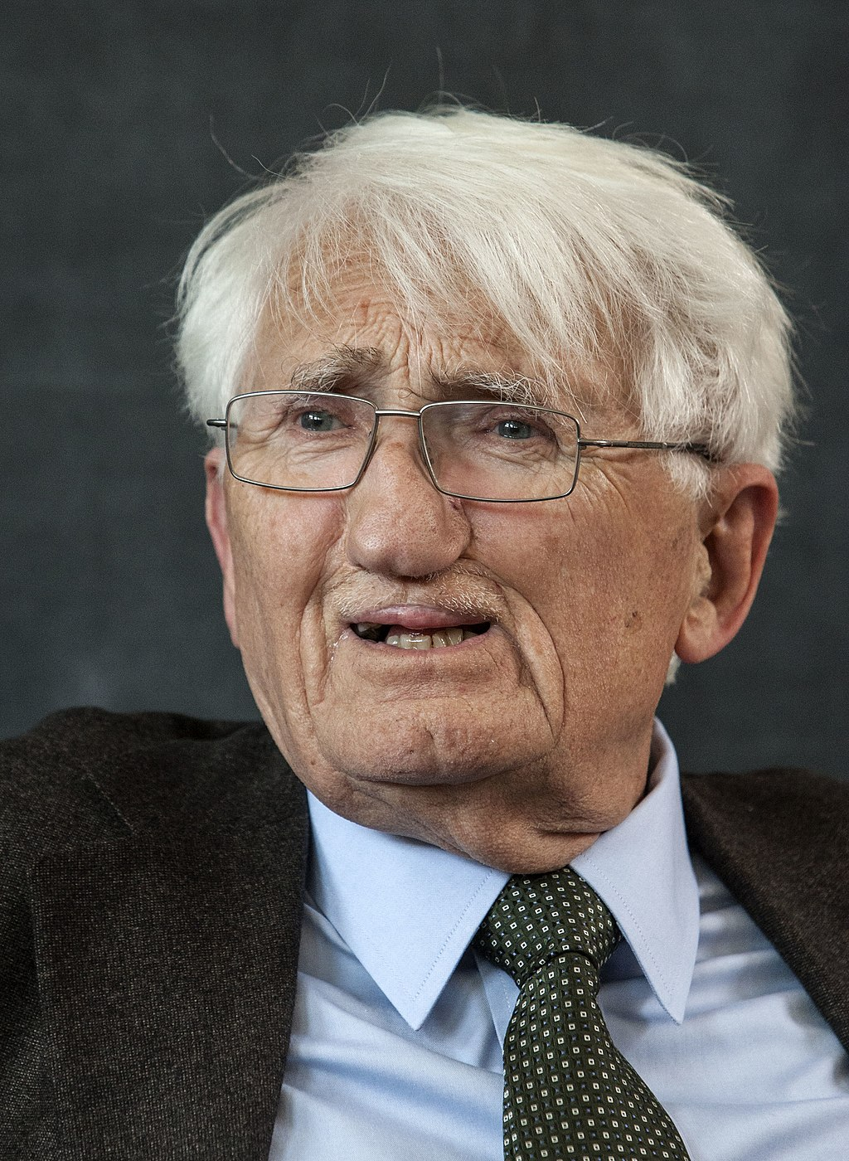
Jurgen Habermas

Slide 4
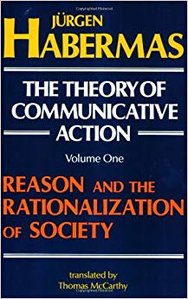

Slide 5
Polish Writer
Krzysztof Karon Warns of the Dangers of Discourse Theory

Slide 6
In a 2016 Speech found on Youtube, Krzysztof Karon warns of the dangers of discourse set up by the cultural marxists:
When we translate into normal language, it means that the truth is that what - during the discourse - is being presented as the truth and accepted as truth by all its participants. Because the condition for truth is the consensus. As it is easy to guess, the reference point for the argumentation supporting different positions cannot really be reality. It’s the power of persuasion that becomes the reference point.

Slide 7
In a 2016 Speech found on Youtube, Krzysztof Karon warns of the dangers of discourse set up by the cultural marxists:
Consensus in the understanding of Discourse Theory does not mean the agreement of all the parties with the elaborated position, but the abandonment of the previous position and the acceptance of the common position as one’s own. Consensus doesn’t so much mean acceptance as affirmation of the elaborated negotiating position. The prerequisite of the very adherence to the discourse is the renunciation of conviction about the objective legitimacy of one’s own position.

Slide 8
In a 2016 Speech found on Youtube, Krzysztof Karon warns of the dangers of discourse set up by the cultural marxists:
I’ll stubbornly reiterate: If anyone uses the notion of ‘discourse’ instead of ‘discussion’ or agrees to participate in a discourse and not a discussion, then he should realize that he is waiving the right to have precise convictions, or to buttress himself with the knowledge of reality as an argument justifying those convictions.

Slide 9
Surrendering to Discourse Means:
1. You accept the Neo-Marxist premise that your position is not fully truthful or acceptable.

Slide 10
Surrendering to Discourse Means:
2.You reject your convictions and you accept the cultural Marxist premise that absolute truth for all times, places and people does not exist.

Slide 11
Surrendering to Discourse Means:
3. You accept the cultural Marxist dictate that truth is determined by discourse and thus group consensus.

Slide 13
Surrendering to Discourse Means:
4. You accept their cultural Marxist language

Slide 14
Surrendering to Discourse Means:
5. You willingly submit to the propaganda and manipulation of the group by the cultural Marxists and their ultimate goal of reality or truth being defined by groups consensus.

Slide 15
Surrendering to Discourse Means:
6. You agree with the cultural Marxist premise that discourse produces consensus which produces culturally acceptable values and thus the politically correct behavior.

Slide 16
Surrendering to Discourse Means:
7. You agree to put yourself into the cultural Marxist arena of conflict and to be marginalized, characterized, and compromised.

Slide 17
Surrendering to Discourse Means:
8. You have allowed your cultural Marxist enemy to define the language, control the narrative, set up the conflict, marginalize your values and give legitimacy to their values by surrendering to their psychological process.

