Slide 2
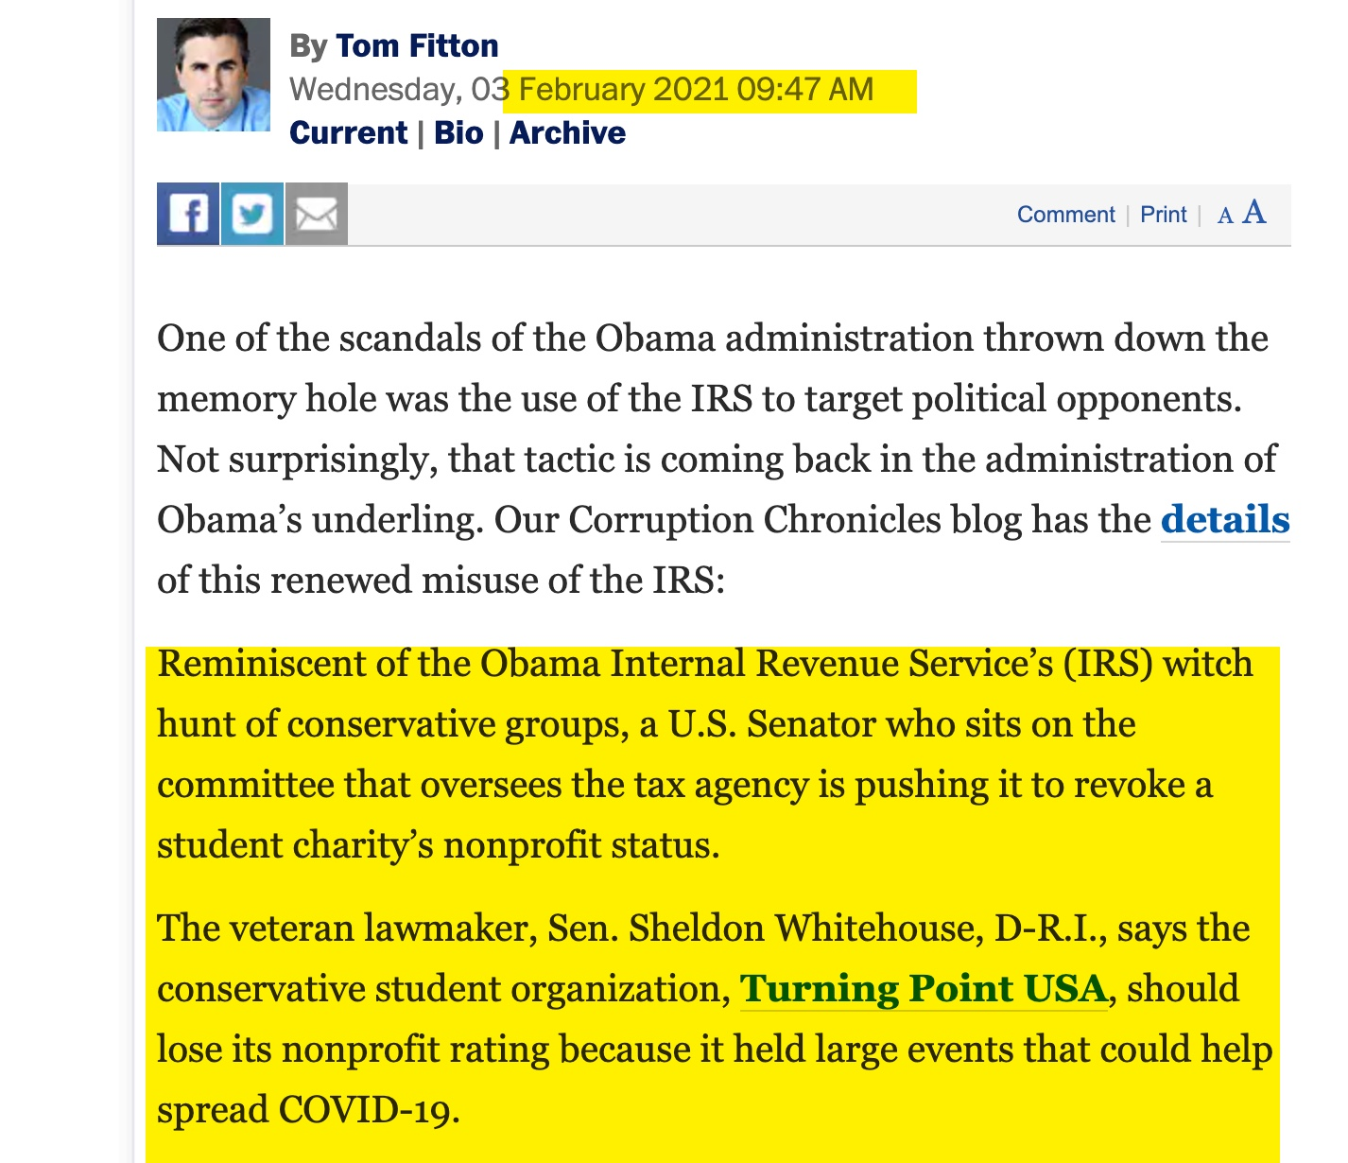

Slide 3
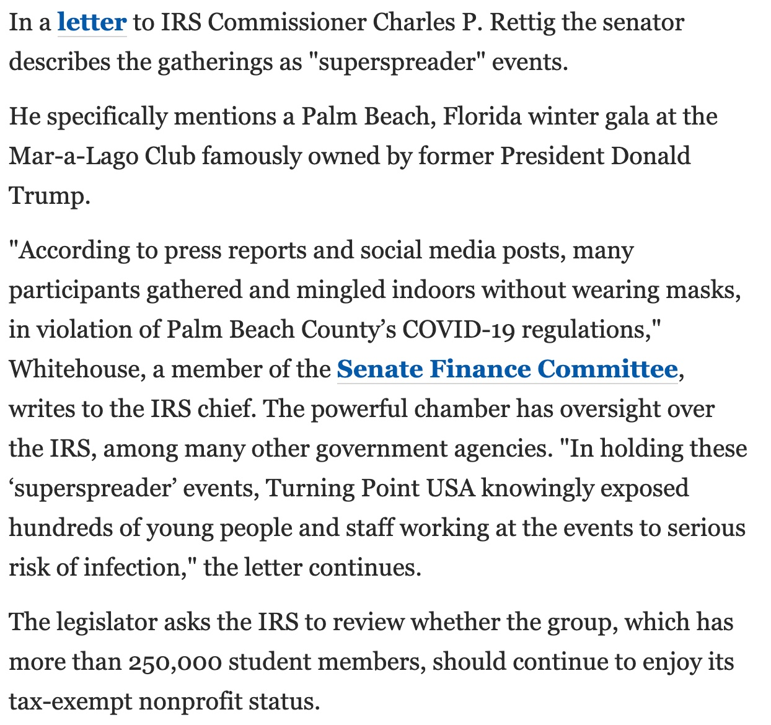

Slide 4
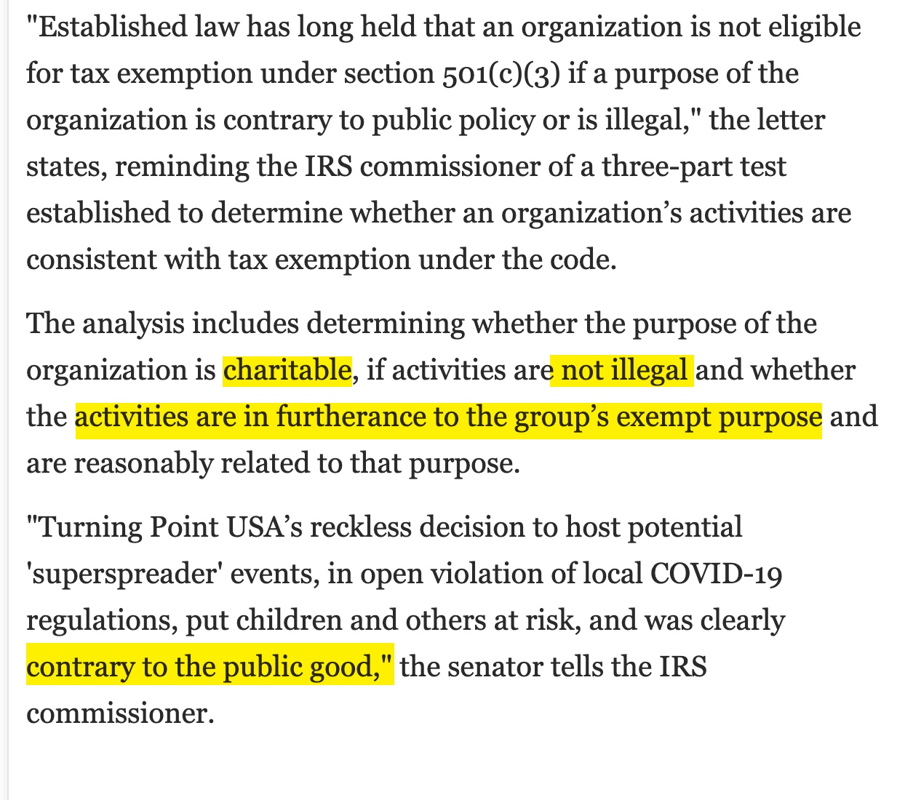

Slide 6
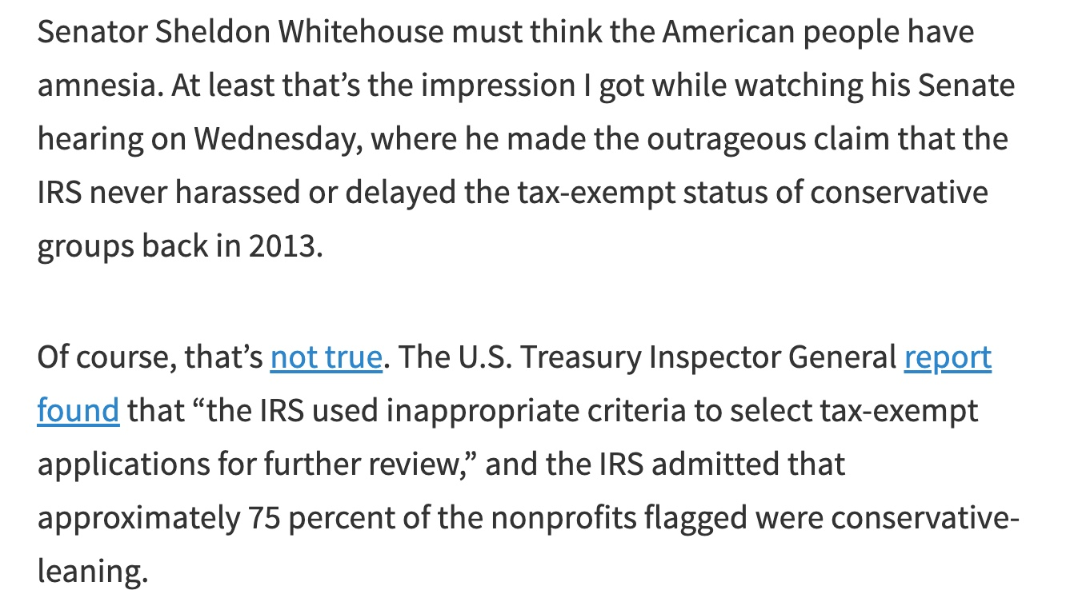

Slide 7
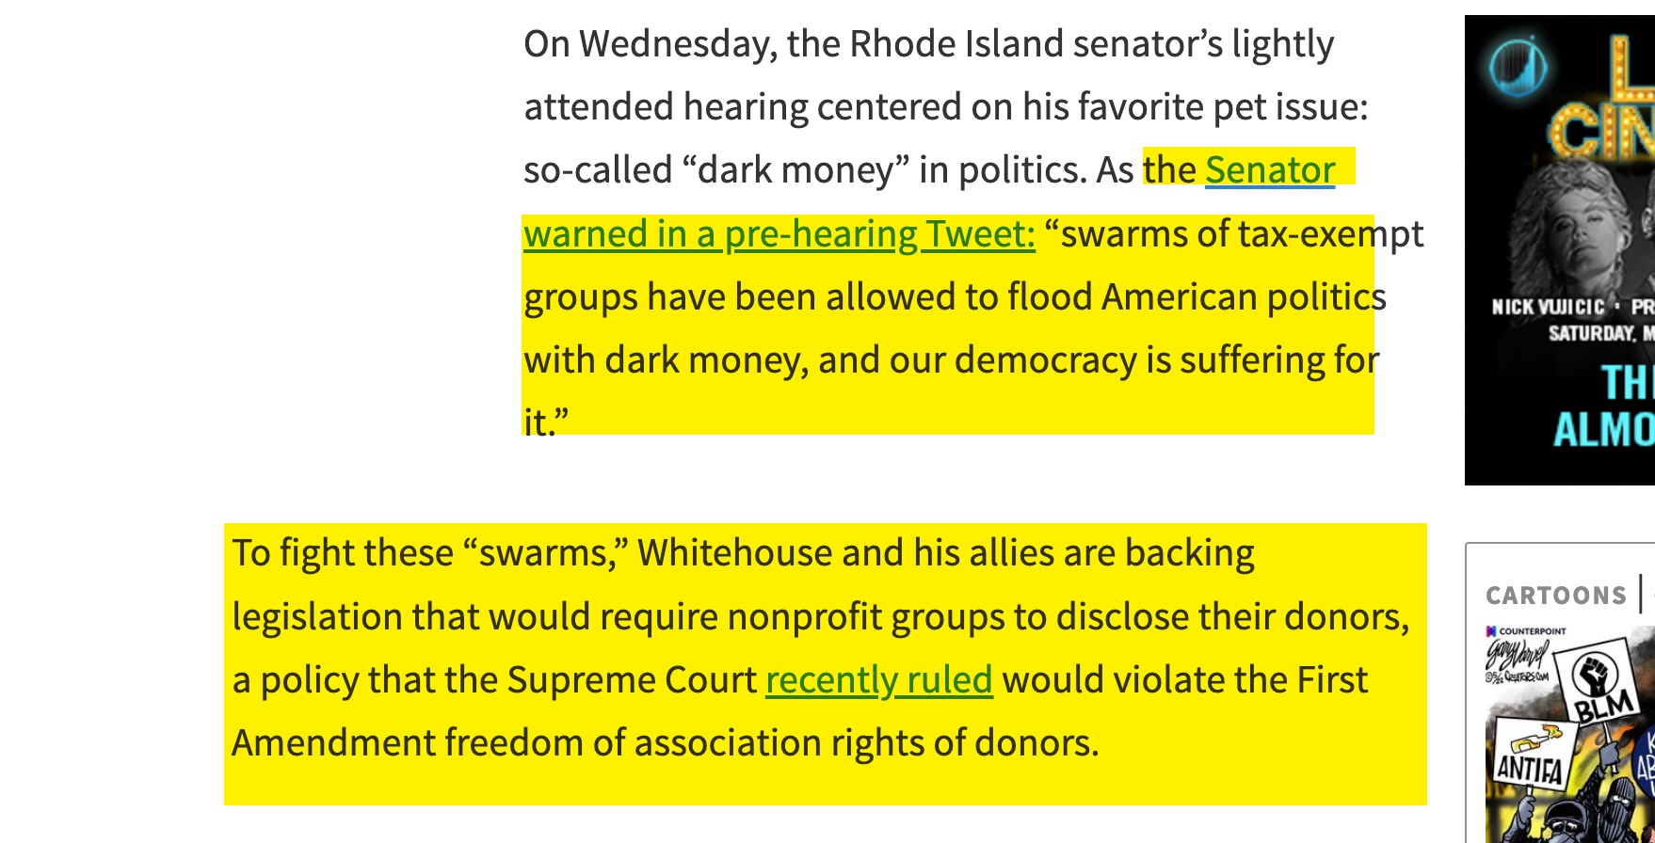

Slide 8
https://thefederalist.com/2022/05/02/bill-would-allow-feds-to-purge-u-s-military-and-local-police-using-charges-of-hate-crimes/

Slide 9
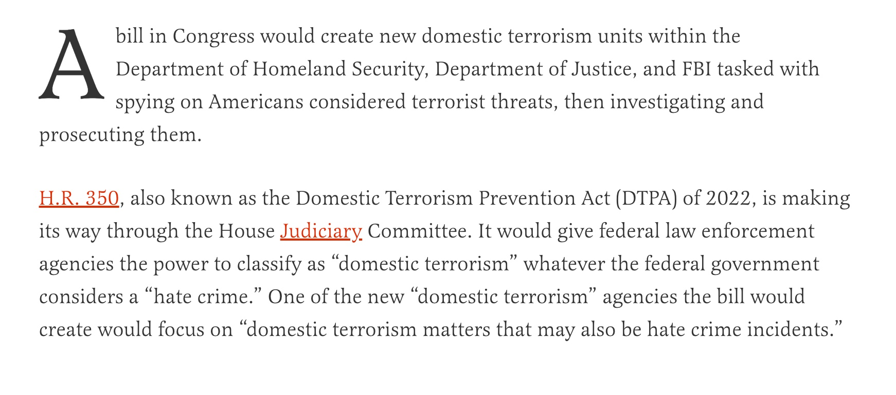

Slide 10
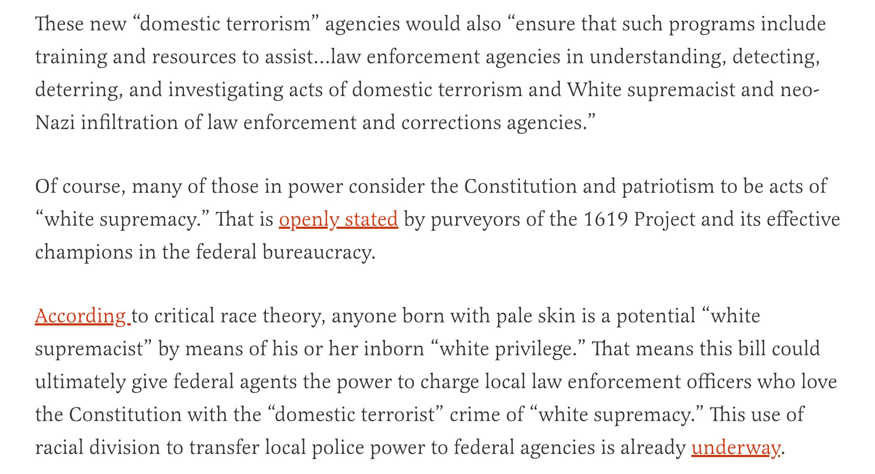

Slide 11
