Slide 1
James Comey Writes:
Niebuhr believes that the Christian must pursue justice and that justice is achieved through power. The Christian must recognize this connection between power, coercion and justice.

Slide 2
James Comey Writes:
Justice is distributive, says Niebuhr, and must be accomplished through power, with one eye on the standard of love and the other on the regulative principle of equality. He clearly believes the duty to establish this justice to lie with the government.

Slide 3
James Comey Quotes Reinhold Niebuhr:
“To the sensitive spirit, society must always remain something of a jungle…which might be brought a little closer to the Kingdom of God if only the sensitive could learn…how to use force in order to establish justice.”

Slide 4
James Comey Writes:
Thus “it is the duty of a Christian in politics to have no specific ‘Christian politics.’” By this Niebuhr does not mean a Christian viewpoint is irrelevant but that a set of Christian political decisions is impossible given the evil present in such decisions.

Slide 5
James Comey Writes:
Thus he declares the heart of Christian politics to be “the readiness to use power and interest in the service of an end dictated by love, and yet an absence of complacency about the evil inherent in them.”

Slide 6
James Comey Writes:
The Christian in politics must be willing to transgress any purely Christian ethic. He must be willing to sin in the name of Justice.

Slide 7
Workers of the Church, Unite: The Radical
Marxist Foundation of Tim Keller’s Social Gospel
by Timothy F. Kauffman

Slide 8
There is one high-profile Marxist who is particularly effective at repacking Marxism for a Christian audience, but due to his ability to disguise his economic philosophy, he is largely falling “under the radar.” That Marxist is Tim Keller, pastor of Redeemer Presbyterian Church in New York City.

Slide 9
It may come as a surprise to his conservative evangelical readers that Tim Keller’s recent book, Every Good Endeavor: Connecting Your Work to God’s Work, is simply a recapitulation of Marxism theory of alienation, and that Keller’s solution to the problem of alienation is indistinguishable from Marx’s.

Slide 10
It will surprise his readers to know that Keller’s theory of wages is derived from Marxism. It will surprise his readers to know that when Keller recommends modern examples of churches that implement a Christian economic ideal, he identifies churches and organizations that are thoroughly Marxist, and are inspired by leftist Saul Alinsky, the author of Rules for Radicals.

Slide 11
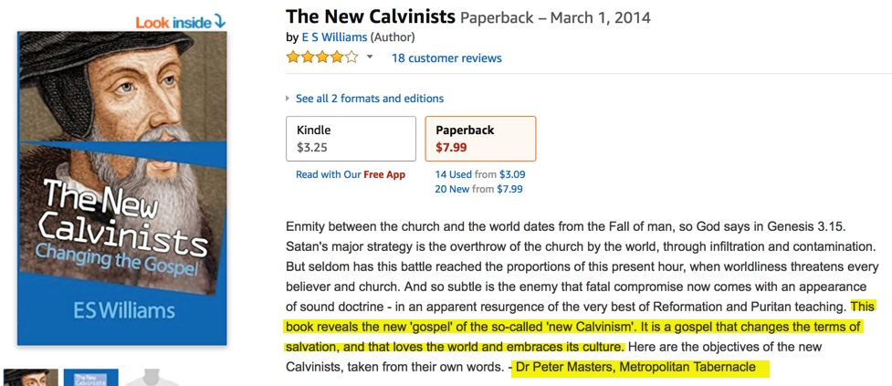

Slide 12
In Keller’s Marxist Sympathies
E.S. Williams Writes:
It is a gospel that changes the terms of salvation and that loves the world and embraces its culture…Timothy Kauffman has examined Keller’s claim that God’s radical plan is that “we are to work together to make the world a better place, to help each other, and to find purpose for our lives,” and demonstrated that it does not come from biblical wisdom, as Keller wants us to believe but from a Marxist worldview. To convince his reader of “God’s radical plan,” Keller quotes from the writings of three Marxists, Robert Bellah, Gustavo Gutierrez and Reinhold Niebuhr, without mentioning their political affiliation.

Slide 13
In Keller’s Marxist Sympathies
E.S. Williams Writes:
In effect, Keller has surreptitiously replaced the gospel of Christ with the utopia of Marx, and presented it as biblical truth. The importance of Kauffman’s analysis is that it demonstrates how Marist ideology can masquerade as Christian truth.

