Slide 1
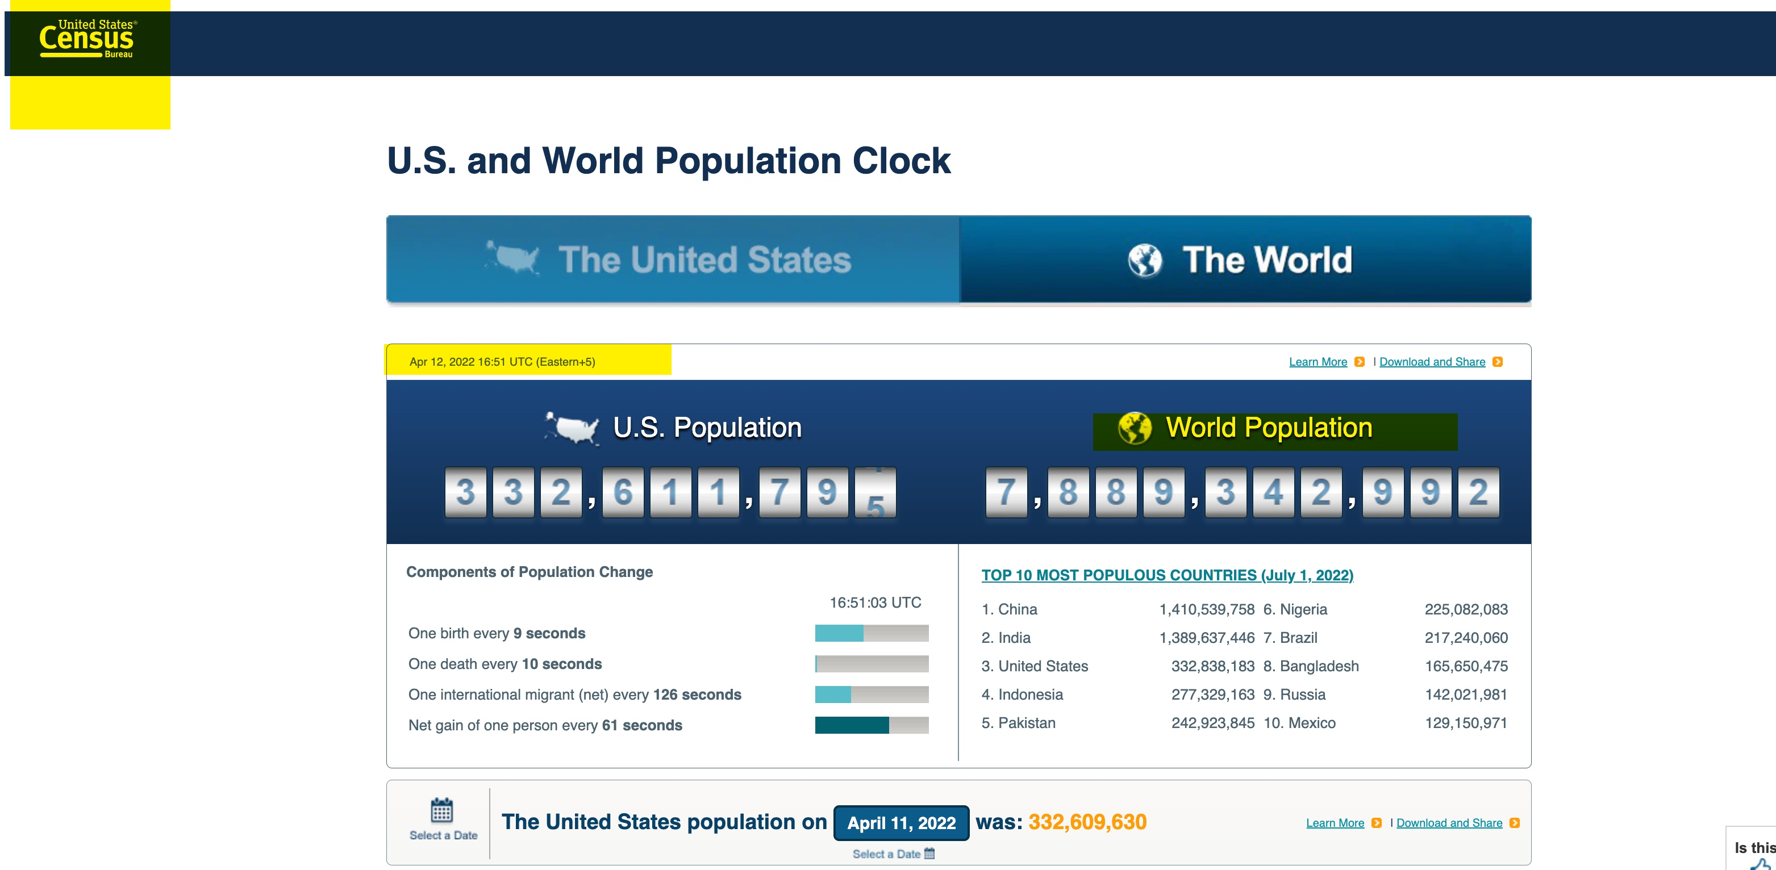

Slide 2
Kissinger Report on Population Control

Slide 3


Slide 4
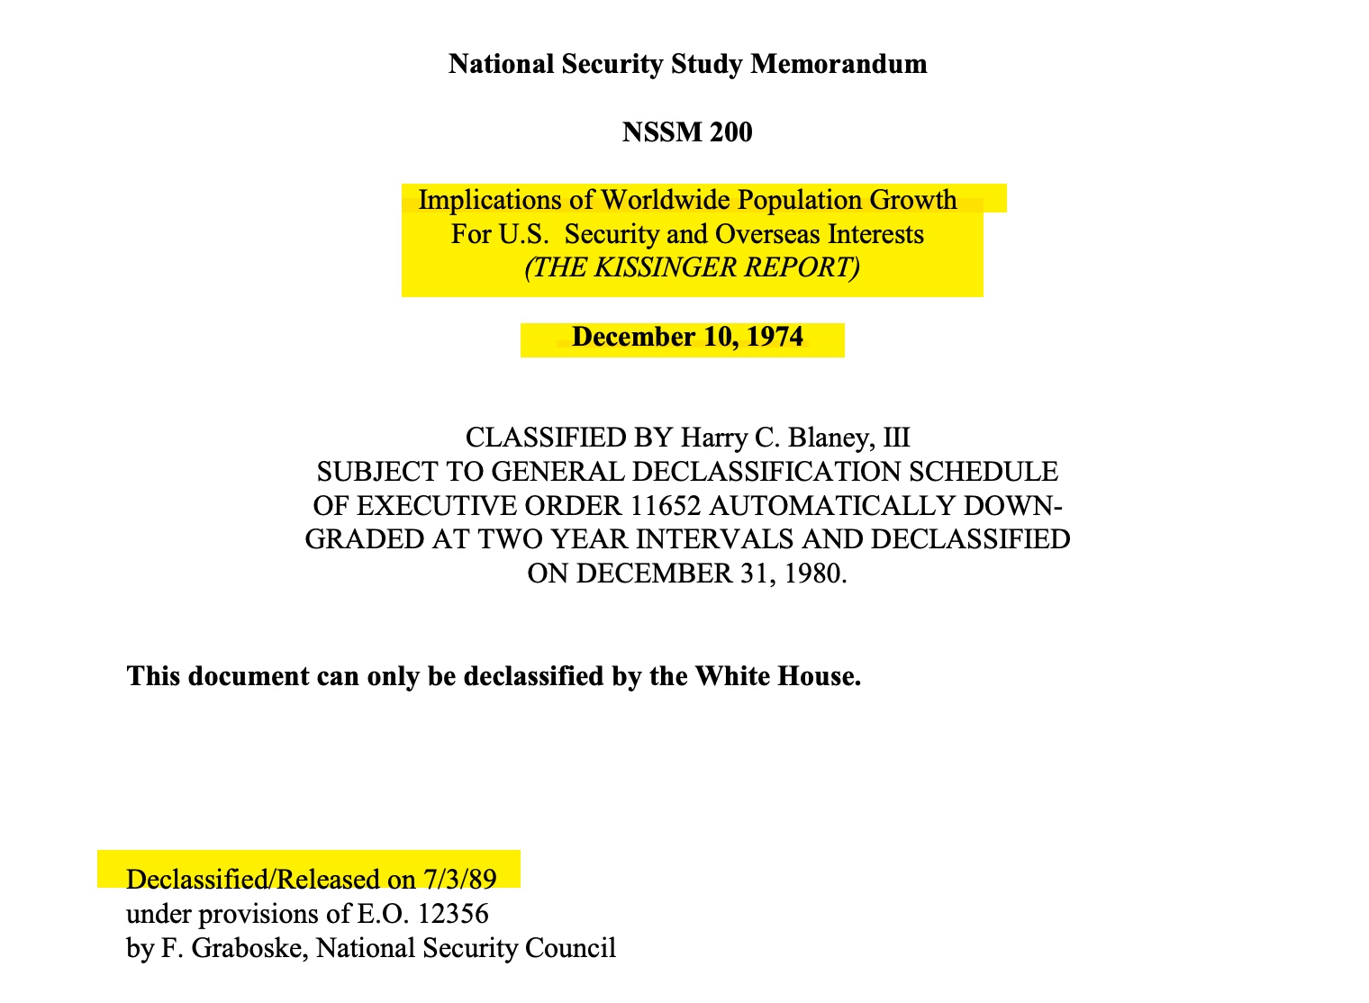

Slide 5
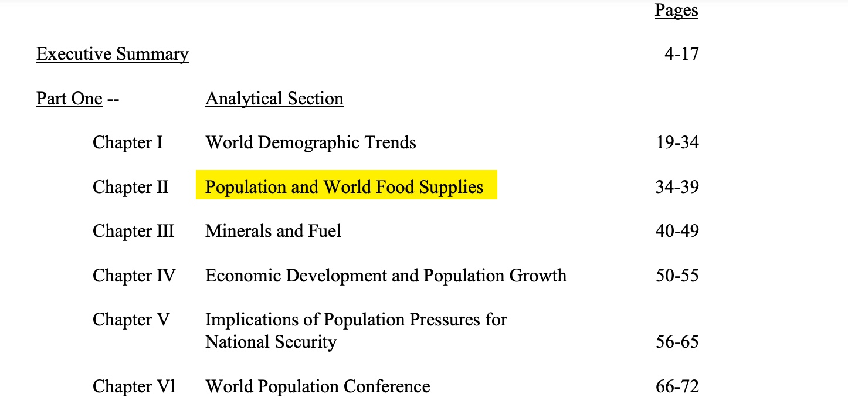

Slide 6
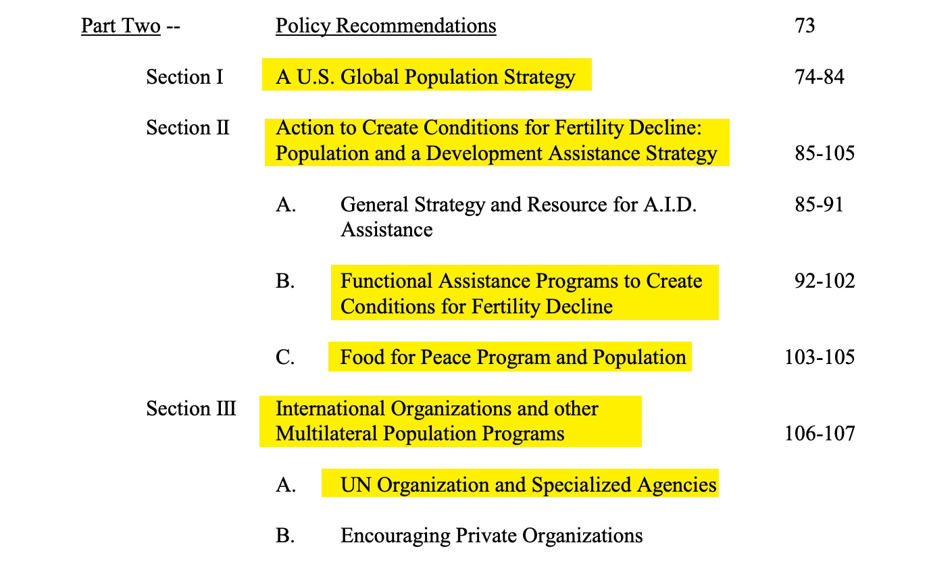

Slide 7
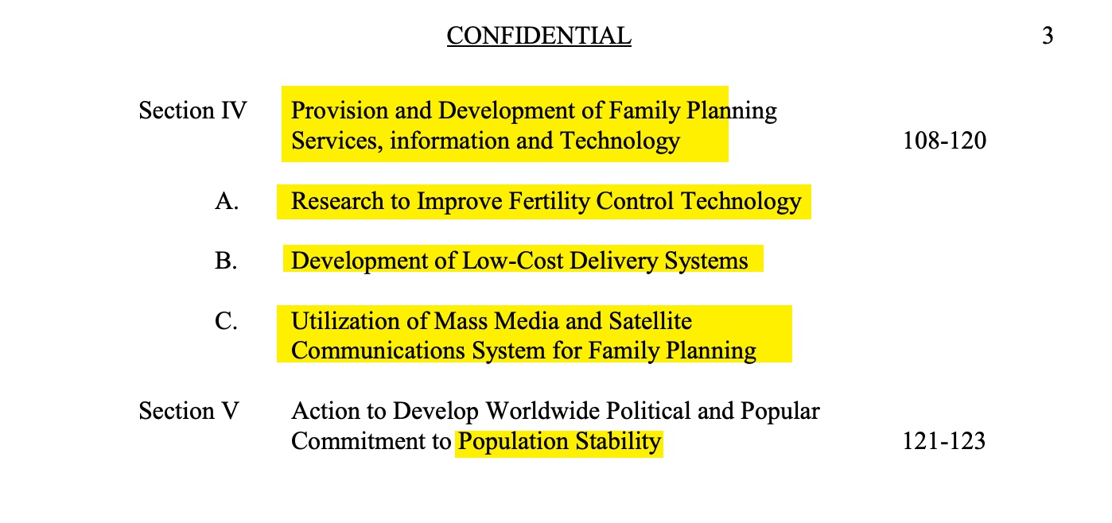

Slide 8


Slide 9


Slide 10


Slide 13
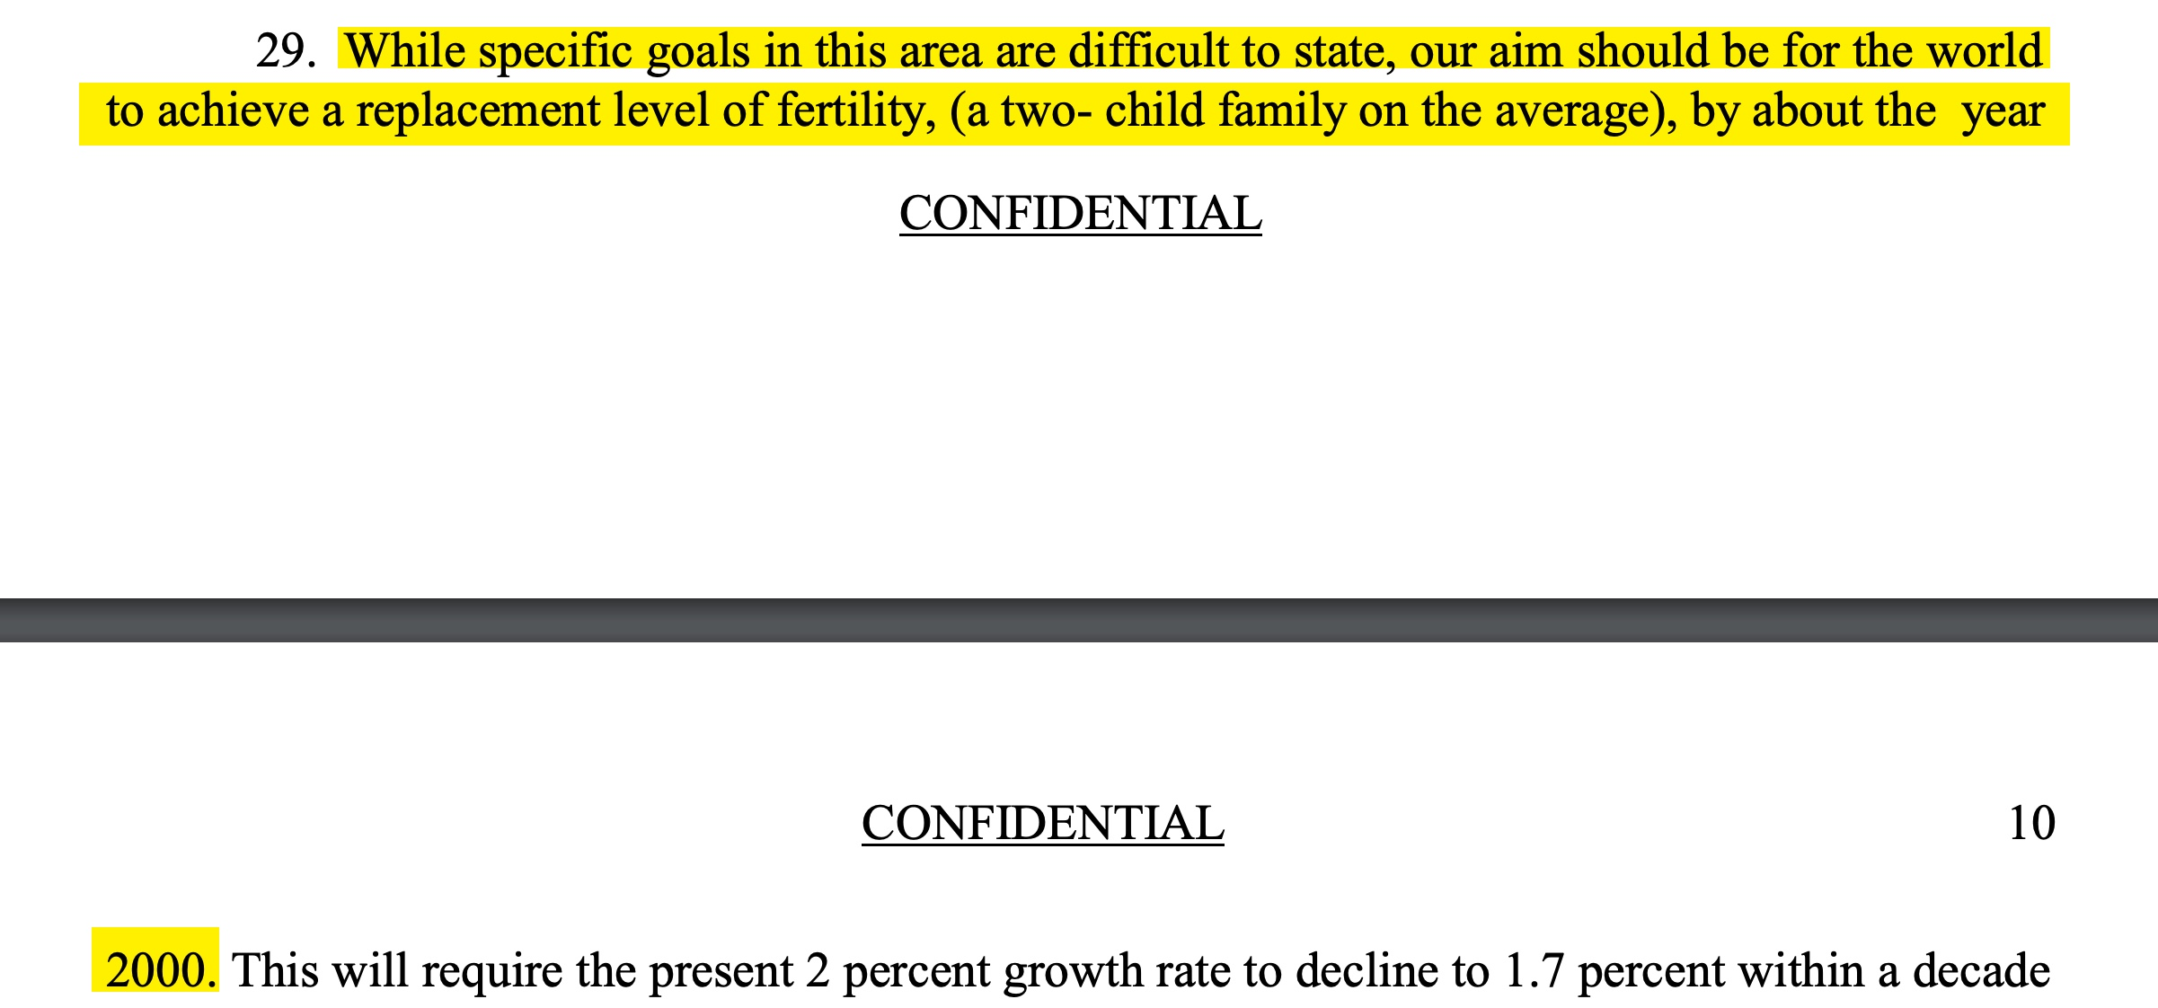

Slide 14


Slide 15


Slide 16


Slide 17


Slide 18
Stopped here

Slide 19


Slide 21


Slide 22


Slide 23


Slide 24


Slide 25


Slide 26
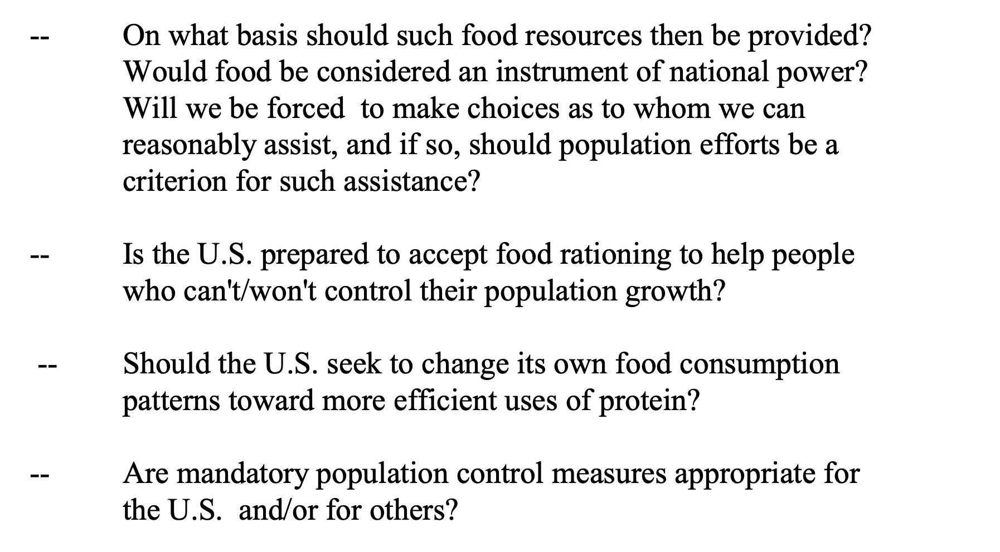

Slide 27


Slide 28


Slide 29


Slide 30


Slide 31
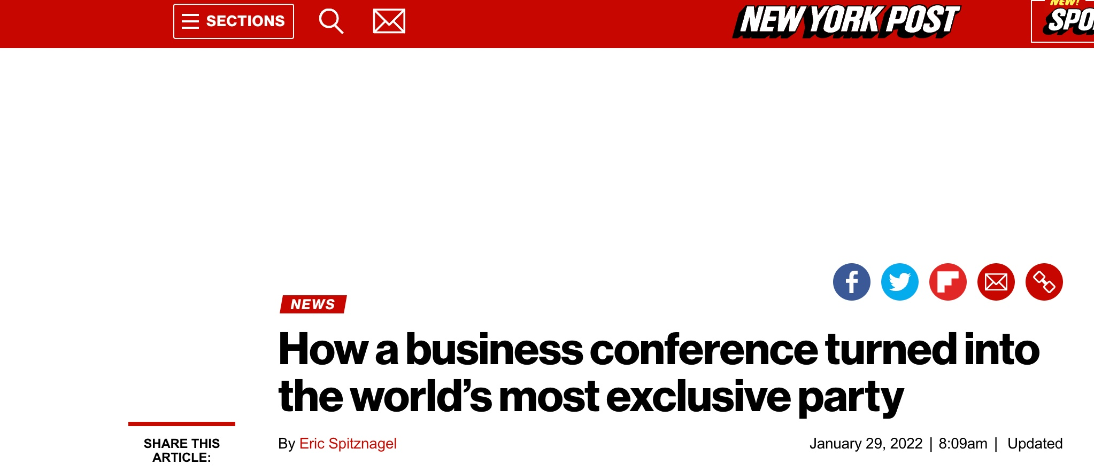


Slide 32


Slide 33


