Slide 1
Neo-Evangelicals:
Community Organizers
For The Cultural Marxists

Slide 2


Slide 3


Slide 4
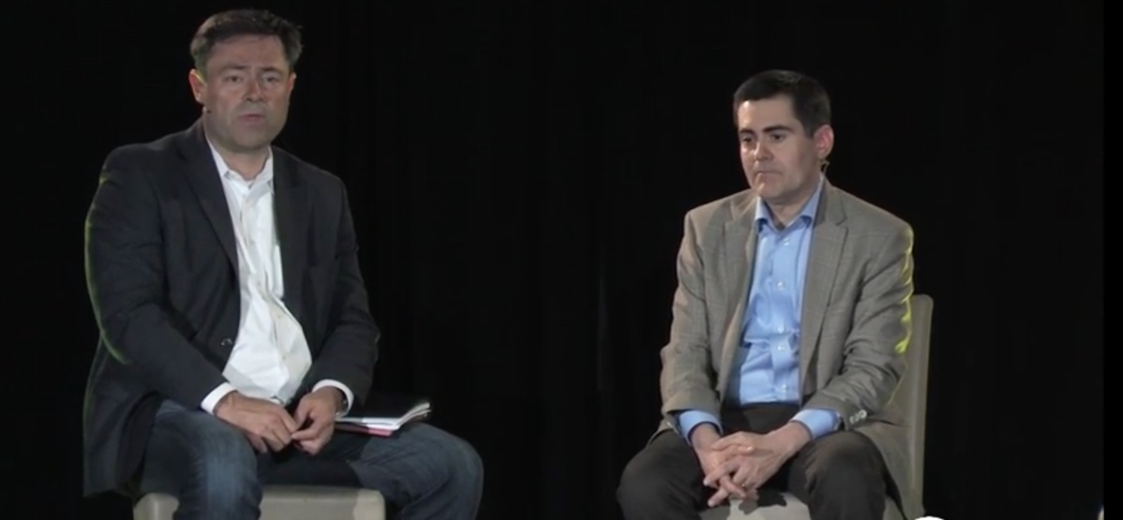
Mark Dever & Russell Moore

Slide 5


Slide 6
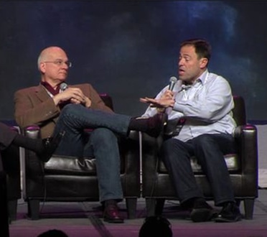
Mark Dever and Tim Keller

Slide 7

Mark Dever Praises Radical, Liberal,
Anti-Biblical Book “Divided By Faith”

Slide 8
Mark Dever Praising The Book “Divided By Faith”
Whose Co-Author is Known For Praising Liberation Theology

Slide 9

Mark Dever’s “Church” Co-Sponsored
The Livingout Survey Conference

Slide 10

Livingout Survey Promoted By
Mark Dever’s “Church”

Slide 11

Livingout Survey Promoted By
Mark Dever’s “Church”

Slide 12


Slide 13


Slide 14


Slide 15
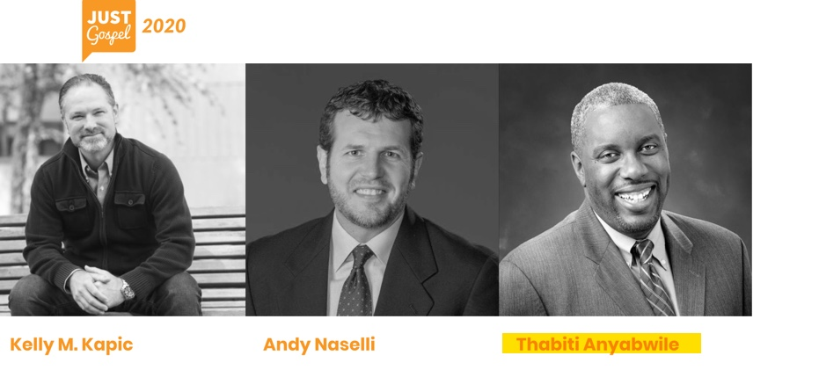

Slide 16


Slide 17
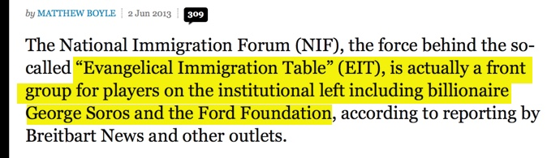

Slide 18
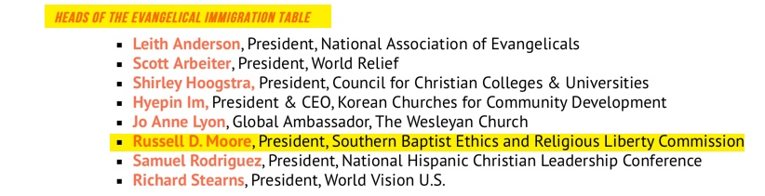

Slide 19
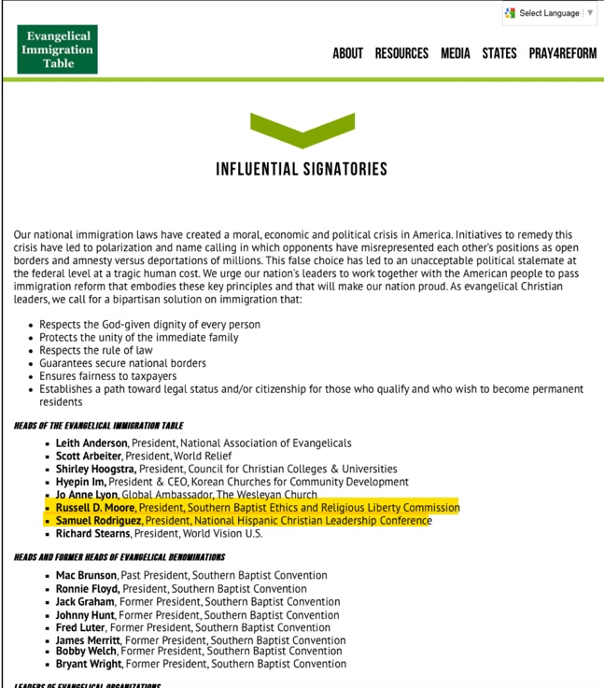

Slide 20


Slide 21


Slide 22
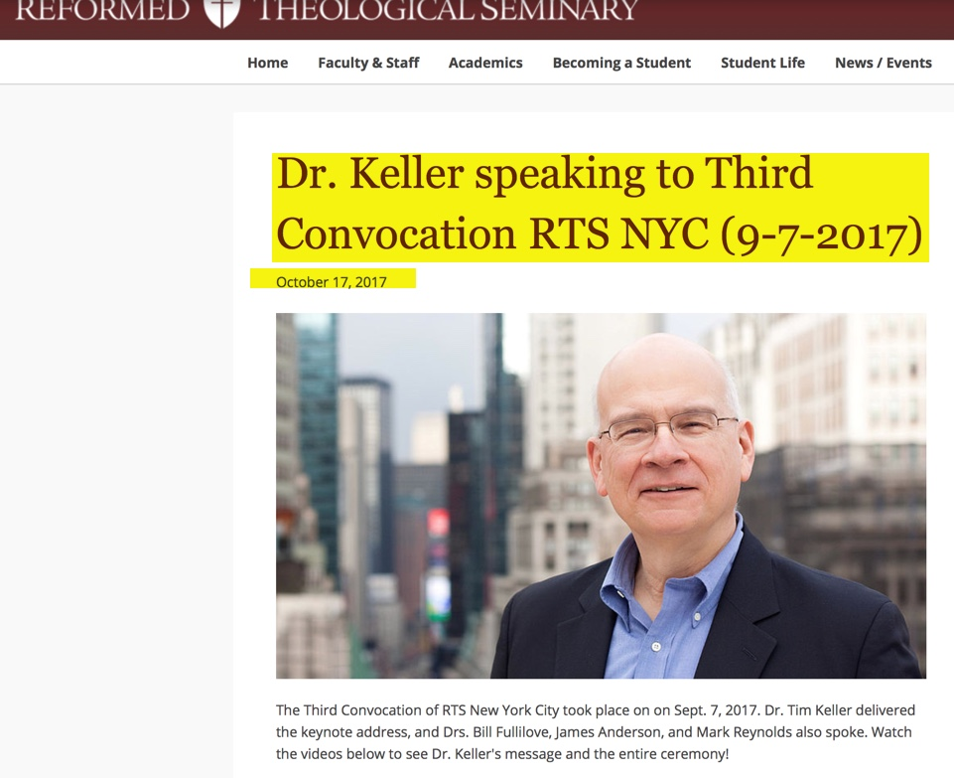

Slide 23


Slide 24


Slide 25


Slide 26


Slide 27


Slide 28


Slide 29

From The Gospel Coalition Website

Slide 30

From The Gospel Coalition Website

Slide 31


Slide 32


Slide 33


Slide 34


Slide 35


Slide 36


Slide 37


Slide 38
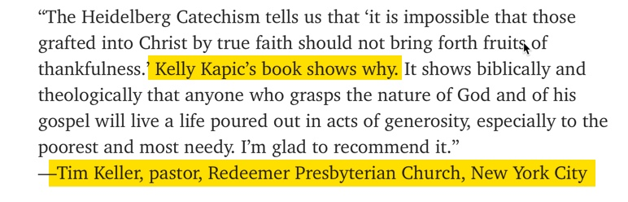

Slide 39
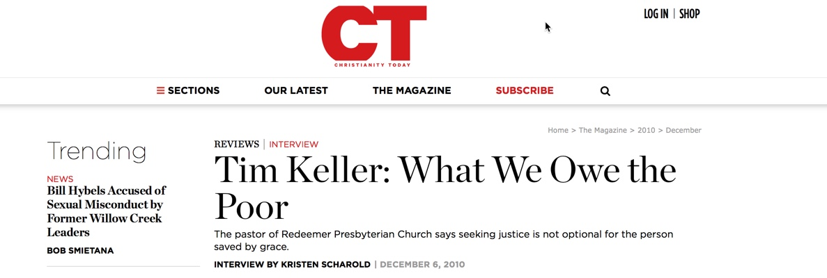

Slide 40
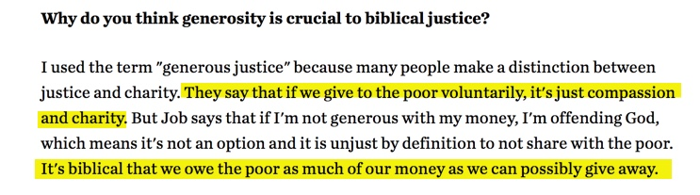

Slide 41
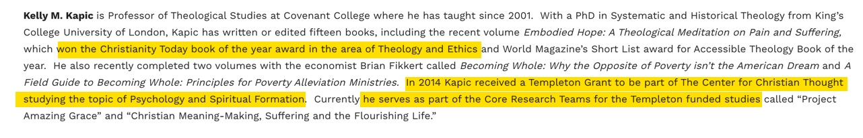

Slide 42
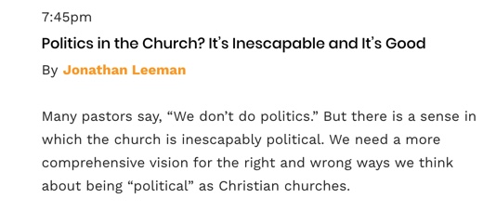

Slide 43
Evangelicals Are Sabotaging America
Just As Muslim Brotherhood
Planned & Predicted

Slide 44


Slide 45
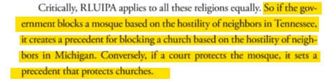
Page 150

Slide 46
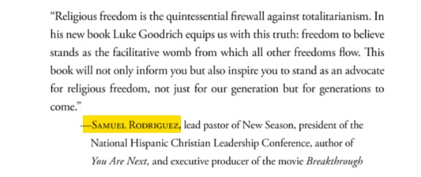
Samuel Rodriguez endorsement in front of book by Luke Goodrich

Slide 48


Slide 49


Slide 50
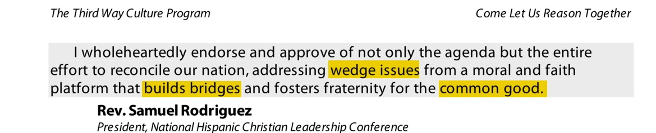

Slide 51


Slide 54
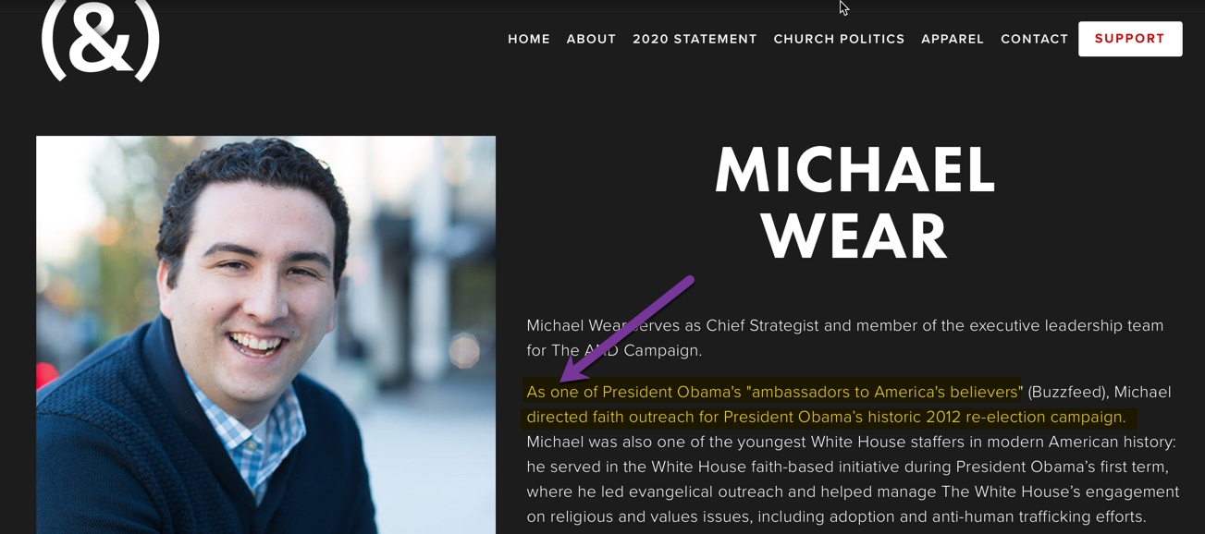

Slide 55


Slide 56


Slide 57


Slide 58


Slide 59


Slide 60
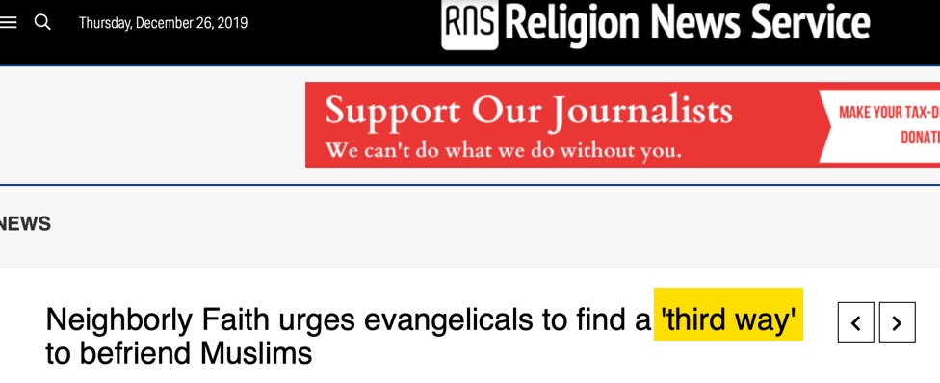

Slide 61


Slide 62


Slide 63


Slide 64
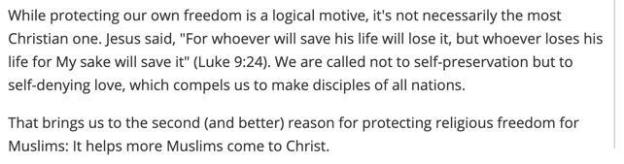

Slide 65
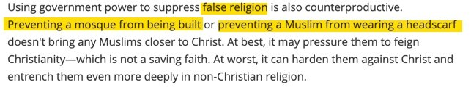

Slide 66
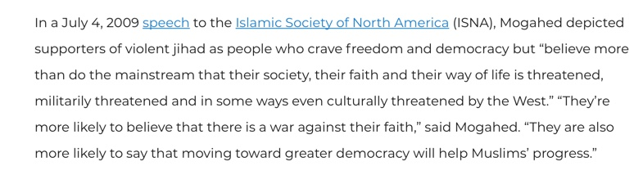
Discover The Networks

Slide 67
Quran 24:31:
And say to the believing women to restrain their eyes and to guard their private parts and do not display their ornaments, except that which appears from it, and that they throw their veils over their bosoms and do not display their ornaments, except to their husbands, or their fathers or their husband’s fathers or their sons or their husband’s sons or their brothers or their brothers’ sons or their sisters’ sons or their…

Slide 68
Quran 24:31:
O you prophet, say to your wives and to your daughters and the women of the believers, let down their hijab over them, that in this way they will be known, so they will not be harmed.

Slide 69
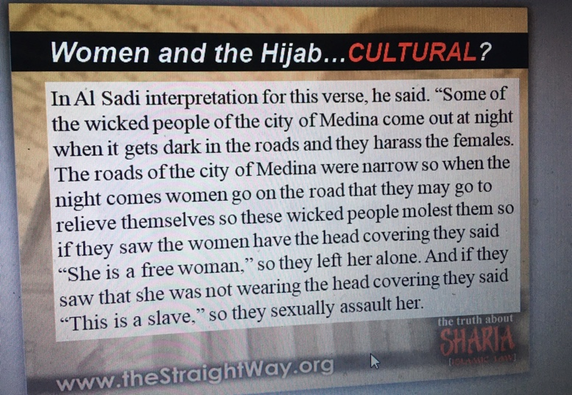

Slide 70
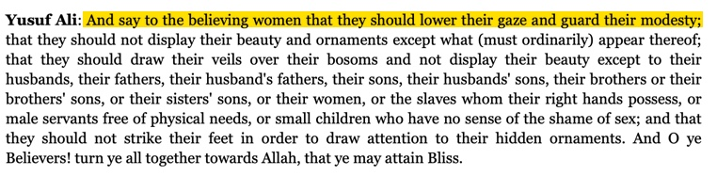

Slide 72
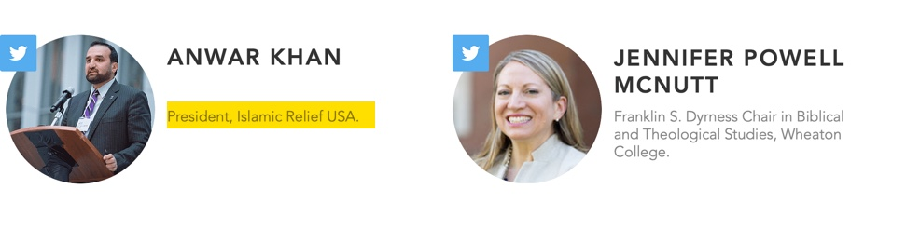

Slide 73


Slide 74
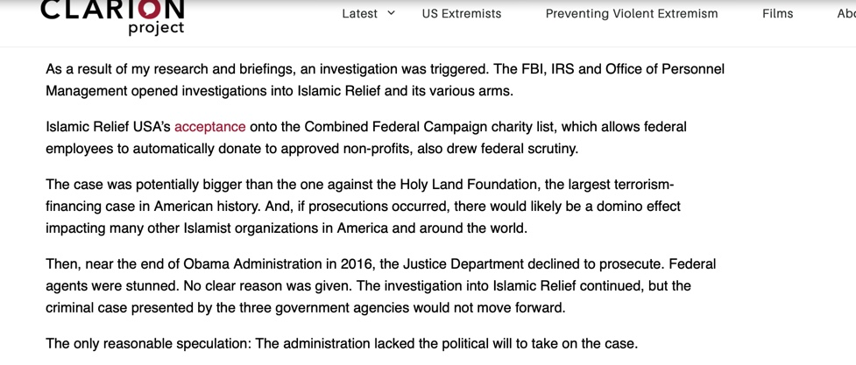

Slide 75
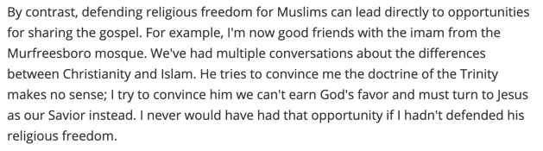

Slide 76
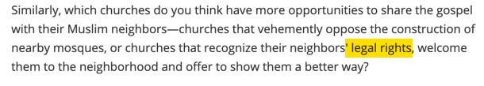

Slide 77
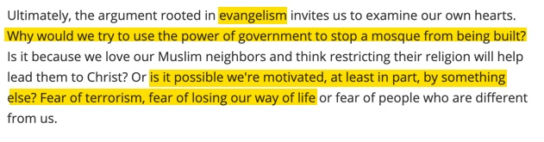

Slide 78


Slide 79

Tim Wildmon and American Family Association Interview & Promote False Teacher Heidi Baker

Slide 80

American Family Association Interview & Promote False Teacher Lou Engle

Slide 81
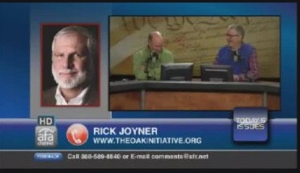
Tim Wildmon and American Family Association Interview & Promote False Teacher Rick Joyner

Slide 82


Slide 83


Slide 84


Slide 85
Tim Wildmon and American Family Association Interview & Promote False Teacher Rick Joyner

Slide 86


Slide 87
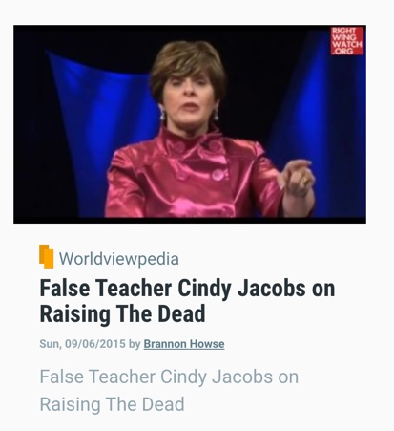

Slide 88


Slide 89
Fairness For All
Is a Third Way Trap

Slide 90


Slide 91
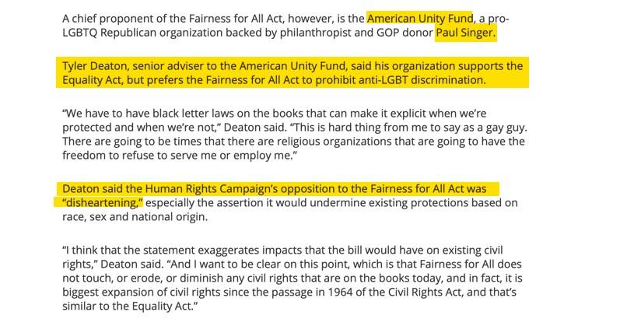

Slide 92


Slide 93
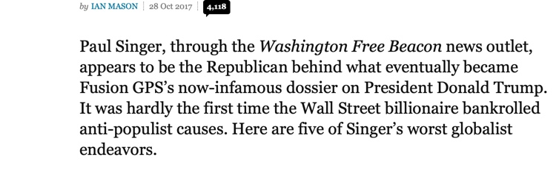

Slide 94
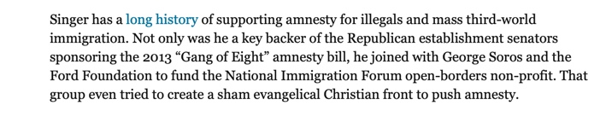

Slide 95


Slide 96


Slide 97


Slide 98


Slide 99


Slide 100


Slide 101


Slide 102


Slide 103


Slide 104


Slide 105
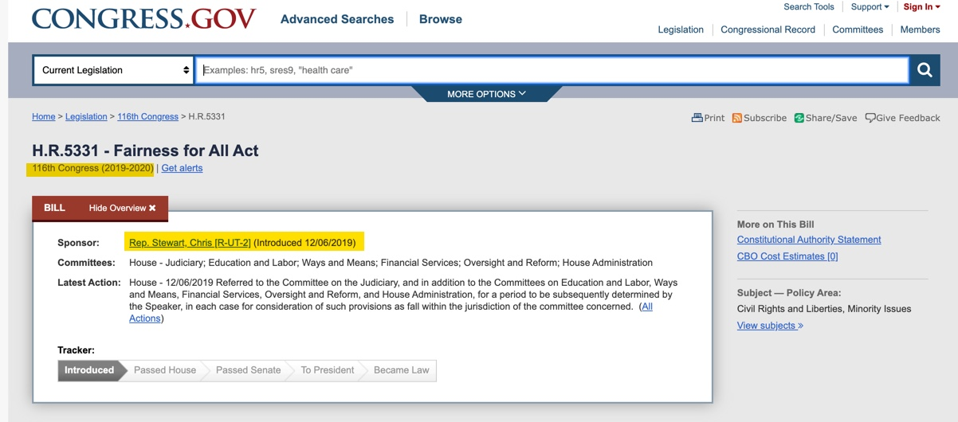

Slide 106
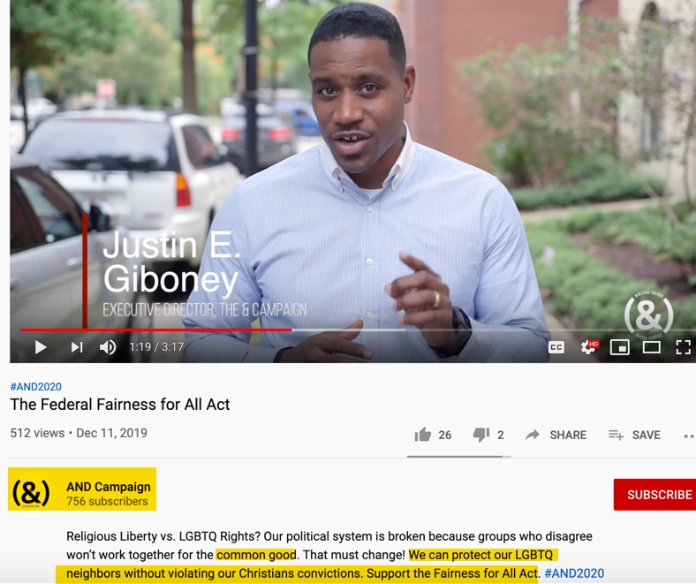

Slide 107


Slide 108


Slide 109


Slide 110


