Slide 1
The Pre-Marxist Revolution Riots of 2020
&
The History That Brought us to This Tipping Point

Slide 2
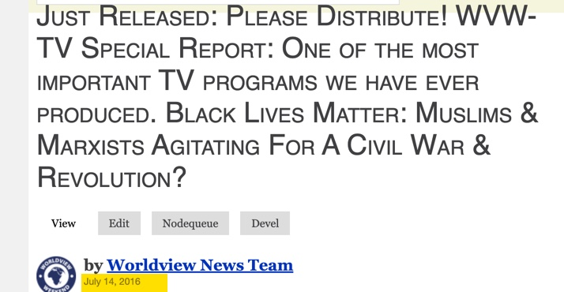

Slide 3
Former Communist Philip Abbot Luce in
Road to Revolution Wrote:
All of us, as good Communists were responsible for some work in the riots and each of us longed for the possibility that Harlem would herald the beginning of a nationwide war.

Slide 4
John Stormer in
None Dare Call it Treason Writes:
Cincinnati Police Chief Jacob W. Schott charged that four months of firebombing and guerrilla-type violence followed an April 29,1966 speech in which agitator Stokely Carmichael urged Negroes [as they were described then] to “fight the police and burn the city.”

Slide 5
St. Lous Dispatch, July 26, 1967 Reported That Stokely Carmichael in a Meeting in Havana with Latin American Communists Leaders Declared:
In Newark we applied the war tactics of the guerillas. We are preparing groups of urban guerrillas for our defense in the cities. The price of these rebellions is a high price one must pay. This fight is not going to be a simple meeting. Its going to be a fight to the death…get a gun. I don’t care if it’s a BB gun with poisoned BB’s. America has got to come around or black people are going to burn it down.

Slide 6
The Cuyahoga County Special Grand Jury that invested the summer of 1966 riots in Cleveland declared:
This jury finds that the outbreak of lawlessness and discord was both organized, precipitated, and exploited by a relatively small group of trained and disciplined professionals at this business. They were tied and abetted, willingly or otherwise, by misguided people of all ages and colors, many of whom were avowed believers in violence and extremism, and some of whom are either members or officers of the Communist Party.

Slide 7
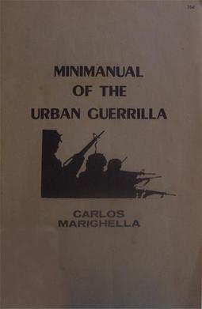

Slide 8
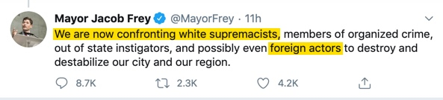

Slide 9
In 1972 Communist Party USA leader
Gus Hall wrote:
Our electoral policy has for some 25 years been expressed in the phrase “the three legs of a stool”…The stool was constructed at a time when the Party was under sharp attack…the concept was built on the idea that when the two legs, namely, the Communist Party and ‘the forces of political independence’,

Slide 10
get strong enough, then and only then would the stool sit on three legs. But until that day comes the one operation leg would be the liberal wing of the Democratic Party.

Slide 11
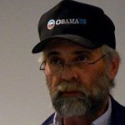
Mark Froemke
Trevor Loudon has called “The Most Influential
Communist in Minnesota.”

Slide 12
Pressure From Above
&
Pressure From Below

Slide 13
Before He Died in 1924,
Lenin Declared:
First, we will take eastern Europe, then the masses of Asia, then we will encircle the United States which will be the last bastion of capitalism. We will not have to attack. It will fall like an overripe fruit into our hands.

Slide 14
February 1967 Testimony of FBI Director
J. Edgar Hoover Before a Congressional Committee:
Communists and other subversives and extremists strive and labor ceaselessly to precipitate racial trouble and take advantage of racial discord in this country. Such elements were active in exploiting and aggravating the riots, for example in Harlem, Watts, Cleveland and Chicago.

Slide 15
The U.S. House of Representatives Committee on
Un-American Activities December of 1961
…bold and deceitful Communist tactics can overcome strategical and numerical disadvantages when the non-Communist opposition fails to comprehend a threat to its existence until it is too late.

Slide 16
Stokely Carmichael:
"Honorary Prime Minister" of the Black Panther Party
Leader of the All-African
People's Revolutionary Party

Slide 17
Lionizing the Enemy
By Matthew Vadum
Frontpagemag.com June 16, 2014:
Not surprisingly, Carmichael was friends with Communist propagandist Howard Zinn and an acolyte of Nation of Islam demagogue Louis Farrakhan. Carmichael received political and financial support from Farrakhan’s organization.

Slide 18
“When you talk of black power," Carmichael said, "you talk of building a movement that will smash everything Western civilization has created.”

Slide 19
His hatred of America was profound. The United States, he said, was "the most disgusting country in the world.”
Carmichael mocked calls for “integration,” saying they amounted to "a subterfuge for the maintenance of white supremacy.”

Slide 20
He publicly spoke of the importance of “offing the pigs” and “killing the honkies.” He urged the dynamiting of businesses and expressed hope that black U.S. soldiers serving in Vietnam would one day come home and "kill in the streets" of America.

Slide 21
He encouraged blacks to riot in order to give white America “a little taste of chaos” and vowed that “[t]he Negro [was] going to take what he deserves from the white man.“
End of Quotes From Article by
Matthew Vadum

Slide 22
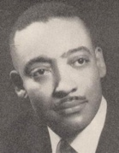
Black Columnists Louis Lomax
Reporting on the 1967 Detroit Riot in the
August 19,1967 St. Louis
Democrat, Wrote:
…an organized group, largely from outside the Detroit area, had been operating in the city more than a month…this group had an assignment: burn and destroy…revolutionaries committed to the conclusion that the power structure does not have the moral fiber to repent for its socioeconomic sins; that the only truly corrective measures is to leave the nation in ashes.

Slide 23
The principal U.S. cities have been chosen as the battleground simply because they afford the kind of cooperation by the innocent and the uninformed that such revolution needs.

Slide 24
The Revolutionary Abolitionists Movement:
Their Stated Goal of Burning Down America, The Suburbs, & Ending Police & Prisons

Slide 25


Slide 26
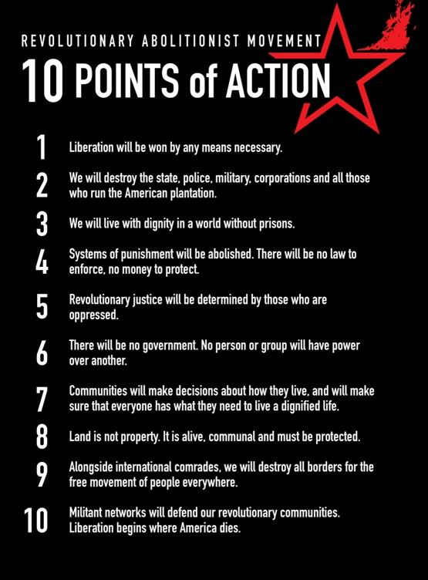

Slide 27
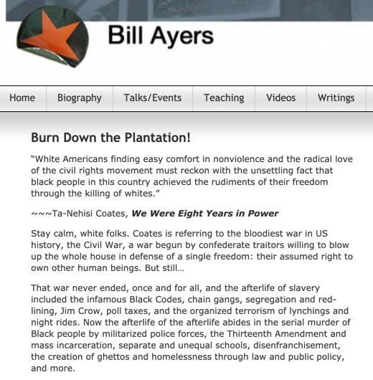

Slide 28
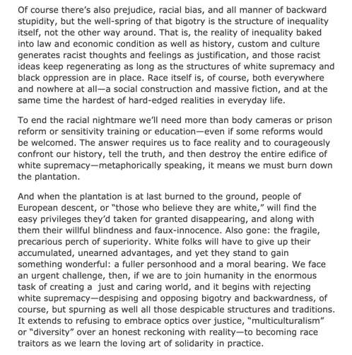
Article by Bill Ayers

Slide 29
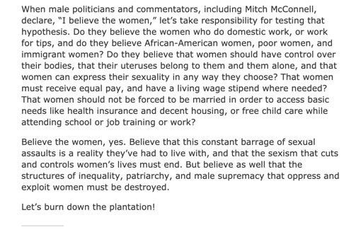
Article by Bill Ayers

Slide 31
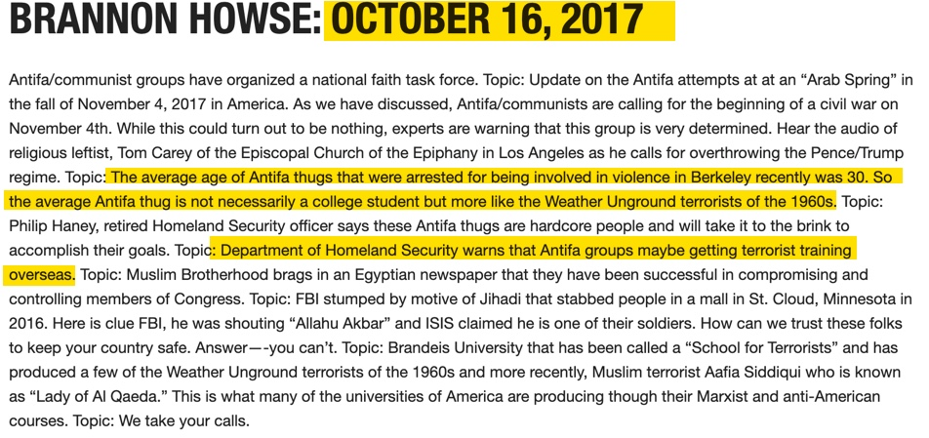

Slide 32
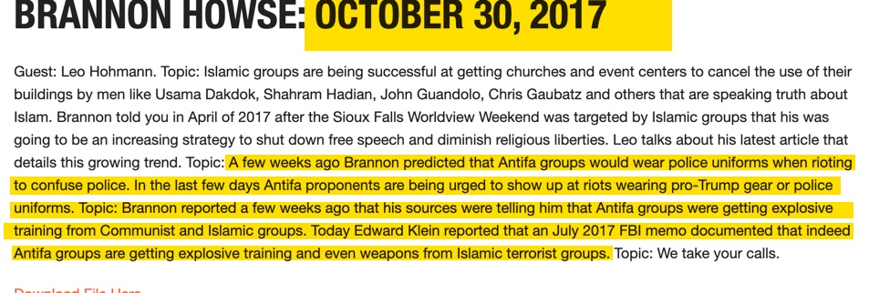

Slide 33

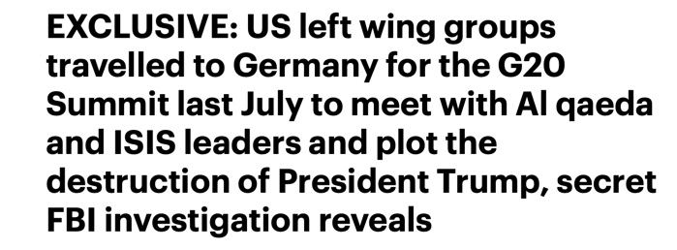

Slide 34
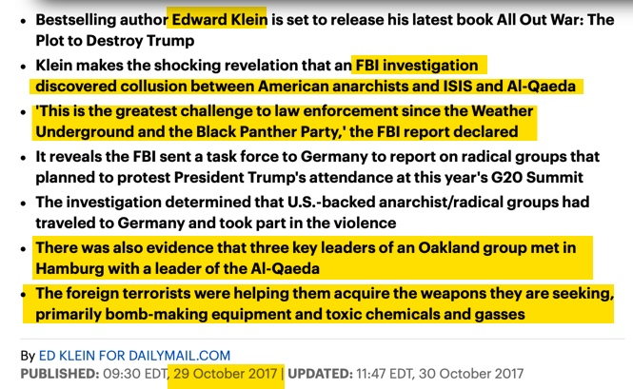

Slide 35
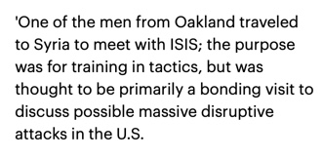

Slide 36
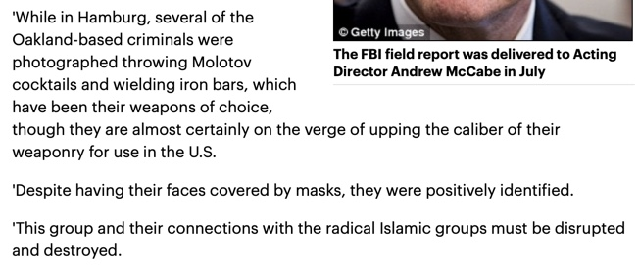

Slide 37


Slide 38
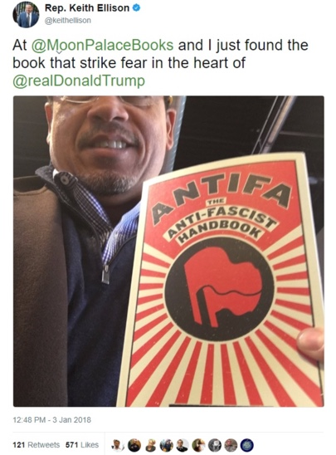

Slide 39
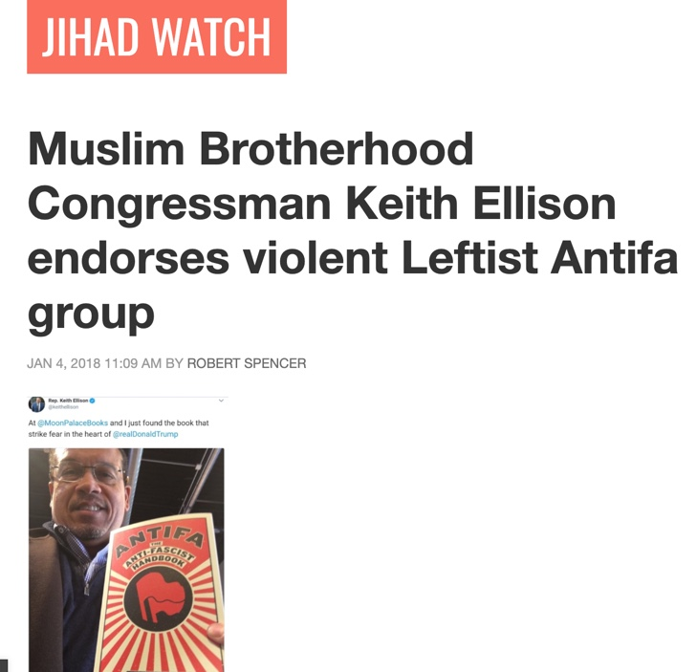

Slide 40
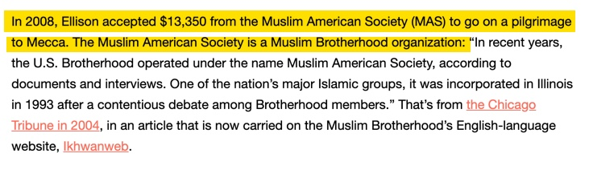

Slide 45


Slide 46
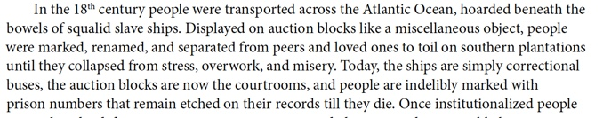

Slide 47
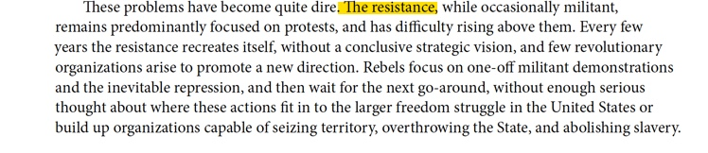

Slide 48
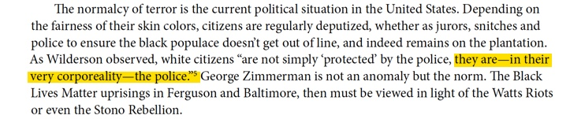

Slide 49
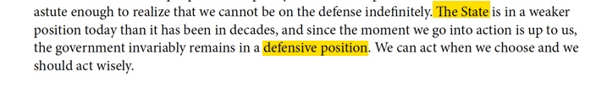

Slide 50
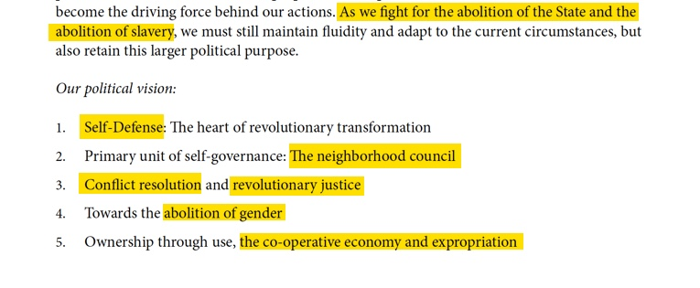

Slide 51
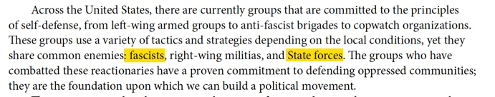

Slide 52


Slide 54
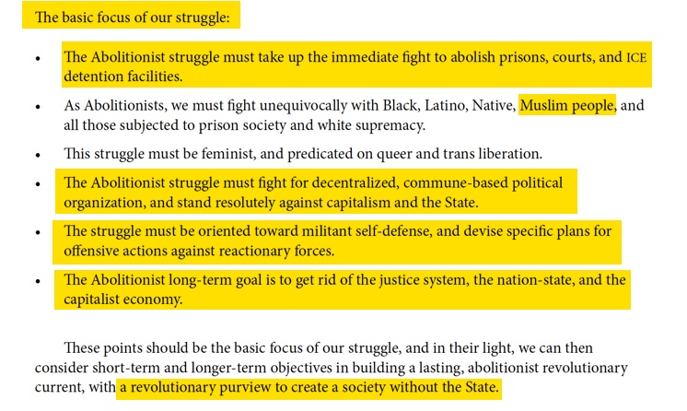

Slide 55
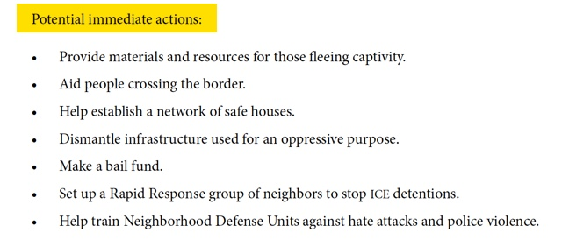

Slide 56
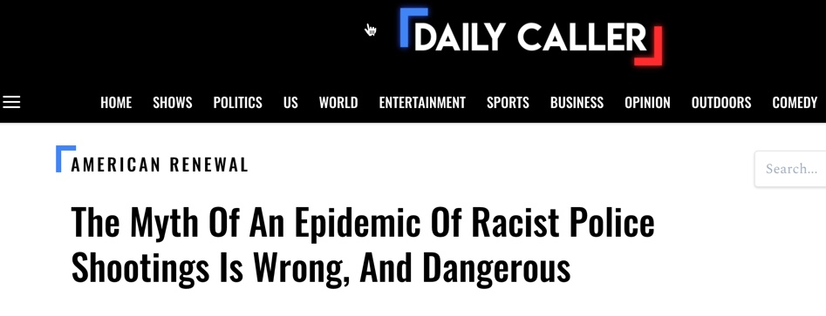

Slide 57
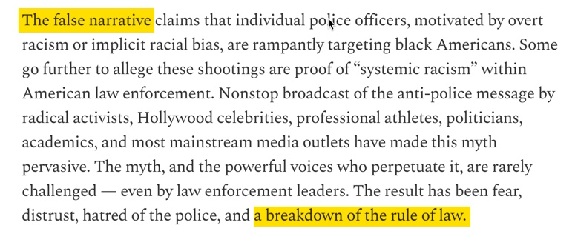

Slide 58
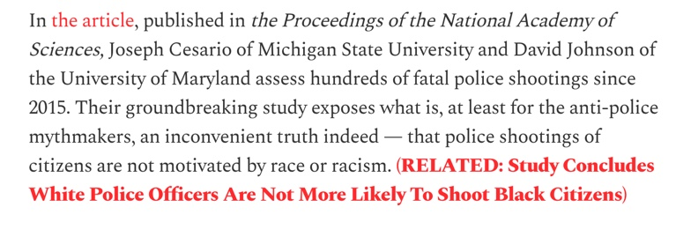

Slide 59
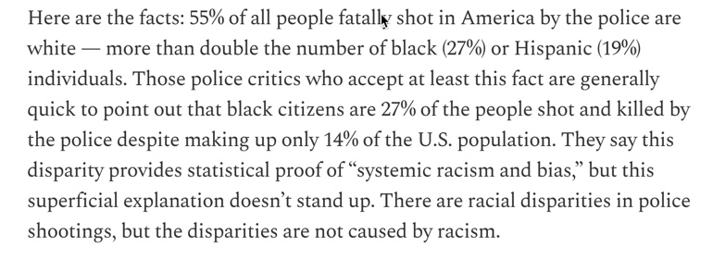

Slide 60
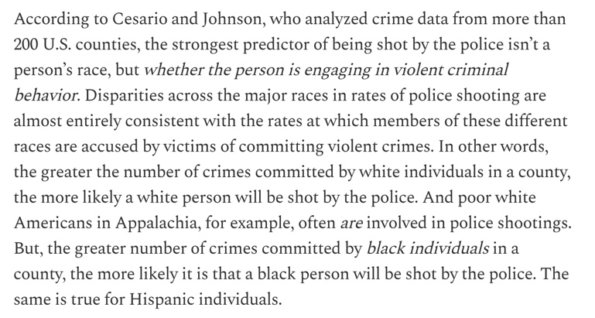

Slide 61
