Slide 1
The Power Elite Exposed

Slide 2
1. The Power Elite Conspire

Slide 3
2. Power Elite Consolidate

Slide 4
3.The Power Elite Chaos

Slide 5
4.The Power Elite Control

Slide 6
5. The Power Elite
Crushed

Slide 7
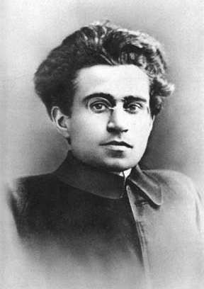
Antoni Gramsci
One of the Founders of the Communist Party in Italy
Socialism is precisely the religion that must overwhelm Christianity . . . In the new order, Socialism will triumph by first capturing the culture via infiltration of schools, universities, churches and the media by transforming the consciousness of society. —

Slide 8
Washington Post
December 24, 2018

Slide 9
Washington Post
December 24, 2018

Slide 10
Washington Post
December 24, 2018

Slide 11
Liberal, Columbia University Sociologist C. Wright Mills in His 1956 Book
The Power Elite Writes:
There is…little doubt that the American power elite—which contains, we are told, some of “the greatest organizations in the world”—has…planned and plotted…Certain types of men from each of the dominant institutional areas, more far-sighted

Slide 12
Liberal, Columbia University Sociologist C. Wright Mills in His 1956 Book
The Power Elite Writes:
than others, have actually promoted the liaison before it took its truly modern shape…The power elite is not all together “surfaced.” Many higher events that would reveal the working of the power elite can be withheld from public knowledge under the guise of secrecy.

Slide 13
Liberal, Columbia University Sociologist C. Wright Mills in His 1956 Book
The Power Elite Writes:
With the wide secrecy covering their operations and decisions, the power elite can mark their intentions, operations and further consolidation…New men come into it and assume its existence without question.

Slide 14
President Woodrow Wilson in The New Freedom Published in 1913, The First Year of His Presidency Writes:
Since I entered politics, I have chiefly had men’s views confided to me privately. Some of the biggest men in the United States, in the field of commerce and manufacturing, are afraid of somebody, are afraid of something. They know that there is a power somewhere so organized, so subtle, so watchful, so interlocked, so complete, so pervasive, that they had better not speak above their breath when they speak in condemnation of it…

Slide 15
President Woodrow Wilson in The New Freedom Published in 1913, The First Year of His Presidency Writes:
We have been dreading all along the time when the combined power of high finance would be greater than the power of the government…We have come to be one of the worst ruled, one of the most completely controlled and dominated, governments in the civilized world—no longer a government of free opinion, no longer a government by conviction and the vote of the majority, but a government by the opinion and duress of small groups of
dominant men.

Slide 16
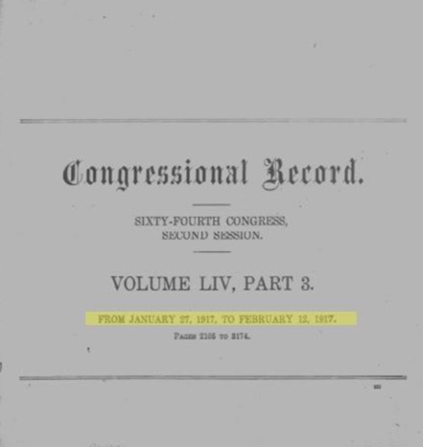
Congressional Record of February 9, 1917, Page 2947, as Entered by Representative Oscar Callaway of Texas:

Slide 17
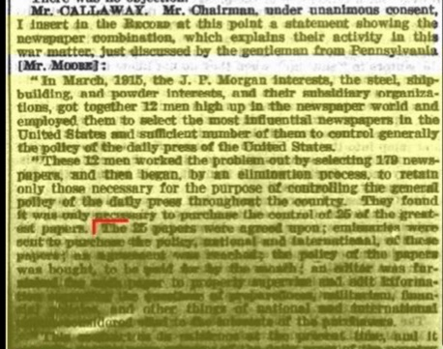
Congressional Record of February 9, 1917, Page 2947, as Entered by Representative Oscar Callaway of Texas:

Slide 18
Congressional Record of February 9, 1917, Page 2947, as Entered by Representative Oscar Callaway of Texas:
“In March, 1915, the J.P. Morgan interests, the steel, shipbuilding, and powder interest, and their subsidiary organizations, got together 12 men high up in the newspaper world and employed them to select the most influential newspapers in the United States and sufficient number of them to control generally the policy of the daily press. …They found it was only necessary to purchase the control of 25 of the greatest papers.

Slide 19
Congressional Record of February 9, 1917, Page 2947, as Entered by Representative Oscar Callaway of Texas:
An agreement was reached; the policy of the papers was bought, to be paid for by the month; an editor was furnished for each paper to properly supervise and edit information regarding the questions of preparedness, militarism, financial policies, and other things of national and international nature considered vital to the interests of the purchasers.”

Slide 20
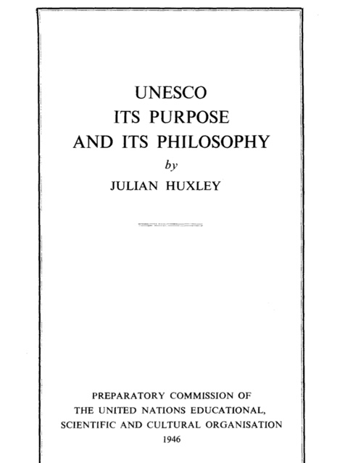

Slide 21
Julian Huxley:
The task is to help the emergence of a single world culture…at the moment, two opposing philosophies of life confront each other….You may categorize the two philosophies as super nationalism, or as individualism versus collectivism…or as capitalism versus communism, or as Christianity verses Marxism. Can these opposites be reconciled, this antithesis be resolved in a higher synthesis? I believe not only that this can happen, but that, through the inexorable dialectic of evolution, it must happen.

Slide 22
The Real War (1980) By President Richard Nixon:
The nation’s immediate problem is that while the common man fights America’s wars, the intellectual elite sets its agenda. Today, whether the West lives or dies is in the hands of its new power elite: those who set the terms of public debate, who manipulate the symbols, who decide whether nations or leaders will be depicted on 100 million television sets as “good” or “bad.” This power elite sets the limits of the possible for President and Congress. It molds the impressions that move the nation, or that mire it.

Slide 23
November 6, 1980 The San Jose Mercury Ronald Reagan
I think there is an elite in this country and they are the very ones who run an elitist government. They want a government by a handful of people because they don’t believe the people themselves can run their lives…Are we going to have an elitist government that makes decisions for people’s lives, or are we going to believe as we have for so many decades, that the people can make these decision for themselves?”

Slide 24
The Secret Constitution and the Need for Constitutional Change (1987) by Arthur S. Miller
…a pervasive system of thought control exists in the United States…The citizenry is indoctrinated by employment of the mass media and the system of public education…People are told what to think about…The old order is crumbling…Nationalism should be seen as a dangerous social disease…A new vision is required to plan and manage the future, a global vision that will transcend national boundaries and eliminate the poison of nationalistic “solutions.”

Slide 25
In 2002, David Rockefeller’s Book Memoirs is Released

Slide 26
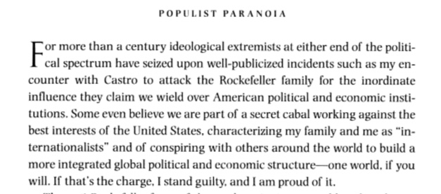
In 2002, David Rockefeller’s Book Memoirs is Released in Which He Wrote on Page 405:

Slide 27
In a 1991 Speech That Was Secretly Recorded, David Rockefeller Can Be Heard Declaring:
We are grateful to the Washington Post, The New York Times, Time Magazine and other publications whose directors have attended our meetings and respected their promises of discretion for almost forty years. It would have been impossible for us to develop our plan for the world if we had been subject to the bright lights of publicity during those years. But the world is now more sophisticated and prepared to march toward a world government. . . .

Slide 28
1. The Power Elite Conspire

Slide 29
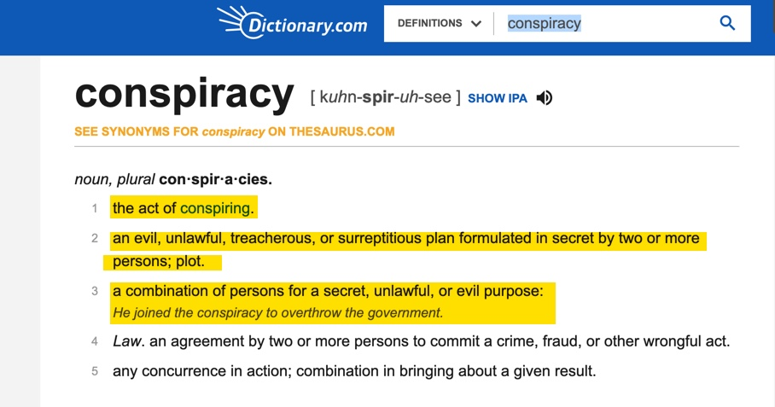

Slide 31
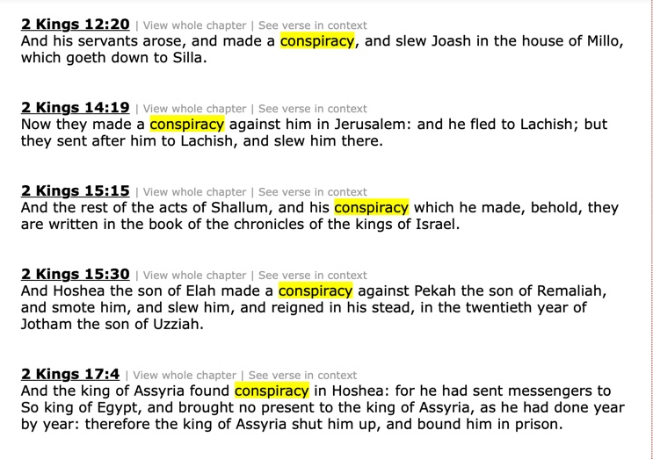

Slide 32
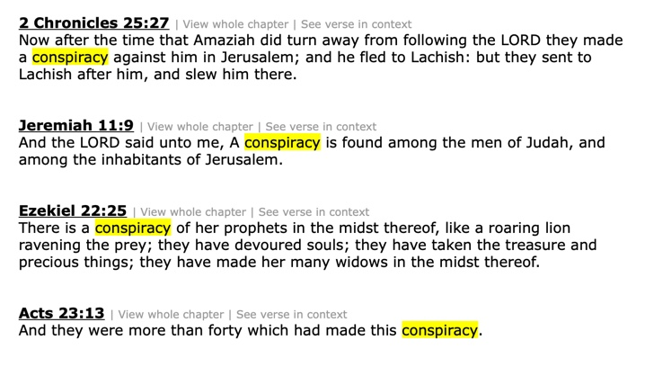

Slide 33
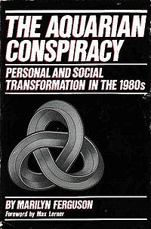
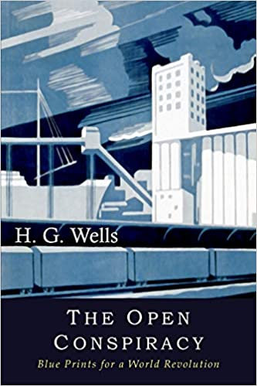

Slide 34
The Aquarian Conspiracy By Marilyn Ferguson
…there are legions of conspirators…Of the Aquarian conspirators surveyed, more were involved in education than any other single category of work…A major ambition of the curriculum is autonomy. This is based on the belief that if our children are to be free, they must be free even from us—from our limiting beliefs…One veteran bureaucrat at the National Institute

Slide 35
of Mental Health said, “There are a lot of us in the woodwork.” He was referring to a loose coalition of conspirators in agencies and on Congressional staffs. Within the Department of Health, Education and Welfare, innovators have created informal rap groups to share their strategies for slipping new ideas into a resistant system and to give each other moral support. Concepts that might otherwise appear “far out” can be given legitimacy by a single federally funded program.

Slide 36
The grant-making apparatus of government determines fashion in some re-search fields. This aura of legitimacy is fostered here and there by conspirator-bureaucrats.

Slide 37
1. The Power Elite Conspire

Slide 38
2. Power Elite Consolidate

Slide 39
3.The Power Elite Chaos

Slide 40
4.The Power Elite Control

Slide 41
5. The Power Elite
Crushed

Slide 42
The Power Elite Consolidate

Slide 43
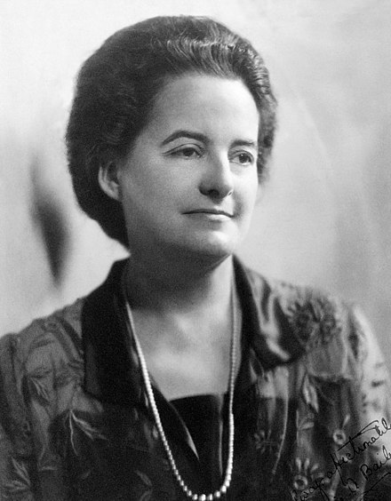
Alice Bailey,
1880-1949

Slide 44
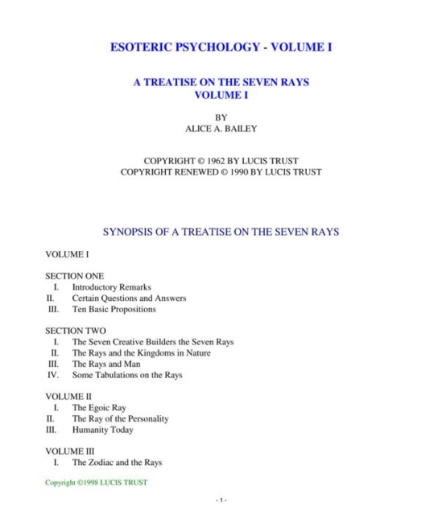

Slide 45
Big Business Religion/Spirituality Government

Slide 46
Revelation 18:3

Slide 47
Revelation 18:23-24

Slide 48
Revelation 18: New American Standard & New King James
Merchants = Used Four Times Kings = Used Twice Nations = Used Twice Sorcery = Used Once

Slide 49
1930, The New York Times article quoting Rep. Louis McFadden (chairman of the House Committee on Banking and Currency): The Federal Reserve Bank of New York is eager to enter into a close relationship with the Bank for International Settlements…The conclusion is impossible to escape that the State and Treasury Departments are willing to pool the banking systems of Europe and America, setting up a world financial power independent of and above the Government of the United States…The United States under present conditions will be transformed from the most active of manufacturing nations into a consuming and importing nation with a balance of trade against it.

Slide 50
Bill Clinton in His 1992 Democratic Nation Convention Acceptance Speech Spoke of His Georgetown Professor Carroll Quickly: As a teenager, I heard John Kennedy’s summons to citizenship. And then, as a student at Georgetown, I heard that call clarified by a professor named Carroll Quigley, who said to us that America was the greatest Nation in history because our people had always believed in two things—that tomorrow can be better than today and that every one of us has a personal moral responsibility to make it so.

Slide 51
Carroll Quigley: “Tragedy and Hope” Published in 1966
The power of financial capitalism had another far reaching plan, nothing less than to create a world system of financial control in private hands able to dominate the political system of each country and the economy of the world as a whole. This system was to be controlled

Slide 52
in a feudalistic fashion by the central banks of the world acting in concert, by secret agreements arrived at in frequent meetings and conferences. The apex of the system was to be the Bank for International Settlements in Basle, Switzerland, a private bank owned and controlled by the world’s central banks, which were themselves private corporations.

Slide 53
Each central bank, in the hands of men like Montagu Norman of the Bank of England, Benjamin Strong of the New York Federal Reserve Bank, Charles Rist of the Bank of France, and Hjalmar Schacht of the Reichsbank, sought to dominate its government by its ability to control treasury loans, to manipulate foreign exchanges, to influence, The level of economic activity in the country, and to influence co-operative politicians by subsequent rewards in the business world.

Slide 55
In June 2009, Pope Benedict XVI Issued a 30,000-Word Encyclical Calling For: Reform of the United Nations so there could be “true world political authority”

Slide 56
In His June 2009 Encyclical
Pope Benedict XVI Also Called For:
A global tax
Global redistribution of wealth from rich countries to poor countries a worldwide redistribution of energy resources, so that countries lacking those resources can have access to them.

Slide 57
Vatican Calls For “Central World Bank” In October of 2011 the Vatican released an 18 page report that called for a "global public authority" and a "central world bank" and "a supranational authority" with "universal jurisdiction". The 18 page document released by the Vatican contained the often used communitarian phrase “common good” twenty-two times.

Slide 60
Alice Bailey

Slide 61
1. The Power Elite Conspire

Slide 62
2. Power Elite Consolidate

Slide 63
3.The Power Elite Chaos

Slide 64
4.The Power Elite Control

Slide 65
5. The Power Elite
Crushed

Slide 66
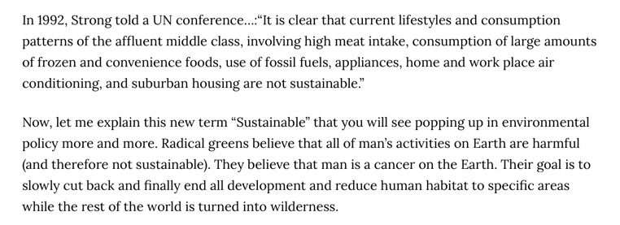
The Most Dangerous Man in the World
Article By Tom DeWeese

Slide 67
The Most Dangerous Man in the World
Article By Tom DeWeese

Slide 68
The Most Dangerous Man in the World
Article By Tom DeWeese

Slide 69
The Power Elite Manufacture Chaos

Slide 72
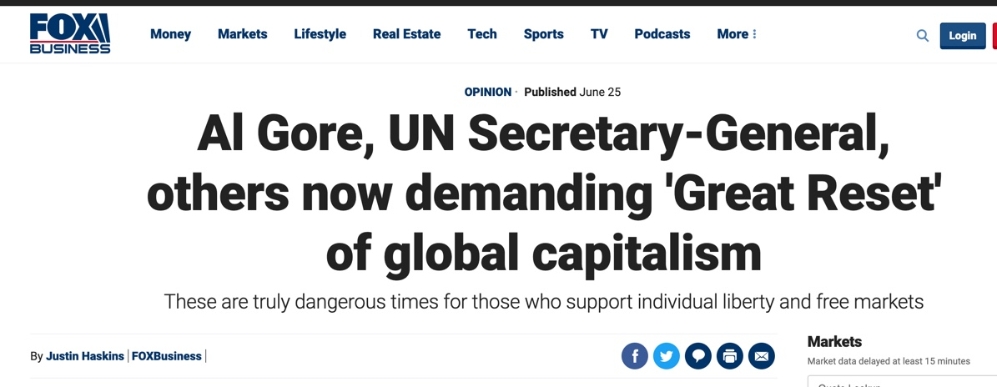
Foxnews.com, June 25, 2020

Slide 73
Foxnews.com, June 25, 2020

Slide 74
James MacGregor Burns admits when he writes:
Let us face reality. The framers [of the Constitution] have simply been too shrewd for us. They have outwitted us.

Slide 75
James MacGregor Burns:
They designed separated institutions that cannot be unified by mechanical linkages, frail bridges, tinkering. If we are to "turn the founders upside down" we must directly confront the constitutional structure they erected.

Slide 76
James MacGregor Burns:
Others might press for major constitutional restructuring but I doubt that Americans under normal conditions could agree on the package of radical and "alien" constitutional changes that would be required. They would do so, I think only during and following a stupendous national crisis and political failure.

Slide 77
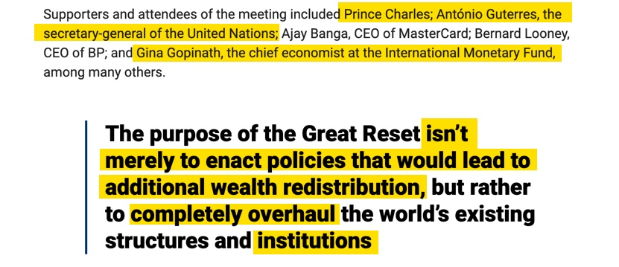
Foxnews.com, June 25, 2020

Slide 78
Foxnews.com, June 25, 2020

Slide 79
Foxnews.com, June 25, 2020

Slide 80
Foxnews.com, June 25, 2020

Slide 81
Foxnews.com, June 25, 2020

Slide 83
The Power Elite’s Central Banks

Slide 84
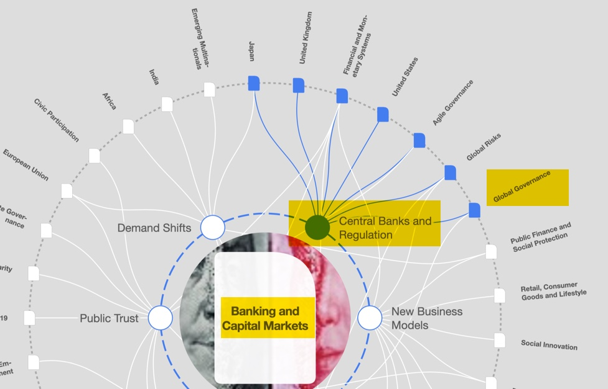

Slide 85
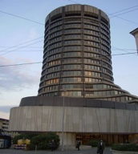
Bank For International Settlements Picture by David Croll, taken March 17 2005 . This picture was taken from the German Wikipedia

Slide 86
Carroll Quigley: “Tragedy and Hope” Published in 1966
The power of financial capitalism had another far reaching plan, nothing less than to create a world system of financial control in private hands able to dominate the political system of each country and the economy of the world as a whole. This system was to
be controlled

Slide 87
in a feudalistic fashion by the central banks of the world acting in concert, by secret agreements arrived at in frequent meetings and conferences. The apex of the system was to be the Bank for International Settlements in Basle, Switzerland, a private bank owned and controlled by the world’s central banks, which were themselves private corporations.

Slide 88
Each central bank, in the hands of men like Montagu Norman of the Bank of England, Benjamin Strong of the New York Federal Reserve Bank, Charles Rist of the Bank of France, and Hjalmar Schacht of the Reichsbank, sought to dominate its government by its ability to control treasury loans, to manipulate foreign exchanges, to influence, The level of economic activity in the country, and to influence co-operative politicians by subsequent rewards in the business world.

Slide 89
1930, The New York Times article quoting Rep. Louis McFadden (chairman of the House Committee on Banking and Currency): The Federal Reserve Bank of New York is eager to enter into a close relationship with the Bank for International Settlements…The conclusion is impossible to escape that the State and Treasury Departments are willing to pool the banking systems of Europe and America, setting up a world financial power independent of and above the Government of the United States…The United States under present conditions will be transformed from the most active of manufacturing nations into a consuming and importing nation with a balance of trade against it.

Slide 91
Jean-Claude Trichet, President of the European Central Bank, April 26, 2010: The evolution of global governance: Let me turn to the question of how global governance is evolving after the crisis.

Slide 92
Jean-Claude Trichet, President of the European Central Bank, April 26, 2010:
Overall, the system is moving toward decisively genuine global governance that is much more inclusive, encompassing the key emerging economies as well as industrialized countries. The significant transformation of global governance that we are engineering today is illustrated by three examples.

Slide 93
Jean-Claude Trichet, President of the European Central Bank, April 26, 2010:
First, the emergence of the G20 a the prime group for global economic governance at the level of ministers, governors and heads of state or government. Secondly, the establishment of the Global Economy Meeting of central bank governors under the auspices of the BIS as the prime group for the governance of central bank cooperation.

Slide 94
Jean-Claude Trichet, President of the European Central Bank, April 26, 2010:
…the Global Economy Meeting (GEM), which gathers at the BIS headquarter in Basel. Over the past few years, this forum has included 31 governors as permanent members plus a number of other governors attending on a rotating basis.

Slide 95
Jean-Claude Trichet, President of the European Central Bank, April 26, 2010:
The GEM, in which all systemic emerging economies’ Central Bank governors are fully participating, has become the prime group for global governance among central banks.

Slide 96
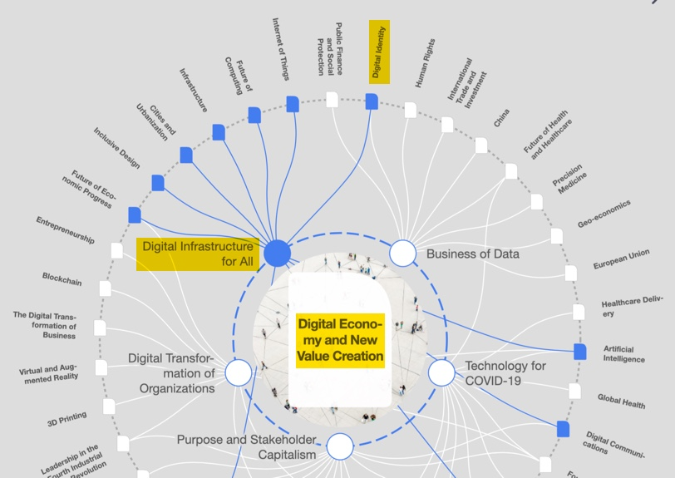

Slide 97
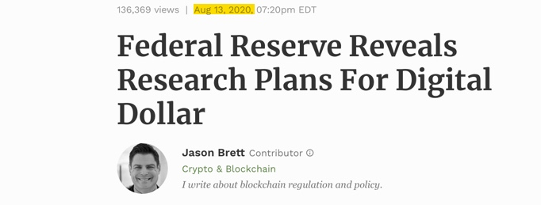
Forbes Magazine, August 13, 2020

Slide 98
Barron’s, September 18, 2020

Slide 99
Barron’s, September 18, 2020

Slide 100
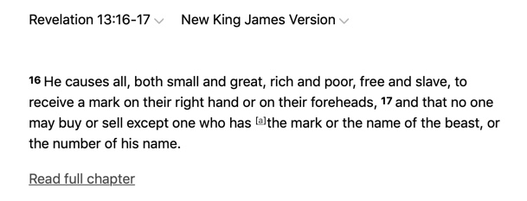

Slide 101
The Power Elite Control

Slide 104
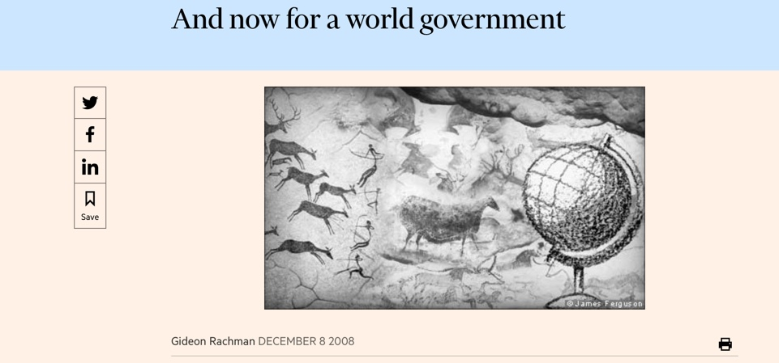
Financial Times

Slide 105
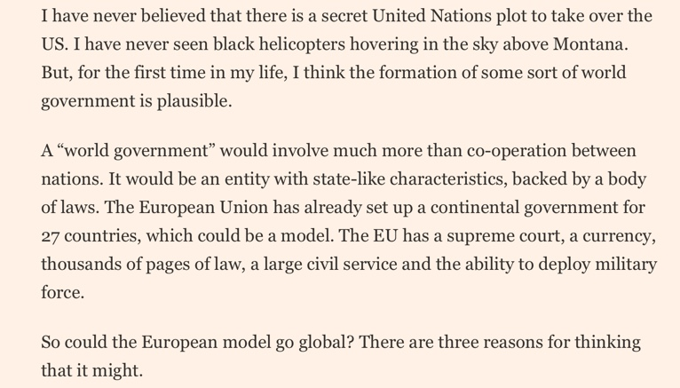

Slide 107
The European Commission is Calling for Ten World Unions Source: http://ec.europa.eu/world/where/index_en.htm North America Central America and Caribbean South America Western Europe Eastern Europe and Central Asia Mediterranean and Middle-East Africa North-East and South Asia South-East Asia Australia and Pacific

Slide 108
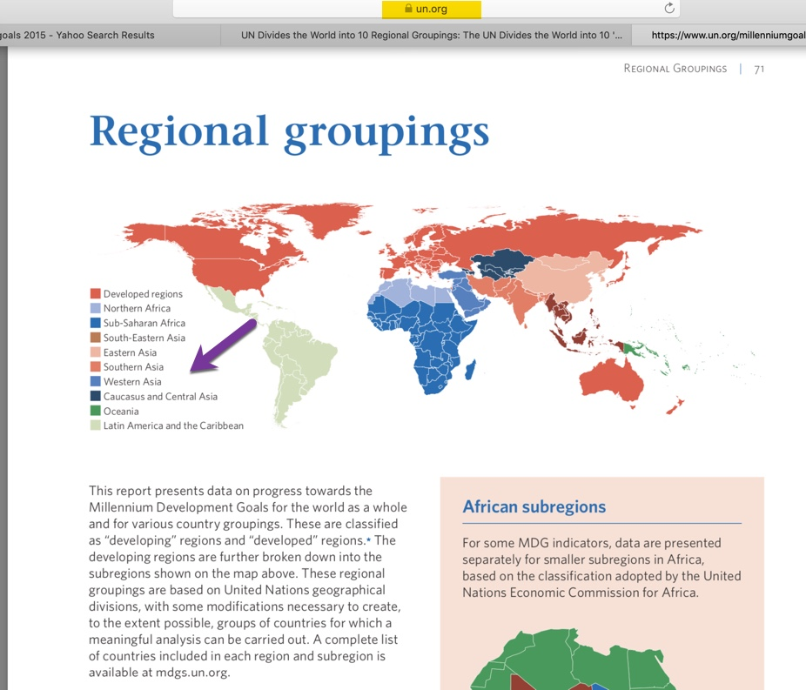

Slide 109
A Diverse Coalition United in Common Goals
Agenda 2030 = Sustainable Development = Environmental Social Justice
Globalism = International Socialism
Global Governance = Global Control by The Power Elite
Global Utopia = Heaven on Earth

Slide 110
A Diverse Coalition United in Common Values
A Hatred of the Judeo-Christian Worldview
A Belief in Biological, Social & Spiritual Darwinianism
A Belief in Pantheism & Panentheism
A Belief in Postmodernism

Slide 111
The Power Elite Crushed

Slide 112
Revelation 18:21

